Slide 1
Welcome to Kindergarten
August 18, 2022

Slide 2
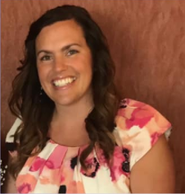
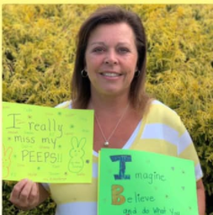
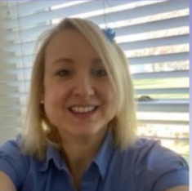
Meet Your Kindergarten Teachers
Mrs. Soukup
Mrs. Beck
Mrs. Juhasz

Slide 3
It’s ALL About Ohio’s Common Core/Ohio Standards!
Curriculum
ELA (English Language Arts)
Mathematics-EDM & Homelinks
Science- Sound, Seasons, Plants
Social Studies-Rules, Gov’t, Jobs
Art, Music, Physical Education

Slide 4
What’s special about Kindergarten?
Life Skills
Dental health, fire safety, character education, peer relations, personal safety, personal hygiene, career education
Read, Write, Rest
No nap, music, read aloud, journaling, listening to books, independent reading
Recess and Lunch for Full Day K.
10:30-11:30

Slide 5
Communication
Green Folders – Homework, special notes, school information.
ROC – Calendar (Record of Conduct)
*In front of Green Folder, sign each night
Goal-earn stickers each day; Positive Rewards
TTT, E-mails, Newsletters

Slide 6
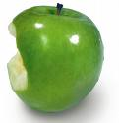
Acceptable Snack Options
Water bottle
Fruit
Vegetable
Cheese sticks
Crackers*
Pretzels*
Nutrigrain /cereal/breakfast bars*
*NO peanut butter or tree nut products.
Other allergies may dictate your child what snacks may be appropriate for your child’s class.
Label Snacks!

Slide 7
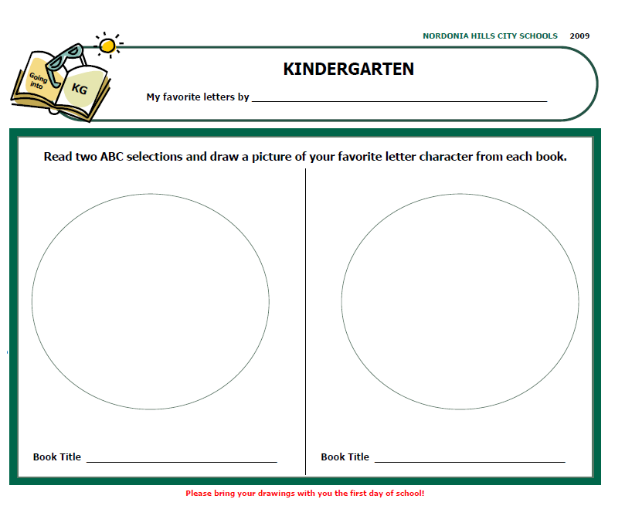
Summer Reading

Slide 8
District Forms
In addition to the forms you filled out at Kindergarten Registration, you must complete
the following online forms before school starts.
Emergency Medical Authorization (EMA)
Technology Acceptable Use
Bullying
Available online early to mid-August-
Forms due September 1st

Slide 9
Transportation
Website: www.nordoniaschools.org/Transportation.aspx
Phone: 330-468-4710
Your child will wear a bus/car tag the first two weeks of school!

Slide 10
Music
ALL LESSONS ARE BASED ON THE OHIO ACADEMIC CONTENT STANDARDS FOR MUSIC.
ALL STUDENTS WILL SING, MOVE TO MUSIC, PLAY CLASSROOM INSTRUMENTS, AND DANCE.
GRADE 1-4 STUDENTS WILL LEARN MUSIC NOTATION AND HOW TO READ MUSIC AT AGE APPROPRIATE LEVELS.
LOOK AT MUSIC GOOGLE CLASSROOM FOR REMOTE ASSIGNMENTS.
GRADES 3 & 4 WILL LEARN TO PLAY RECORDER! GRADE 3 STUDENTS WILL RECEIVE RECORDERS AFTER WINTER BREAK.
MRS. ANGELA PERRINE
ANGELA.PERRINE@NORDONIASCHOOLS.ORG

Slide 11
Art
The major Goal: Art is a language that can express ideas and feelings that other languages such as, but not limited to (math, science, music etc.) cannot. The overall art curriculum Objectives are the learning, doing and appreciation of: 1. The Elements of Arts and Principles of design 2. Art history 3. Types of art 4. Materials and techniques 5 .Drawing 6. Developing one’s own sense of beauty

Slide 12
Physical Ed.
Throughout the year the students will work on the following:
Grade K-2
-Development and proficiency of fundamental skills and movement forms (locomotion, underhand/overhand throwing, catching, dribbling with hands and feet, rolling, striking, fleeing, dodging and evasion) if permissible due to COVID-19 limitations such as: reduced equipment, no shared equipment, no partner activities and social distancing
-Building understanding of basic fitness principles
-Grade 2 Completion of all state assessments for the K-2 grade band
-Please join Mr. Kavak’s Google classroom which can be found by clicking coursework and then under the topics tab clicking on specials on your teacher’s google classroom. Click on PE, click the link and then click join. Check the google classroom on non PE weeks for refresher lessons, practice activities and other content. The google classroom information is to enhance the student learning experience and help build skills for skill assessment. Feel free to do them more than once per week for additional practice.
Contact: Patrick.kavak@nordoniaschools.org

Slide 13
School Counselor and Psychologist
Please watch this short video from our School Counselor, Kirk Galbreath and our School Psychologist, Gina Worsdall.
https://drive.google.com/file/d/10ioaqofefwWw_lzzZPvUhnINHgD2bGKb/view
Kirk.galbreath@nordoniaschools.org
Regina.worsdall@nordoniaschools.org

Slide 14
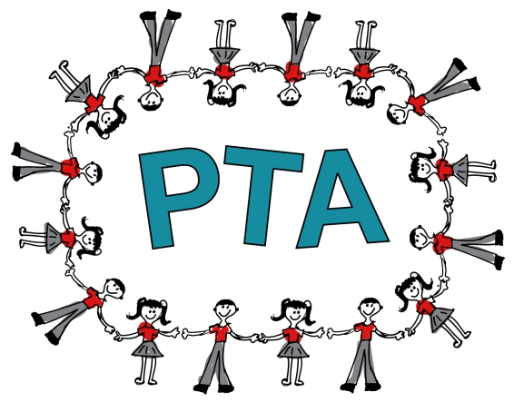
Welcome from PTA
PTA is…
Parents and Teachers Working Together for Every Child
PTA Programming is…
COSI, Scholastic Book Fairs, Family Events, Author Visits,
Educational Assemblies, Community Service,
Staff Appreciation Events, Classroom Volunteers
Millionaire Minutes
PTA Volunteering is…
Being Involved in Big and Small Ways.
Become involved in your school’s PTA today!
Your time can make a world of difference to our children.

