Slide 5
Eight Components of
Ohio’s Career
Advising Policy

Slide 6
#1. Career Connections Learning Strategies
May utilize ODE model curricula
May develop own strategies that help students see and understand the relevance of their learning to future career options

Slide 7
Model Curriculum

Slide 8
#2. Career Advising for all Students Grades 6-12
K-5: Career Awareness
6-8: Career Exploration
9-12: Career Planning
Focused Career Exploration Activities
Activities for Self-Awareness
Activities to identify career pathways that connect with student’s interests, strengths, and aspirations

Slide 9
#3. Interventions for At Risk Students
Must have procedures in place to identify at risk students using a local, research based method
Must develop a Student Success Plan for each at risk student that addresses both the student’s academic and career pathway to successful graduation and the role of career-technical education, college credit, and experiential learning as appropriate

Slide 10
Student Success Plan
Contact Information
Education and Training History
Career Pathway Organizer
Academic Pathway Plan
Assessment Record
Career-Ready Skills
Career Exploration Activities

Slide 11
#4. Employee Training on How to Advise Students on Career Pathways
Training includes how to advise students on pathways and training on advising students using online tools, such as Ohio Means Jobs
May also include training on other tools provided by the district that offer resources to students for discovering career interests, exploring and researching career and education options, and supporting the development of their student success plan.

Slide 12
#5. Pathways
Career Advising Policy offers multiple academic and career pathways including opportunities to earn industry recognized credentials and postsecondary course credit

Slide 13
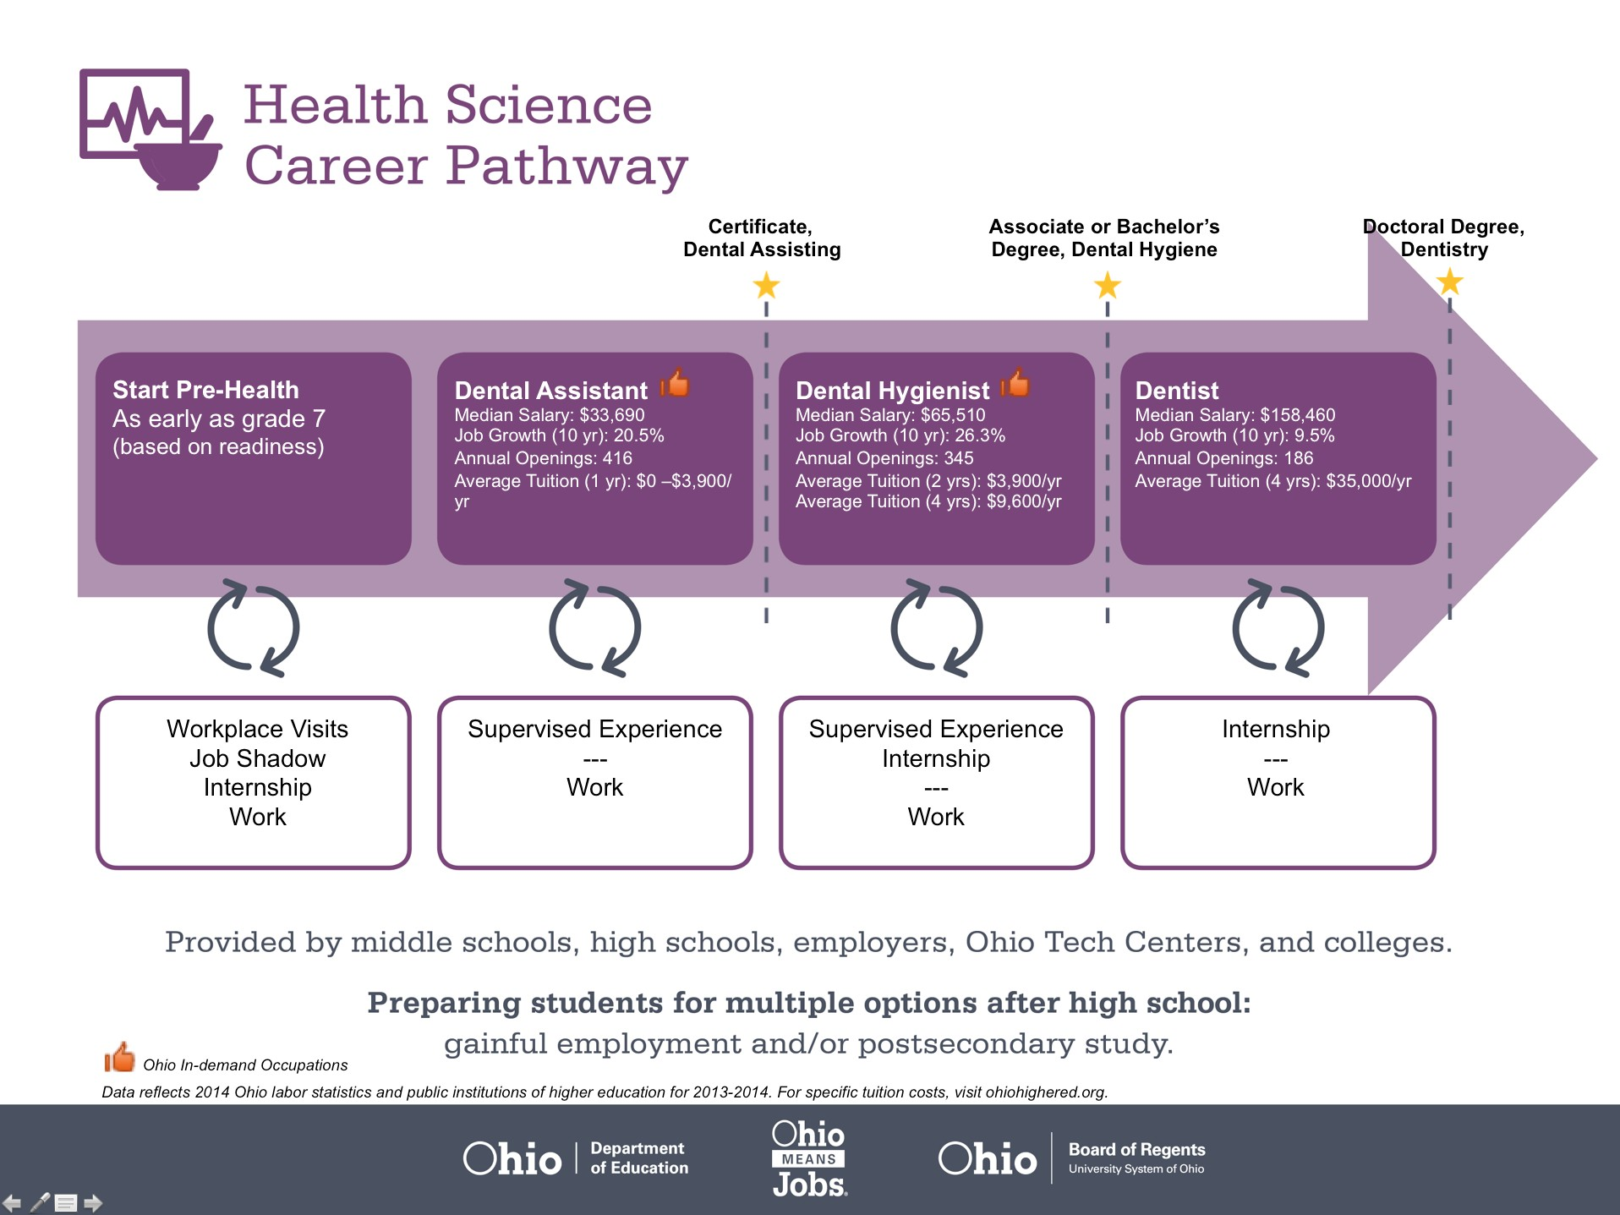
Notes:
Options highlighted in the pathway may include opportunities for students to earn credentials and college credit.

Slide 14
Secondary Pathway: Allied Health and Nursing |  |  |  | Postsecondary Program: Dental Hygiene
An Example of Courses with Secondary and Postsecondary Credits
Secondary | 7 8 | English I | Algebra I | Physical Science | Social Studies | Fine Arts | Health Science & Technology
 | 9 10 | English II | Geometry | Biology | World History | Health (.5) PE (.5) | Principles of Allied Health | World Languages
 | 11 | English III | Algebra II | Chemistry | U.S. History | Dental Technology | Medical Terminology | World Languages
 | 12 | English IV | Trigonometry/ Calculus | Anatomy & Physiology | U.S. Government | Dental Radiography | Oral Diagnosis & Treatment Planning
Postsecondary | Year 1 1st Semester | College Seminar | Human Patho-physiology | Dental Anatomy & Physiology | Dental Hygiene Pre-Clinic | Intro to Dental Hygiene | Periodontology I | Preventive Concepts | Techniques I
 | Year 1 2nd Semester | English | Intro to Microbiology | Techniques II | Clinic I | Oral Pathology | Periodontology II | Community Health Concepts | Dental Radiography
 | Year 2 1st Semester | Interpersonal Communication | Community Health | Techniques III | Clinic II | Sociology | Pharmacology | Dental Materials | Pain Management
 | Year 2 2nd Semester | Oral Communication | College Algebra | Techniques IV | Clinic III | Psychology | Dental Hygiene Case & Concepts | Humanities Elective
 |  | High School Career-Technical Education Program Courses
 |  | High School Courses for Postsecondary Credit (Including Apprenticeship Hours) and the Corresponding Postsecondary Courses
 |  | Required Courses
 |  | Recommended Electives
Visit education.ohio.gov/CareerConnections for reference information.
Course titles and sequences will vary between schools.
11/2014
Notes:
FACILITATOR’S NOTE: Explain & have them work through handout
Pathway Activity
Using the sample pathway, how can we use this tool to advise students on careers? Record on sticky notes and place on poster
How can teachers use the career pathways as a tool? Record on sticky notes and place on poster

Slide 15
#6. Academic & Technical Courses
What types of academic and technical education program options do your schools/districts offer?
What technical courses do area students have access to in grades 7-12?
What options do area students have as far as academic courses outside standard curriculum? (Credit Flex)
Notes:
DEFINE:
Technical Courses - High school technical courses aligned to state and industry standards, leading to credentials and college degrees – examples:
PLTW
Vocational Agriculture – Welding
Business Courses
Technology Courses
2. Academic Courses – ARTICLE - Rigorous academic curriculum, aligned to Ohio’s Learning Standards; Offer higher-level learning experiences that may be inquiry, problem or project-based
Such courses include College Credit Plus, Advance Placement (AP), International Baccalaureate Diploma (IB) and Early College High School Programs. College Credit Plus courses are for students grades 7-12. The new policy replaces postsecondary education options (PSEO) and other dual enrollment programs and allows students to choose any course at a public or participating private college.
May complete in workbook

Slide 16
#7. Documentation on Career Advising
Evidence of services provided to students
Activities completed by students related to Career Connections Framework
Conversations with students
Events available to students
Records of career advising with students and their families
You can use OhioMeansJobs K-12 for documenting Student Success Plan information

Slide 17
#8. Supports for Students to Transition to Postsecondary Destinations
Increasing course offerings
Providing remediation to ensure academic readiness
Enhancing wrap around services at critical transition points

Slide 18
Audit/Sharing Best Practices Activity
Where is your district in your implementation?
Share what is working in your district & how you are addressing the requirements
Discuss what supports are still needed for true implementation

Slide 19
Partnering With Parents
Asking better questions
Participating more effectively in decisions
Support, Monitor, Advocate

Slide 20
Question Formulation Technique
Produce their own questions
Work with and improve their own questions
Prioritize their questions
Strategize on next steps and how to use the questions
Reflect on what they have learned by working with their questions

Slide 21
Create a Question Focus
Name the topic, problem, or situation.
Think about your purpose. Why do you want participants to ask questions?
Name how the questions produced will be used.
Generate three ideas related to the topic.
Choose the idea that you think will best stimulate questioning.
Test it out by asking your own questions.

Slide 22
Q Focus: S seems to be having trouble doing his homework

Slide 24
Prioritize Your Questions
Which three questions do you want to get answered first?
Which three questions will help you address the problem immediately?
What three questions will help you figure out next steps?

Slide 25
Next Steps & Reflection
What information do you still need to get?
What tasks do you need to implement?
How can you use the information?
Who do you need to partner with?
How can this fit with the three parent roles of support, monitor, advocate?

Slide 26
Framework for Accountable Decision Making
Step One- Define and Identify Decisions
Define the term decision- the selection of one option from among two or more options
Identifying decisions- a scaffolded learning process that helps parents identify the many decisions they make every day

Slide 27
Step Two: Explore Three Key Elements in Decision Making
Reason- the basis for all decisions. Zeroing in on the reason for a decision can help clarify why one particular option was selected
Process- fully knowing about the process requires learning about the information used, the steps leading up to the selection of one option, who was (and was not) involved, and the logistics of when and where the decision was made
Role- defining the role the parent can play in the decision-making process

Slide 28
Step Three: Ask Questions About Decisions
Create Questions Around the Three Criteria
Reason- helps parents to understand the legitimacy for a decision
Process- allows parents to see the transparency of the process to arrive at a decision
Role- allows parents to understand their opportunities for participation in the decision

Slide 29
Three Ways to Partner
Support
Meet child’s basic health, nutritional, and emotional needs
Communicate clearly that education is a priority
Create space and time for student to complete school work at home
Do the best they can to ensure students arrive safely to school

Slide 30
Three Ways to Partner
Monitor
Ask more questions about how if their children are making appropriate academic progress
Check to see if student feels safe and comfortable in the school environment
Pay attention to homework assignments
Communicate with the teacher and school on a regular basis

Slide 31
Three Ways to Partner
Advocate
Communicate with teachers and schools about changes in their student’s performance
Ask questions about decisions made related to their student & be an active participant in the decision making process

Slide 32
Google Drive Resources
http://tinyurl.com/hkvgks

Slide 33
Contact Information
Christine Galvin
Director of College and Career Success
Christine.Galvin@escco.org
Office: 614-753-4704
Cell: 567-295-9728

