Slide 1
SST 11 Graduation (What you need to know)
David Bruce Ed.D

Slide 3
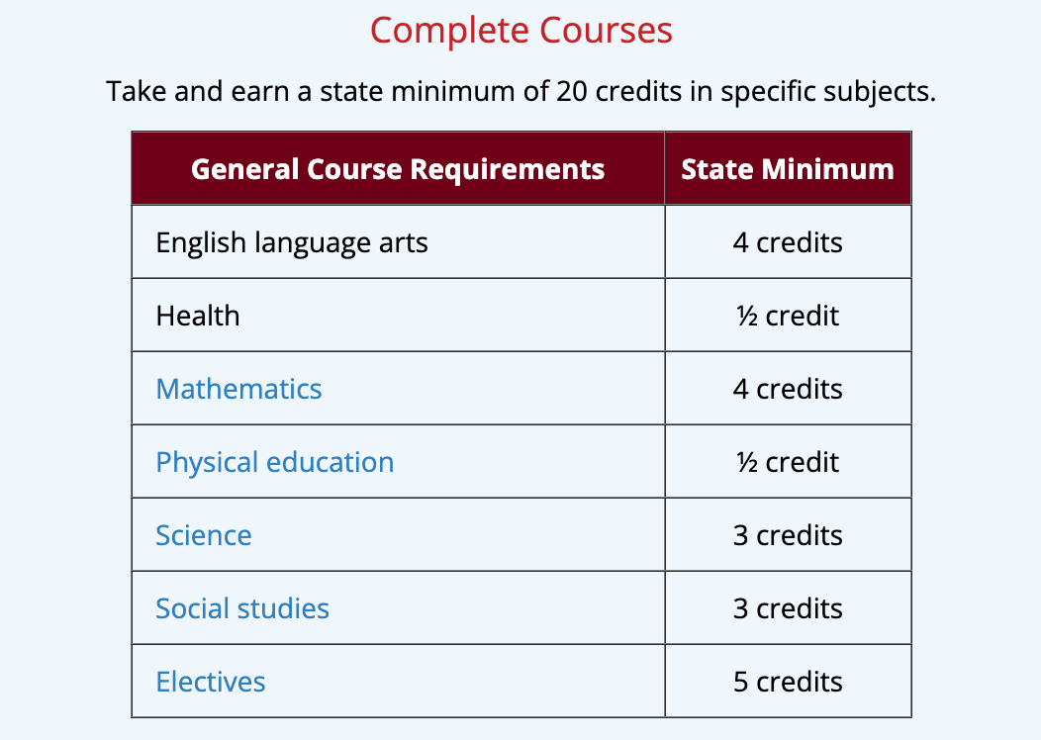
Financial Literacy
Ohio law requires students to receive instruction in financial literacy as part of the high school graduation requirements. However, it is up to local districts to determine how to best meet the needs of their students. For example, the financial literacy content may be incorporated into another course, or some districts may require students to take a standalone financial literacy course for a half credit that can meet either a graduation requirement for social studies or an elective.
½ Credit in Finance-9th grade this year

Slide 5
When do I need to have a Student Success Plan?
Graduation Plan
Only students who are at-risk for not graduating are required to have a Student Success Plan.
All students entering the 9th grade beginning 2019 and beyond. Updated annually

Slide 6
Questions about Credits?
What tools are in place to track?
Who is responsible for tracking? When?
Is this part of the Graduation Plan process? When?
Do you know what students need a Student Success Plan?

Slide 8
Ohio Revised Code section 3301.0712(B)(10).
X
The Ohio Department of Education, after gathering feedback
from education stakeholders and business communities of
Ohio, determined that “competency” would be set at a score
of 684 for both the English language arts II and Algebra I
tests.
There are other state tests, but they do not count toward
COMPETENCY for graduation. They could, however, count for
SEALS. (Science, Social Studies, and Technology)

Slide 9
First, in order to have any other pathway to competency a student MUST receive remediation and then retake the Alg. 1 and ELA II Tests

Slide 10
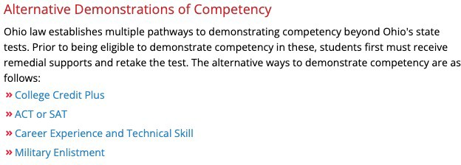

Slide 11
Industry Recognized Credentials – Pathway (12)
Aligned to the Graduation Plan
Career Tech
Related
Options
Ohio Means Jobs Readiness Seal
Work-Based Learning 250 hours
Pre-Apprenticeship
Not necessarily earned at the Career Center.
SST 11

Slide 13
Demonstrating Readiness Graduation Seals
Schools are required to have at least one locally defined seal and are encouraged to offer all state seals.
SST 11

Slide 14
Alternative Assessment
Exemption by IEP Team
Criteria or Decision Framework
Basic Scores:
ELA - 485 & Math - 489
Yes, but this is not considered a graduate by the Federal Guidelines

Slide 15
Schools are required to offer at least one locally defined seal.
Students may not be exempted from earning the seals.
True!
True!

Slide 16
Questions?
Next steps

Slide 17
Contact Information
Mailing Address
2080 Citygate Drive Columbus, OH 43219
Email Address
David.bruce@escco.org
sst11@escco.org
Phone Number
931-808-3836
614.753.4694

Slide 18
Connect With Us
Facebook
@statesupportteam11
Twitter
@SSTRegion11
SoundCloud
statesupportteam11
MF | F/W 2020

