Slide 1
Industry-Recognized Credentials
Emma Waymire
Program Administrator
April 21, 2022
Notes:
Good afternoon! My name is… I am the Program Administrator for Industry-Recognized Credentials and I also administer the Innovative Workforce Incentive Implementation Grant.
I have worked in the Office of Career-Technical Education since 2012 first supporting the agricultural education staff and Ohio FFA members and advisors and then supporting Leah Amstutz when she was the Associate Director. Of course, she is now the Director of Career-Technical Education
However, I do not operate alone. Industry-recognized credentials are exploding and there are new legislative initiatives created in the last state budget that touch many aspects within the Department of Education.
There is an advisory team with members that represent Graduation Requirements, Fiscal, Grants Management, Policy, and the Governor’s Office of Workforce Transformation.
We are all here today to build partnerships between education and business and industry with the end result of preparing students for careers. It may seem obvious to those who work within schools the benefits of students earning industry-recognized credentials but maybe not your industry partners. Industry partners you know how industry-recognized credentials affect your business but maybe schools don’t realize all of the benefits to you.
I am here to bridge the gaps.

Slide 2
What is an Industry-Recognized Credential?
An industry-recognized credential is a verification of an individual’s qualification or competence.
A third party with authority issues a credential.
Industry-recognized credentials are valued in the labor market and are a validation of knowledge and skill.
They can take many forms, including certifications, certificates, and licenses.

Slide 3
Benefits of Industry-Recognized Credentials
Each Child, Our Future is Ohio’s shared plan for ensuring that each student is challenged, prepared and empowered. The plan calls for Ohio high schools to inspire students to identify their paths to future success through career-focused learning.
Earning an industry-recognized credential is the perfect platform for making learning relevant.
Notes:
The plan emphasizes that in high school, each student should see the relevance of his or her learning, be exposed to practical, real-world work settings and begin defining his or her future. The plan calls for Ohio high schools to inspire students to identify their paths to future success through career-focused learning. I think this also means that they are engaged in planning and excited for their futures.
The process of earning an industry-recognized credential allows students to experience education through work by practicing and applying their knowledge through employment experiences. They learn about workplace expectations in terms of professional skills needed for employment. Students acquire soft skills such as communication skills and time management in an applicable employment setting.

Slide 4
Benefits of Industry-Recognized Credentials
What are the forms industry-recognized credential?
Certificate
Certification
License
Benefits student entering workforce or college bound.
Alternate pathway to graduation.
Notes:
Maybe it is important to understand when the term ‘‘industry-recognized’’ is used in reference to a credential,
it means a credential that is recognized, preferred, or required and used for recruitment, screening applicants, making hiring decisions, retention of qualified employees or tied to advancement opportunities;
Certificates are earned by successfully completing a training, course or series of courses.
Are issued for specific skill sets or competencies and may be:
Desirable but not required
Part of the hiring criteria, but not associated with critical job tasks
Certificates of attendance or participation
Certifications indicate mastery of or competency in specific knowledge, skills or processes that can be measured by accepted industry standards.
After attaining, individuals often must meet ongoing requirements to maintain the certification
Occupational licenses are awarded by state government agencies and often required for a specific position.
So for students entering the workforce after graduation, an industry-recognized credential can show potential employers that they have hands-on knowledge and have demonstrated the skills necessary to perform the work.
Ohio offers several ways to qualify for a high school diploma. Many of the options include, at least in part, earning 12 points of industry-recognized credentials from the Department’s approved list as part of graduation requirements.

Slide 5
Process to Add a New Credential
Applications are now open year-round and anybody is able to submit.
Each review round includes:
Labor market research
Industry feedback survey
Education Program Specialist feedback
Industry-Recognized Review Committee experience
Notes:
Our current round closes on May 31
Review rounds take about 10-12 weeks to complete

Slide 6
Process to Modify a Credential Currently on the List
Modification applications are also open year-round.
The application undergoes the same research as a new application.
Changes that may be requested:
A point value increase
Adding a credential to additional career fields
Applications for the same request will only be reevaluated every six months.
Notes:
Our current round closes on May 31
Review rounds take about 10-12 weeks to complete

Slide 7
Point Value Determination
Multiple factors are included in the determination of the point value of a credential.
Factors included:
Industry feedback gathered through a survey.
The feedback indicates the recognition and importance that industry gives each credential.
Notes:
Our current round closes on May 31
Review rounds take about 10-12 weeks to complete

Slide 8
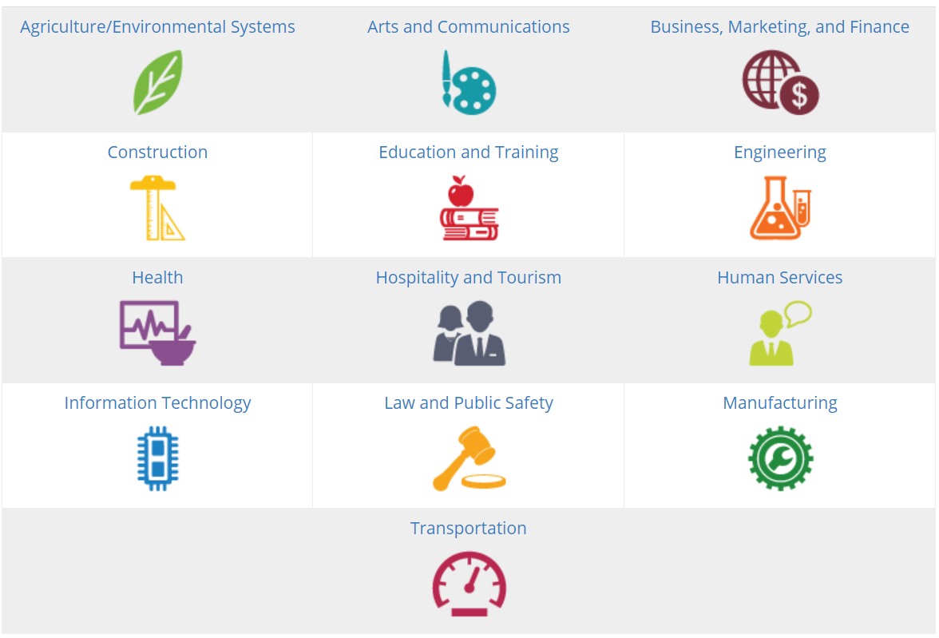
What credentials can they earn?
Programs can select from a number of career fields:
Notes:
There are 13 career fields offered.
To reach graduation requirements, students must earn 12 points worth of industry-recognized credentials within one career field.

Slide 9
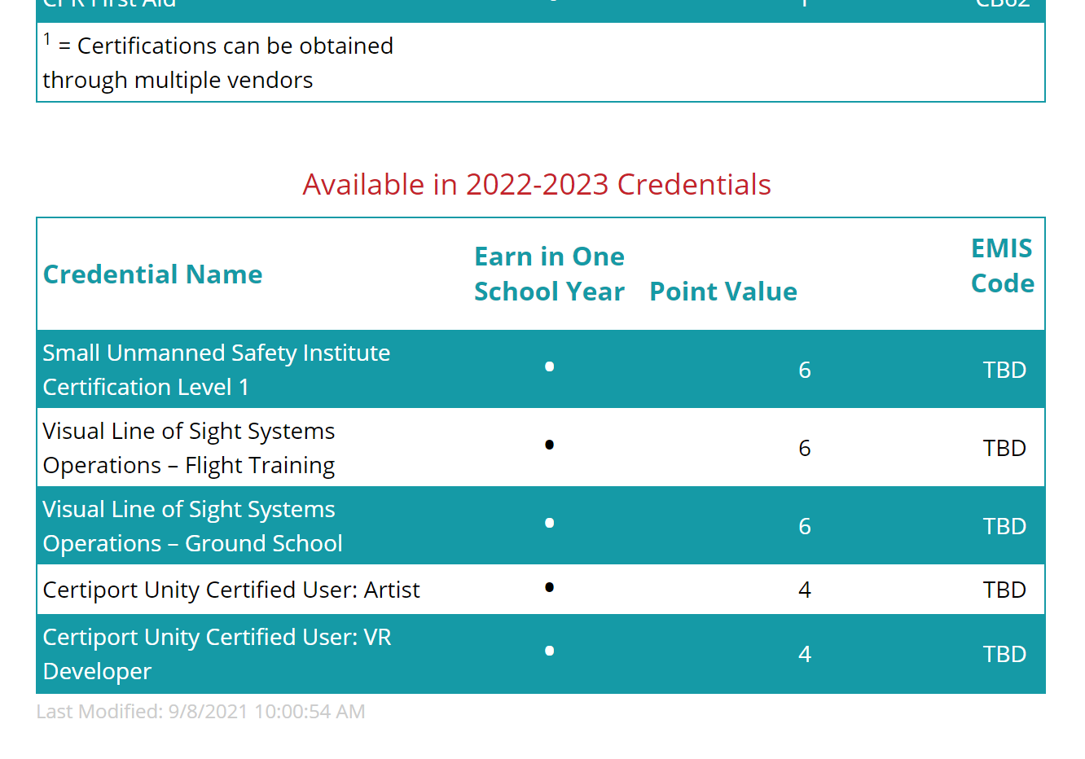
Webpage Updates
Notes:
- There are multiple tables on the pages for each career field, with the second table indicating credentials that will be available for the upcoming school year

Slide 10
Credential Reimbursements
Reimbursement Program
Incentive Payments

Slide 11
House Bill 110
$8,000,000 appropriated for Industry-Recognized Credential Reimbursement
Reimbursement schedule
Schools are reimbursed for the student testing fee amount
Successful credential attempts can be reported up to six months after graduation
Notes:
Gives $8,000,000 to credential reimbursement
Educating entity will pay for the cost of credential
May claim and receive reimbursement for testing fees
May claim reimbursement up to six months after the student has graduated from high school
Reimbursements are received in June of the following year
If amount is not sufficient, reimbursement amounts will be prorated
Link reimbursement spreadsheet
Reimbursements are updated annually
Do not reimburse for train the trainer situation
If no fee for student assessment, then no reimbursement
If multi vendor, we take an average for 3-4 vendor cost

Slide 12
Innovative Workforce Incentive Program
House Bill 110
Innovative Workforce Incentive Program Credential List
Incentive payments of $1,250
No additional EMIS reporting
Payments received in June with other reimbursement payments
Notes:
Credentials worth 6 points or higher in the Construction, Information Technology, Manufacturing, and Critical Jobs
We currently have two rounds of grants with a total of 54 awardees
Included $4.5 million for implementation grants
And $12.5 million for incentive payments

Slide 13
New Credentials for 2022-2023 School Year
Link to New
Credential List
Ohio Driver’s License – 1 point – all career fields
Franklin Covey: Leader In Me – 3 points – all career fields
Information Technology Specialist Suite – 1 point – IT
RISE Up Warehouse, Inventory & Logistics – 3 points – Business & Transportation

Slide 14
Ohio Driver License
Ohio Revised Code allows a student who takes a driver education course to earn either:
0.5 credits toward their elective requirements for a diploma
One point of industry-recognized credentials when reporting the Ohio Driver’s License as earned

Slide 15
Contact me!
Emma Waymire
Emma.Waymire@education.ohio.gov

