Slide 1

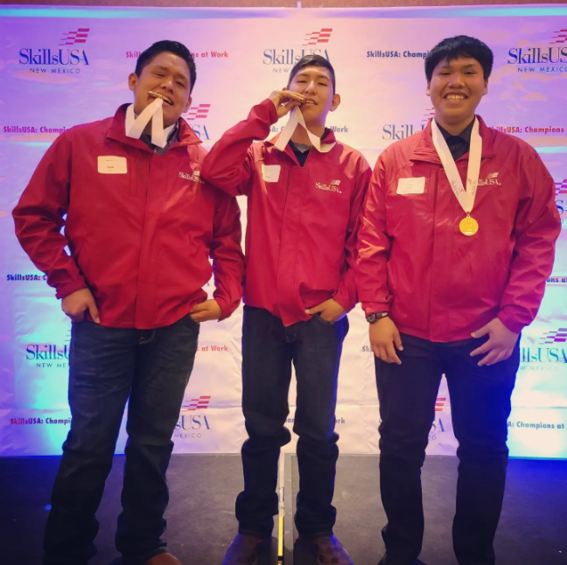
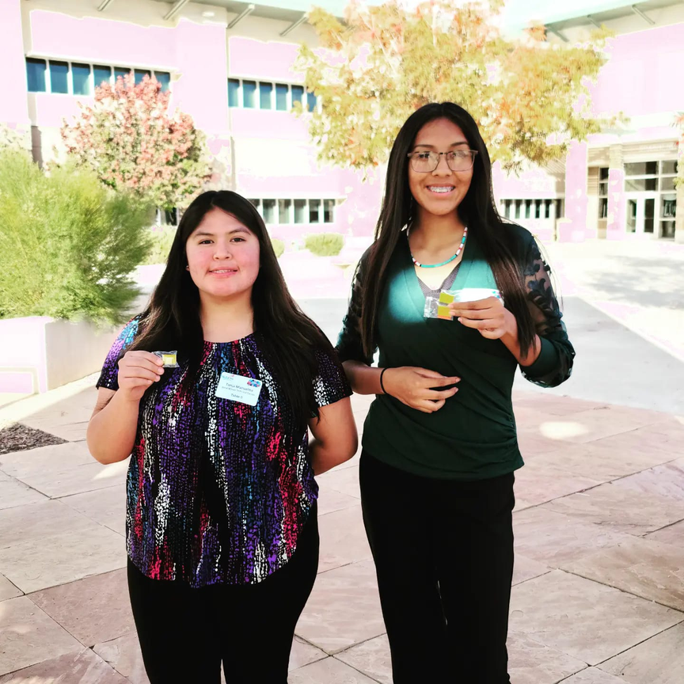
SKILLSUSA
“To empower students to become skilled professionals, career-ready leaders and responsible community members.”

Slide 2
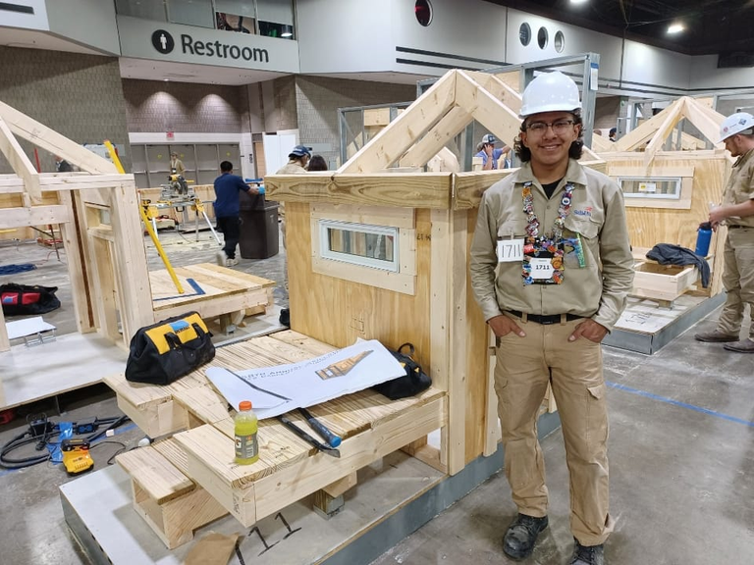

WHAT IS SKILLSUSA?
SkillsUSA is a partnership of students, teachers, and industry working together to ensure America has a skilled workforce. We help each student excel. A nonprofit national education association, SkillsUSA serves middle-school, high-school, and college/postsecondary students preparing for careers in trade, technical and skilled service occupations.

Slide 3
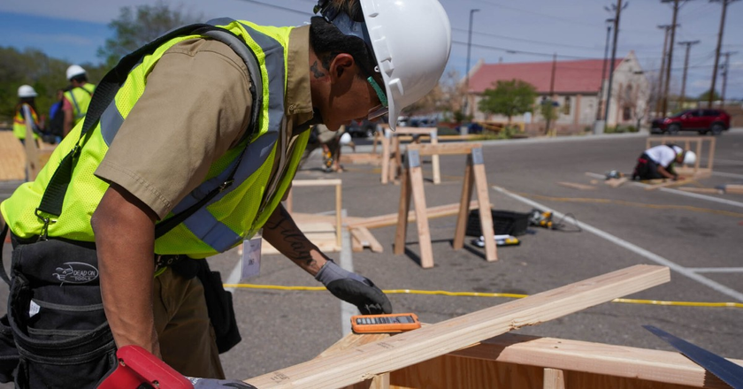
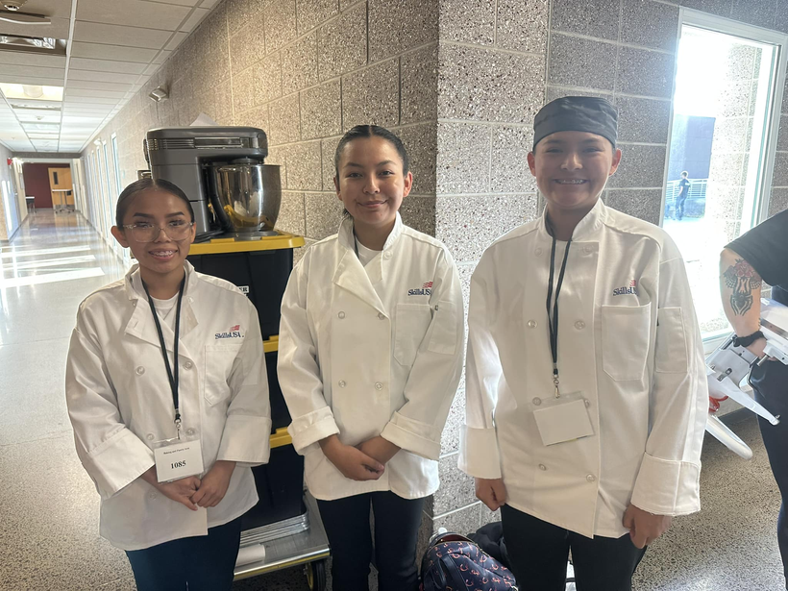
SKILLSUSA
NMSLSC
The SkillsUSA New Mexico Championships are competitive events that showcase the best career and technical education students in the state. The philosophy of the Championships is to reward students for excellence, to involve industry in directly evaluating student performance, and to keep training relevant to employers’ needs. The state gold medalist for each competition moves on to represent SkillsUSA New Mexico at the National Skills and Leadership Conference.

Slide 4
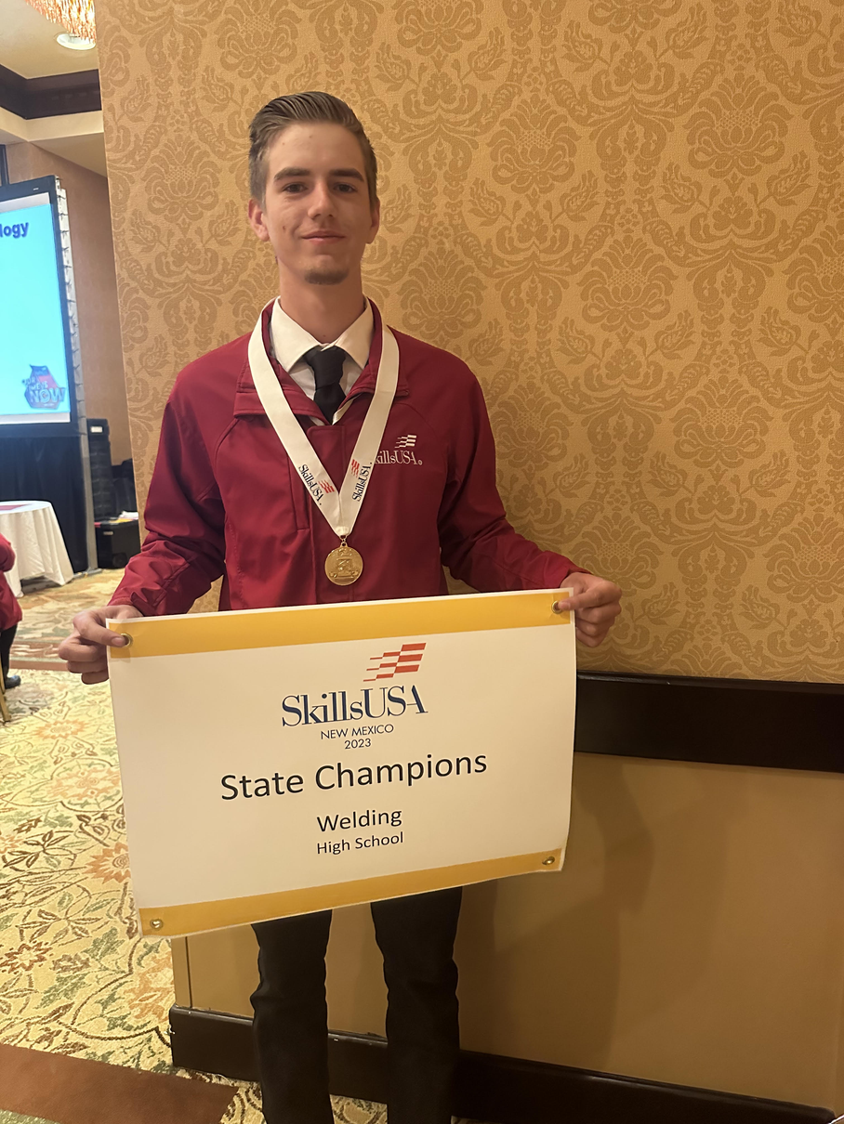
NM SLSC CHAMPIONS
'21
CARPENTRY (GOLD,SILVER, BRONZE)
WELDING (SILVER)
CARPENTRY (GOLD, SILVER)
BASIC HEALTHCARE SKILLS (BRONZE)
CHAPTER DISPLAY (GOLD)
'22
CARPENTRY (GOLD)
CAREER PATHWAYS - HEALTH SCIENCES (GOLD)
WELDING (GOLD)
CHAPTER DISPLAY (GOLD)
BAKING/PASTRY ARTS (BRONZE)
'23
'24
CARPENTRY (GOLD)
JOB APPLICATION (SILVER)

Slide 5

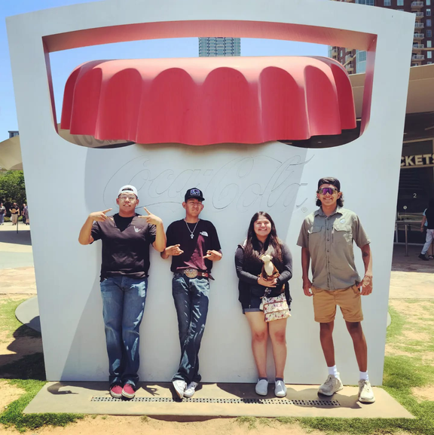
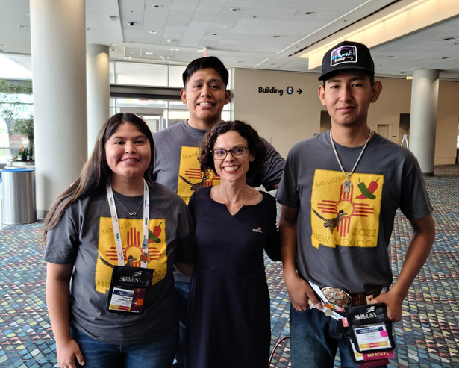
NATIONALS
More than 6,500 outstanding career and technical education students –all state contest winners– will compete hands-on in 108 different trade, technical and leadership fields. Students work against the clock and each other, proving their expertise in occupations such as electronics, computer-aided drafting, precision machining, medical assisting and culinary arts. Contests are run with the help of industry, trade associations and labor organizations, and test competencies are set by industry. Leadership contestants will demonstrate skills including extemporaneous speaking and conducting meetings by parliamentary procedure.

Slide 6

SKILLSUSA ADVISORS
MRS. DAVIS - LEADERSHIP
MR. CLARY - CONSTRUCTION
MR. GUILLORY - WELDING
MRS. BENALLY - HEALTH SCIENCES
MR. COSTNER - LEADERSHIP
MR. REYNOLDS
MR. CISKOWSKI

