Slide 1
WELCOME

Slide 2
INTRODUCTIONS
Mr. Licht – Building Principal
Mr. Yeschenko– Grade Level Principal (11 & 12)
Mr. Cook – Dean of Students
Dr. Plichta – Cyber Principal / 9th Grade
Mr. Inglis – 9th Counselor
Mr. Ruffing – 10th – 12th A - L
Mrs. Shields – 10th – 12th M – Z

Slide 3
HIGH SCHOOL STAFFING
4 ADMINISTRATORS
3 GUIDANCE COUNSELORS
60+ PROFESSIONAL TEACHING STAFF MEMBERS
4 SECRETARIES
1 LIBRARIAN
1 SCHOOL NURSE (FULL-TIME)
CUSTODIANS
CAFETERIA WORKERS
SECURITY GUARDS
1 SCHOOL RESOURCE OFFICER
1 HOME SCHOOL VISITOR
1 ATHLETIC/ACTIVITIES COORDINATOR

Slide 4
HIGH SCHOOL BUILDING INFORMATION
REGULAR CLASSROOMS
SCIENCE LABS
HOME EC. ROOMS
2 ART ROOMS
TECHNOLOGY EDUCATION ROOMS
MUSIC ROOMS INCLUDING A RECORDING STUDIO
A LARGE GROUP INSTRUCTION ROOM (LGI)
1200 SEAT AUDITORIUM
ONE MAIN 1500 SEAT GYMNASIUM, ONE AUXILARY GYMNASIUM
JROTC ROOM
SWIMMING POOL
4000 SEAT STADIUM WITH AN ARTIFICAL SURFACE.
FITNESS CENTER
SCHOOL SPIRIT STORE
GREENHOUSE / OUTDOOR CLASSROOM
TITAN CYBER ACADEMY
TITAN DIPLOMA RETRIEVEL

Slide 5
ONE TO ONE LAPTOP
Goals:
Enhance and diﬀerentiate learning
Increase student engagement
Promote collaboration
Strengthen 21st Century skill development
Help Desk (412)466-9131 #3333
Important Dates: School Calendar

Slide 6
HIGH SCHOOL INFORMATION
958 STUDENTS CURRENTLY ENROLLED
GRADE 9 – 276 STUDENTS
GRADE 10 – 269 STUDENTS
GRADE 11 – 235 STUDENTS
GRADE 12 – 187 STUDENTS

Slide 7
HIGH SCHOOL INFORMATION
OVER 140 DIFFERENT COURSES
MATH, SCIENCE, ENGLISH, SOCIAL STUDIES
AP COURSES
HONORS COURSES
(COLLEGE IN HIGH SCHOOL)
HOME EC. COURSES
TECH ED. COURSES
ROTC
BAND, CHORUS, ORCHESTRA
ART COURSES
MUCH MORE

Slide 9
COLLEGE IN HIGH SCHOOL CLASSES (CHS) College in the High School​​ (CHS)​classes are college-level courses which are taught at the high school by high school teachers using college curriculum with oversight from college faculty and staff. Students earn college credit by passing the course and paying reduced tuition for the credits.
CHS U.S. History | CHS Psychology | CHS Algebra | CHS Chemistry | CHS Physics
CHS Anatomy & Physiology | CHS Biology | CHS Language & Composition | CHS Literature and Composition | CHS Statistics
CHS Calculus AB | CHS Calculus BC

Slide 10
INDEPENDENT STUDY
Independent study courses are available to 10th, 11th and 12th grade students. A maximum of 2 credits will be permitted per year.
A student may not take an independent study for a previously failed course.
Independent study classes are not weighted. College in High School and AP courses will not be offered on an independent study basis.
Students are required to meet with the instructor for support and on-going evaluation for the duration of the independent study project.
Students will maintain a log and submit it to the teacher for approval.
Teachers will review the completed independent study project and assign a final grade for the course

Slide 11
SCHOOL TO WORK PROGRAM
The school-to-work program allows high school juniors and seniors the opportunity to earn elective credits for jobs they perform outside of the school setting. Upon submitting the required documentation and confirmation of employment, the student can earn ¼ credit per 9-week grading period. A maximum of 1 elective credit per year may be awarded for maintaining a job while enrolled as a student at the high school.

Slide 12
IMPORTANT ISSUES FOR STUDENT SUCCESS
Attendance Expectations (A-TSI)
Behavioral Expectations
Academic Performance

Slide 13
ATTENDANCE SUCCESS
Attendance Expectations
Arriving to school on time
Late bell rings at 7:20am (1st period starts)
Doors close at 7:15am
Attendance is taken every morning (parent/guardian must sign students into school after 8:20am.
Arriving to class on time
Attendance is taken during each class period (frequent lates to class will result in consequences) (Lunch & Study Hall)
WMASD Attendance Policy #204
No more than 20 absences in a full year
5 or more absences by Homecoming Dance (exclusion)

Slide 14
ATTENDANCE PROCEDURES
Excuses for Absences
A student who has been absent must present an excuse from the parent/guardian for the absence within 3 days of the last day of absence. A maximum of 10 parentally excused days per school year. Medical excuses should be submitted and recorded as medical.
Unexcused Absences
Unexcused absences include but are not limited to; failing to turn in a note after an absence, cutting class, etc. If the work or test is made up before the unexcused absence is detected, no credit will be given. In addition, the student may suffer disciplinary action.

Slide 15
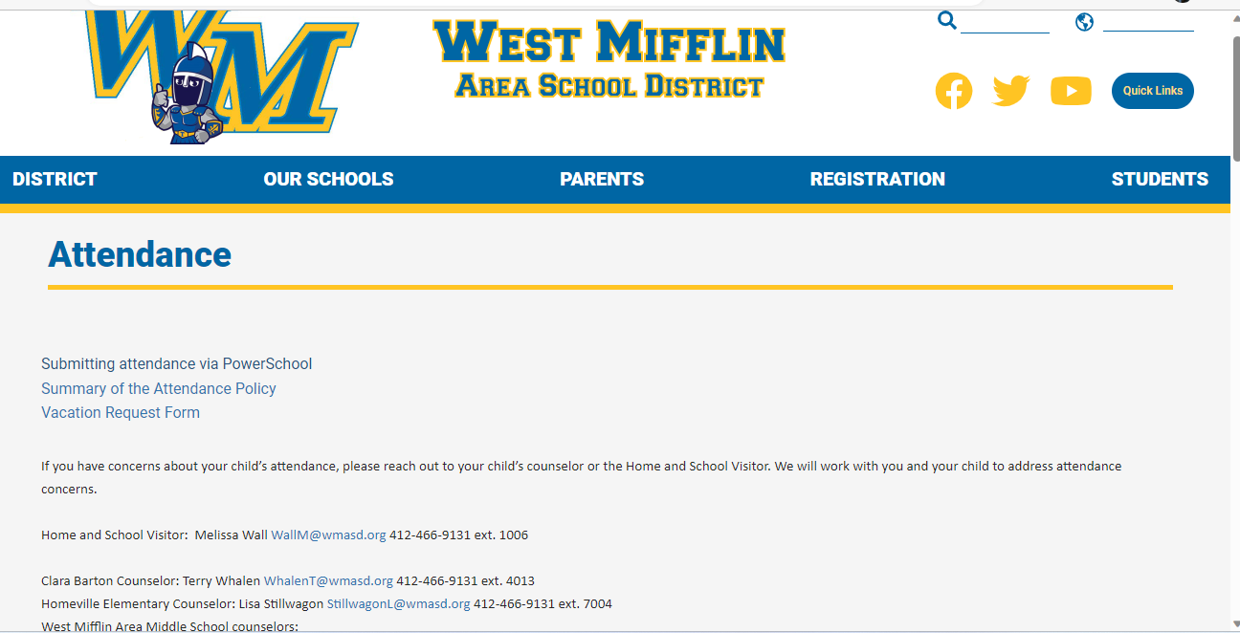
SUBMITTING ATTENDANCE
SANDY CUBAKOVIC – CUBAKOVICS@WMASD.ORG

Slide 16
BEHAVIORAL SUCCESS
Behavioral Expectations
As a freshman/student you are expected to:
Be prepared, on time and ready to learn
Be respectful to others and yourself
Work hard and be responsible
Follow all WMAHS and classroom rules and policies
PATH OF THE TITAN: Be Respectful Be Accountable Be Proud

Slide 17
BEHAVIORAL SUCCESS
ITEMS OF EMPHASIS
-Attendance (on time to classes)
-Cafeteria, Hallways, Classrooms, Buses
-Bathrooms (vaping)
-Dress Code (no hats and hoods)

Slide 18
INTERVENTIONS
Student Meeting
Parent Phone Call
Parent Meeting
Reflection documents
Behavior contract
Conflict agreements
Connect student to school activities
Involve teachers in meetings, mentors
Diploma Retrieval / Resource Room
Titan Academy

Slide 19
COUNSELOR INTERVENTONS
Check in/out
Schedule modification
Conflict Resolution Strategies
Mentoring
Peer Mediation
Referral to Group
Individual, group or community-based counseling

Slide 20
STUDENT SAFETY AND SECURITY
WALK THROUGH METAL DETECTORS (Three entrances in the morning, one main entrance once school begins)
SECURITY GUARDS
1 RESOURCE OFFICER
CAMERA SYSTEMS (throughout the campus and district)
HALO
E-PASS SYSTEM
ACT 26: CYBER HARRASSMENT
SAFE 2 SAY
SOCIAL SUSPENSIONS (vape, threats, acts of violence)

Slide 21
ACADEMIC SUCCESS
1.5 List
The West Mifflin Area School District is notifying you that your child is currently on the ineligibility list for having less than a 1.5 GPA. This list is generated from PowerSchool every Friday. It is based on your student’s letter grades from the previous week. As a result, your child is academically ineligible to participate in athletics, extra-curricular activities, clubs, and attend school events as a spectator. If, by the following Friday, a student is no longer under a 1.5 GPA, he/she becomes eligible at once.

Slide 22
COUNSELORS ACADEMIC SUCCESS
Schedules
PowerSchool
Graduation Requirements

Slide 23
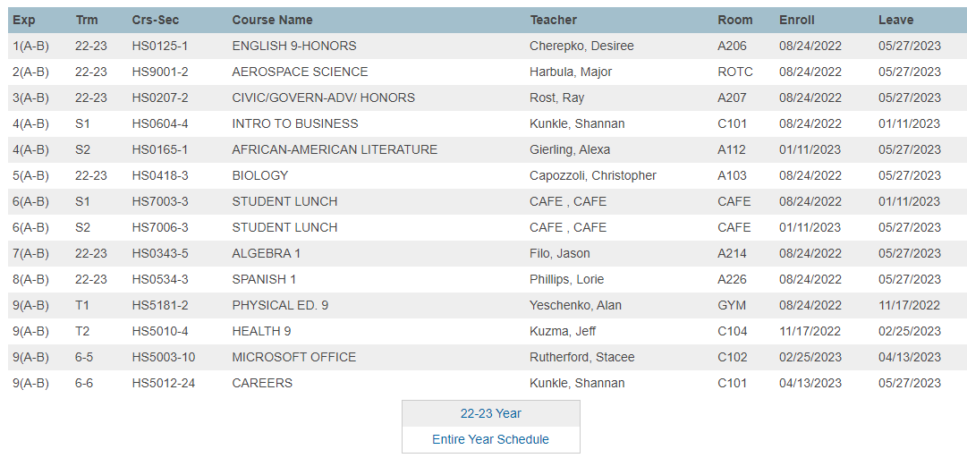
BELL SCHEDULES
Bell Schedule
1 | 7:20 – 8:06
2 | 8:10 – 8:54
3 | 8:58 – 9:42
4 | 9:46 – 10:30
5 | L5) 10:34 – 11:04 | L5-6) 10:34 – 11:18 | L5-6) 10:34 – 11:18
6 | 6-L6) 11:08 – 11:52 | L6) 11:22 – 11:52 | L6-7) 11:22 – 12:06
7 | 7-L7) 11:56 – 12:40 | 7-L7) 11:56 – 12:40 | L7) 12:10 – 12:40
8 | 12:44 – 1:28
9 | 1:32 – 2:15

Slide 24
POWERSCHOOL PARENT PORTAL
Grade and attendance information
Students can login with their student number and password (usually first name)
Can create multiple parent accounts with access to children in the district
Do not need to set up new account each year

Slide 25
QUICK LOOK UP

Slide 26
CLASS GRADE REPORT

Slide 27
ACADEMIC PERFORMANCE
Graduation Requirements – 24 Credits
English: 4 Credits
Math: 3 Credits
History: 4 Credits
Science: 3 Credits
Physical Education/Health: 2 Credits
Arts/Humanities: 2 Credits
Electives: 6 Credits

Slide 28
GRADE CLASSIFICATION
In order for a student to be considered a member in proper academic standing of his/her next year’s class:
Freshman (Grade 9) – Must have completed a minimum of 6 credits to be considered a Sophomore.
Sophomore (Grade 10) – Must have completed a minimum of 12 credits to be considered a junior.
Junior (Grade 11) – Must have completed a minimum of 18 credits to be considered a senior.
Senior (Grade 12) – Must complete a minimum of 24 credits to graduate.

Slide 29
GET INVOLVED OVER 30 CLUBS AND ORGANIZATIONS
Art
Beavers
Biology
Canteen
Chess
Environment
Freshman Class Officers
Future Homemakers
The Future is Mine
GSA (Gay Straight Alliance)
Graphics Club
Junior Class Officers
Interact Club
Leo Club (Key)
National Honor Society
National Thespians Society
Pep Club
Photography Club
Riseup
Robotics
SADD
Senior Class Officers
Ski Club
Sophomore Class Officers
Spanish Club
Student Leaders (Community Service)
Student Leaders (Mentoring)
Student Council
Tri M National Society
Tech Ed Club
Yearbook
Youth Crime Watch

Slide 30
HIGH SCHOOL INFORMATION
19 J.V./VARSITY SPORTS TEAMS
Baseball Soccer (Boys & Girls)
Tennis (Girls & Boys) Basketball (Girls & Boys)
Cheerleading Softball (Girls)
Cross Country (Boys & Girls) Track & Field (Boys & Girls)
Football Golf
Wrestling Volleyball (Girls)
Bowling (Girls & Boys) Swimming (Boys & Girls)

Slide 31
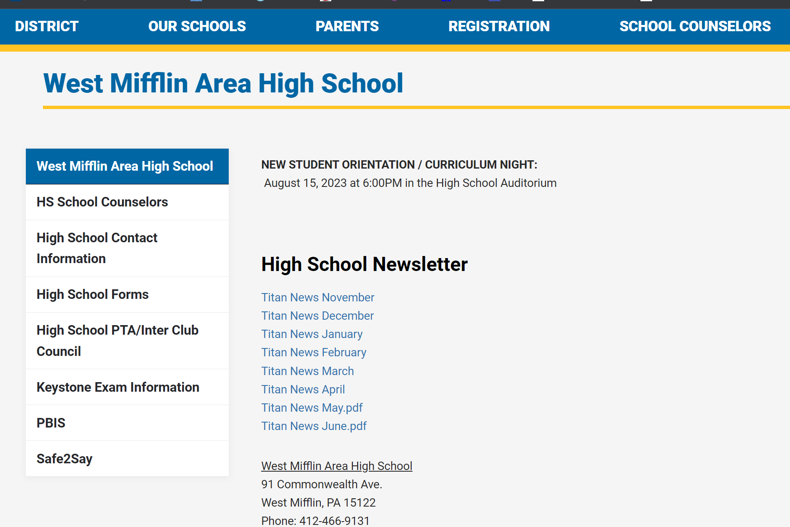
West Mifflin Area High School Communication
All Call System

Slide 32
TITLE 1
Largest federal aid program for public schools in U.S.
The District Right To Know
*The right to request information about the qualifications of the
classroom staff working with your child.
Every Student Succeeds Act (ESSA)
*Ensures teachers hold an appropriate state certification and
licensure requirements.
*Requires us to notify parents if their child is being taught for four or more consecutive weeks by a teacher who does not meet “appropriate state certification”

Slide 33
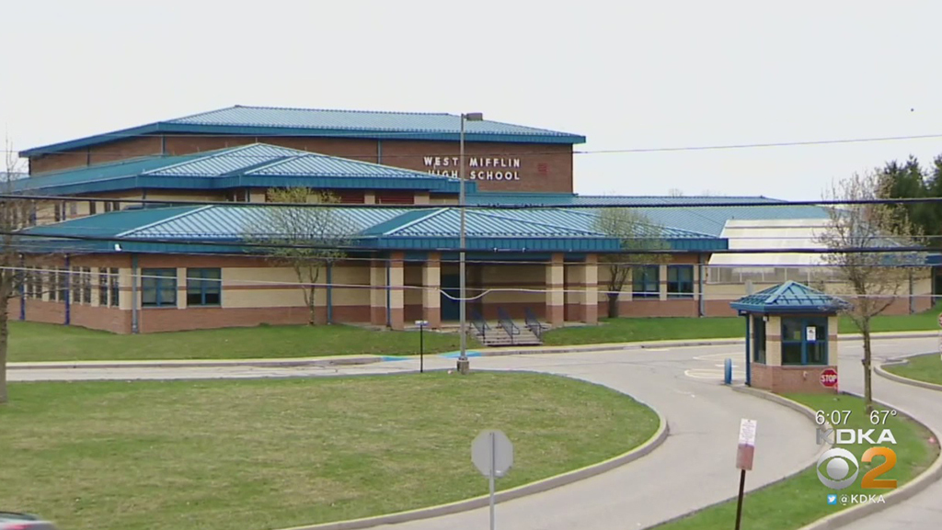
THANK YOU!

