Slide 1
WELCOME

Slide 2
INTRODUCTIONS
Mr. Licht – Building Principal
Mr. Yeschenko– TCA Principal
Mr. Bonacci – Assistant Principal
Mr. Inglis – 9th Counselor
Mr. Ruffing – 10th – 12th A - L
Mrs. Shields – 10th – 12th M – Z

Slide 3
ONE TO ONE LAPTOP
Goals:
Enhance and diﬀerentiate learning
Increase student engagement
Promote collaboration
Strengthen 21st Century skill development
Help Desk (412)466-9131 #3333
Important Dates: School Calendar

Slide 4
HIGH SCHOOL INFORMATION
OVER 140 DIFFERENT COURSES
MATH, SCIENCE, ENGLISH, SOCIAL STUDIES
AP COURSES
HONORS COURSES
(COLLEGE IN HIGH SCHOOL)
HOME EC. COURSES
TECH ED. COURSES
ROTC
BAND, CHORUS, ORCHESTRA
ART COURSES
MUCH MORE

Slide 6
COLLEGE IN HIGH SCHOOL CLASSES (CHS) College in the High School​​ (CHS)​classes are college-level courses which are taught at the high school by high school teachers using college curriculum with oversight from college faculty and staff. Students earn college credit by passing the course and paying reduced tuition for the credits.
CHS U.S. History | CHS Psychology | CHS Algebra | CHS Chemistry | CHS Physics
CHS Anatomy & Physiology | CHS Biology | CHS Language & Composition | CHS Literature and Composition | CHS Statistics
CHS Calculus AB | CHS Calculus BC

Slide 7
INDEPENDENT STUDY
Independent study courses are available to 10th, 11th and 12th grade students. A maximum of 2 credits will be permitted per year.
A student may not take an independent study for a previously failed course.
Independent study classes are not weighted. College in High School and AP courses will not be offered on an independent study basis.
Students are required to meet with the instructor for support and on-going evaluation for the duration of the independent study project.
Students will maintain a log and submit it to the teacher for approval.
Teachers will review the completed independent study project and assign a final grade for the course

Slide 8
SCHOOL TO WORK PROGRAM
The school-to-work program allows high school juniors and seniors the opportunity to earn elective credits for jobs they perform outside of the school setting. Upon submitting the required documentation and confirmation of employment, the student can earn ¼ credit per 9-week grading period. A maximum of 1 elective credit per year may be awarded for maintaining a job while enrolled as a student at the high school.

Slide 9
IMPORTANT ISSUES FOR STUDENT SUCCESS
Attendance Expectations (A-TSI)
Behavioral Expectations
Academic Performance

Slide 10
ATTENDANCE SUCCESS
Attendance Expectations
Arriving to school on time
Late bell rings at 7:20am (1st period starts)
Doors close at 7:16am
Attendance is taken every morning (parent/guardian must sign students into school after 8:20am.
Arriving to class on time
Attendance is taken during each class period (frequent lates to class will result in consequences) (Lunch & Study Hall)
WMASD Attendance Policy #204
No more than 20 absences in a full year
5 or more absences by Homecoming Dance (exclusion)

Slide 11
ATTENDANCE PROCEDURES
Excuses for Absences
A student who has been absent must present an excuse from the parent/guardian for the absence within 3 days of the last day of absence. A maximum of 10 parent excused days per school year. Medical excuses should be submitted and recorded as medical.
Unexcused Absences
Unexcused absences include but are not limited to; failing to turn in a note after an absence, cutting class, etc. If the work or test is made up before the unexcused absence is detected, no credit will be given. In addition, the student may suffer disciplinary action.

Slide 12
POLICY: UNEXCUSED ABSENCES/MAKE-UP PRIVELAGES
The following unexcused absences carry makeup privileges:
Emergency at home – One or more days of absence may include make-up privileges depending upon the nature of the emergency.
Runaways – Each case must be dealt with on its own individual merit. A decision to grant makeup privileges is the responsibility of the administrator involved.
Weddings and Graduations – Make-up work will be granted for the day and reasonable travel time.
The following absences from school do not carry makeup privileges:
• Leaving school without permission • Class cut • Students that miss 18 days of school that are parent excused and/or unexcused will not have the ability to make up any missed classroom work or assessments.

Slide 13
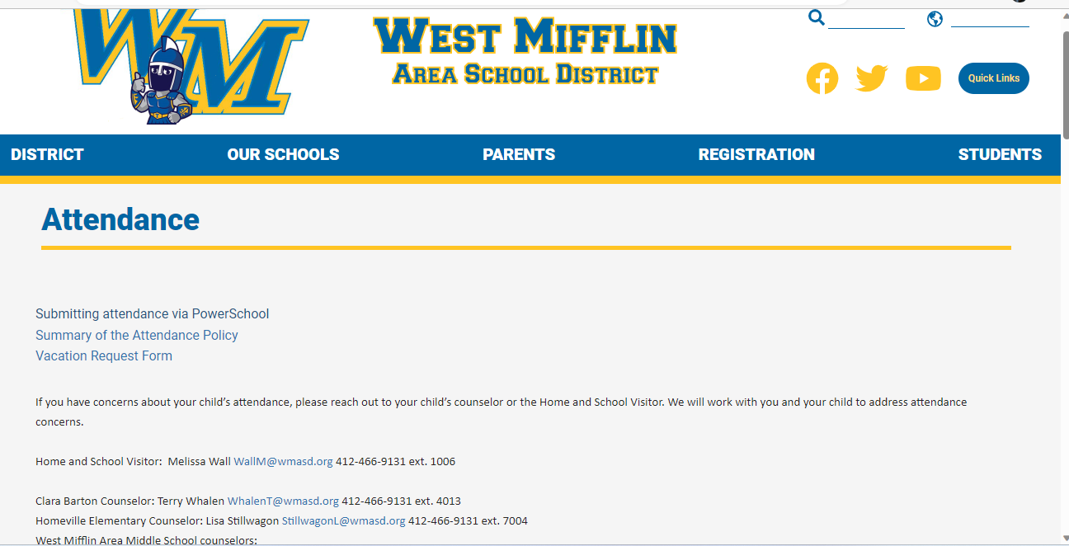
SUBMITTING ATTENDANCE
SANDY CUBAKOVIC – CUBAKOVICS@WMASD.ORG

Slide 14
BEHAVIORAL SUCCESS
Behavioral Expectations
As a freshman/student you are expected to:
Be prepared, on time and ready to learn
Be respectful to others and yourself
Work hard and be responsible
Follow all WMAHS and classroom rules and policies
PATH OF THE TITAN: Be Respectful Be Accountable Be Proud

Slide 15
BEHAVIORAL SUCCESS
ITEMS OF EMPHASIS
-Attendance (on time to classes)
-Cafeteria, Hallways, Classrooms, Bus
-Bathrooms (vaping)
-Dress Code (no hats and hoods)

Slide 16
INTERVENTIONS
Student Meeting
Parent Phone Call
Parent Meeting
Reflection documents
Behavior contract
Conflict agreements
Connect student to school activities /TLT
Involve teachers in meetings, mentors
TCA
Diploma Retrieval / Resource Room
Titan Academy
Expulsions

Slide 17
STUDENT SAFETY AND SECURITY
TITAN SAFETY 360
WALK THROUGH METAL DETECTORS
RESOURCE OFFICER’S / SECURITY GUARDS
CAMERA SYSTEMS (throughout the campus and district)
HALO
E-PASS SYSTEM
ACT 26: CYBER HARRASSMENT
SAFE 2 SAY
SOCIAL SUSPENSIONS (vape, threats, acts of violence)
THREAT = 60, FIGHT=365
SMOKING/VAPE = 45 for 1st offense, 365 for second offense

Slide 18
ACADEMIC SUCCESS
1.5 List
The West Mifflin Area School District is notifying you that your child is currently on the ineligibility list for having less than a 1.5 GPA. This list is generated from PowerSchool every Friday. It is based on your student’s letter grades from the previous week. As a result, your child is academically ineligible to participate in athletics, extra-curricular activities, clubs, and attend school events as a spectator. If, by the following Friday, a student is no longer under a 1.5 GPA, he/she becomes eligible at once.

Slide 19
“TITAN LEARNING TIME” GOALS
Increase student learning and reduce failure rates.If a student is failing a class, teachers add that student to one of their remediations sessions.
Decrease stress for students since students have more time to complete work and get help DURING the school day.
Build positive relationships among students and staff.
Decrease interruptions to the school day

Slide 20
HOW DOES “TLT” WORK
Periods 1-5 and 7-8 would run as normal
6th period would become a 90-minute period.
The 90-minute period would be split into 3 30-minute blocks: A, B, and C.
During 3rd period each day, students would sign up for their lunch period (A, B, or C) and two other PLT sessions. (Period is 4 min. longer.)

Slide 21
HOW DOES THIS BENEFIT STUDENTS
Students who are failing classes can be pulled into remediation sessions.
Students can select the teacher that they are with (less issues).
Students can select a study hall to complete their work.
Students can use the time to prepare for exams (AP, CHS, Keystone, SAT).
Students can pick the same lunch as their friends.
Students can pick some kind of activity for enrichment. (Think of the activities that teachers volunteered to run on our Flex Days.)
Club meetings can happen.
Rehearsals, school photos, and class meetings can happen during this time instead of class time.

Slide 22
EXAMPLE ACTIVITIES
Weight Room
Pickleball
Yoga
Board Games
Mindfulness
Support Groups
Visiting Colleges
Career Presentations
College Visits
Club Meetings
Rehearsals (chorus, band)
Mentoring
Ceramics
E-Sports
Kahoot, Quizlet Live
Study Hall
Ping Pong

Slide 23
COUNSELORS ACADEMIC SUCCESS
Schedules
PowerSchool
Graduation Requirements

Slide 24
BELL SCHEDULE
PERIOD | LENGTH | TIMES
1 | 41 | 7:20 – 8:01
2 | 41 | 8:05 – 8:46
3 | 44 | 8:50 – 9:35 TLT SIGN UP/ANNOUNCMENTS
4 | 41 | 9:38 – 10:19
5 | 41 | 10:23 – 11:04
6A | 30 | 11:08 – 11:38
6B | 30 | 11:42 – 12:12
6C | 30 | 12:16 – 12:46
7 | 41 | 12:50 – 1:31
8 | 40 | 1:35 – 2:15

Slide 25
POWERSCHOOL PARENT PORTAL
Grade and attendance information
Students can login with their student number and password (usually first name)
Can create multiple parent accounts with access to children in the district
Do not need to set up new account each year

Slide 26
QUICK LOOK UP

Slide 27
CLASS GRADE REPORT

Slide 28
ACADEMIC PERFORMANCE
Graduation Requirements – 24 Credits
English: 4 Credits
Math: 3 Credits
History: 4 Credits
Science: 3 Credits
Physical Education/Health: 1 Credit
Arts/Humanities: 2 Credits
Electives: 6 Credits

Slide 29
GRADE CLASSIFICATION
In order for a student to be considered a member in proper academic standing of his/her next year’s class:
Freshman (Grade 9) – Must have completed a minimum of 6 credits to be considered a Sophomore.
Sophomore (Grade 10) – Must have completed a minimum of 12 credits to be considered a junior.
Junior (Grade 11) – Must have completed a minimum of 18 credits to be considered a senior.
Senior (Grade 12) – Must complete a minimum of 24 credits to graduate.

Slide 30
GET INVOLVED OVER 30 CLUBS AND ORGANIZATIONS
Art
Beavers
Biology
Canteen
Chess
Environment
Freshman Class Officers
Future Homemakers
The Future is Mine
GSA (Gay Straight Alliance)
Graphics Club
Junior Class Officers
Interact Club
Leo Club (Key)
National Honor Society
National Thespians Society
Pep Club
Photography Club
Riseup
Robotics
SADD
Senior Class Officers
Ski Club
Sophomore Class Officers
Spanish Club
Student Leaders (Community Service)
Student Leaders (Mentoring)
Student Council
Tri M National Society
Tech Ed Club
Yearbook
Youth Crime Watch

Slide 31
HIGH SCHOOL INFORMATION
19 J.V./VARSITY SPORTS TEAMS
Baseball Soccer (Boys & Girls)
Tennis (Girls & Boys) Basketball (Girls & Boys)
Cheerleading Softball (Girls)
Cross Country (Boys & Girls) Track & Field (Boys & Girls)
Football Golf
Wrestling Volleyball (Girls)
Bowling (Girls & Boys) Swimming (Boys & Girls)

Slide 32
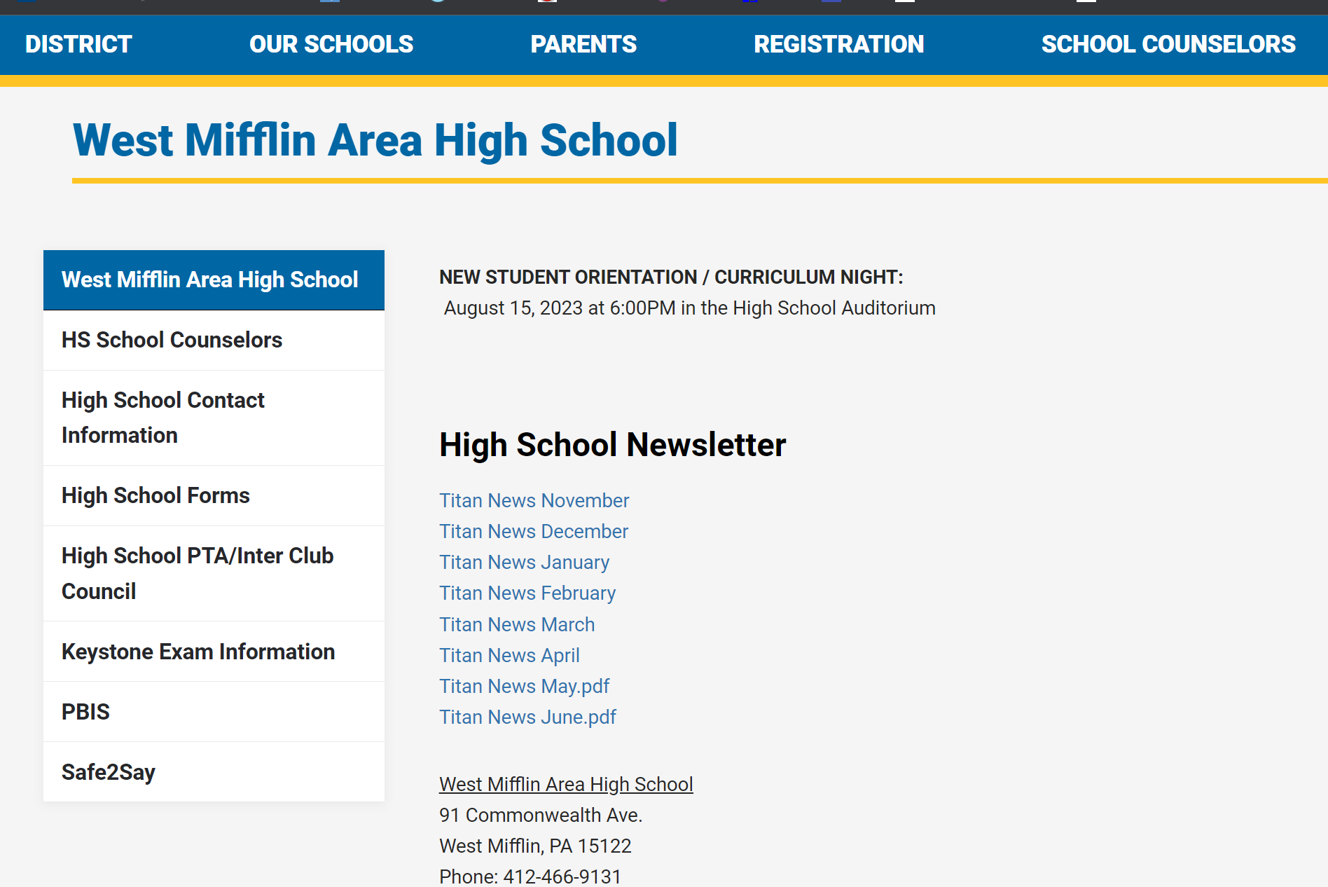
West Mifflin Area High School Communication
All Call System

Slide 33
TITLE 1
Largest federal aid program for public schools in U.S.
The District Right To Know
*The right to request information about the qualifications of the
classroom staff working with your child.
Every Student Succeeds Act (ESSA)
*Ensures teachers hold an appropriate state certification and
licensure requirements.
*Requires us to notify parents if their child is being taught for four or more consecutive weeks by a teacher who does not meet “appropriate state certification”

Slide 34
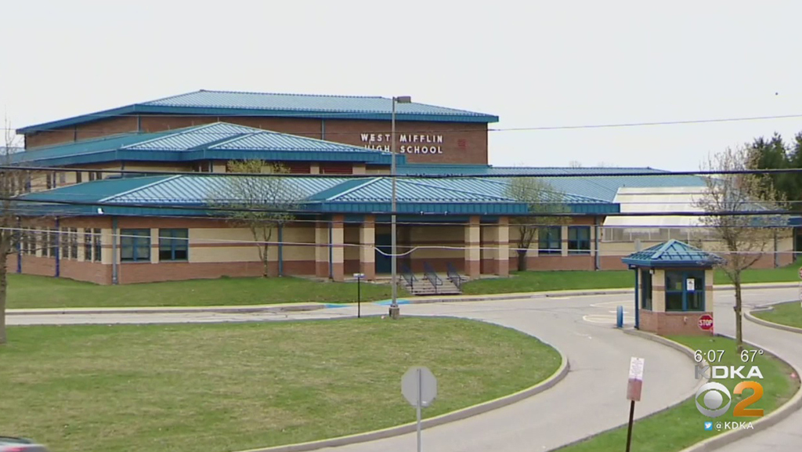
THANK YOU!

