Slide 1
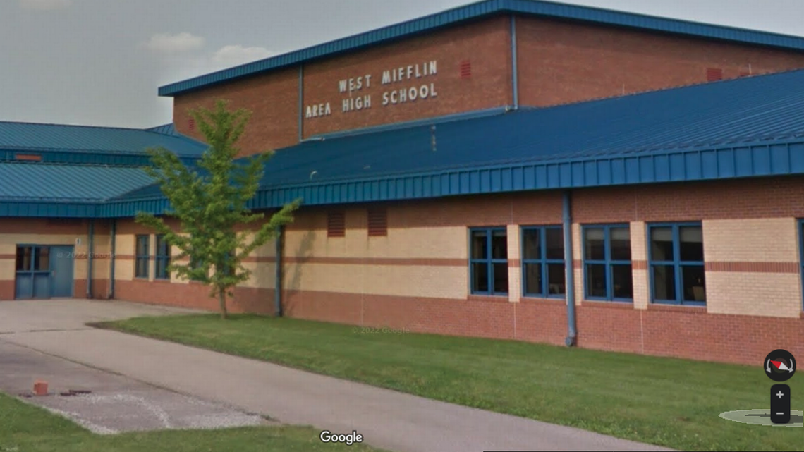

Welcome!
West Mifflin Area High School
Home of the Titans

Slide 2

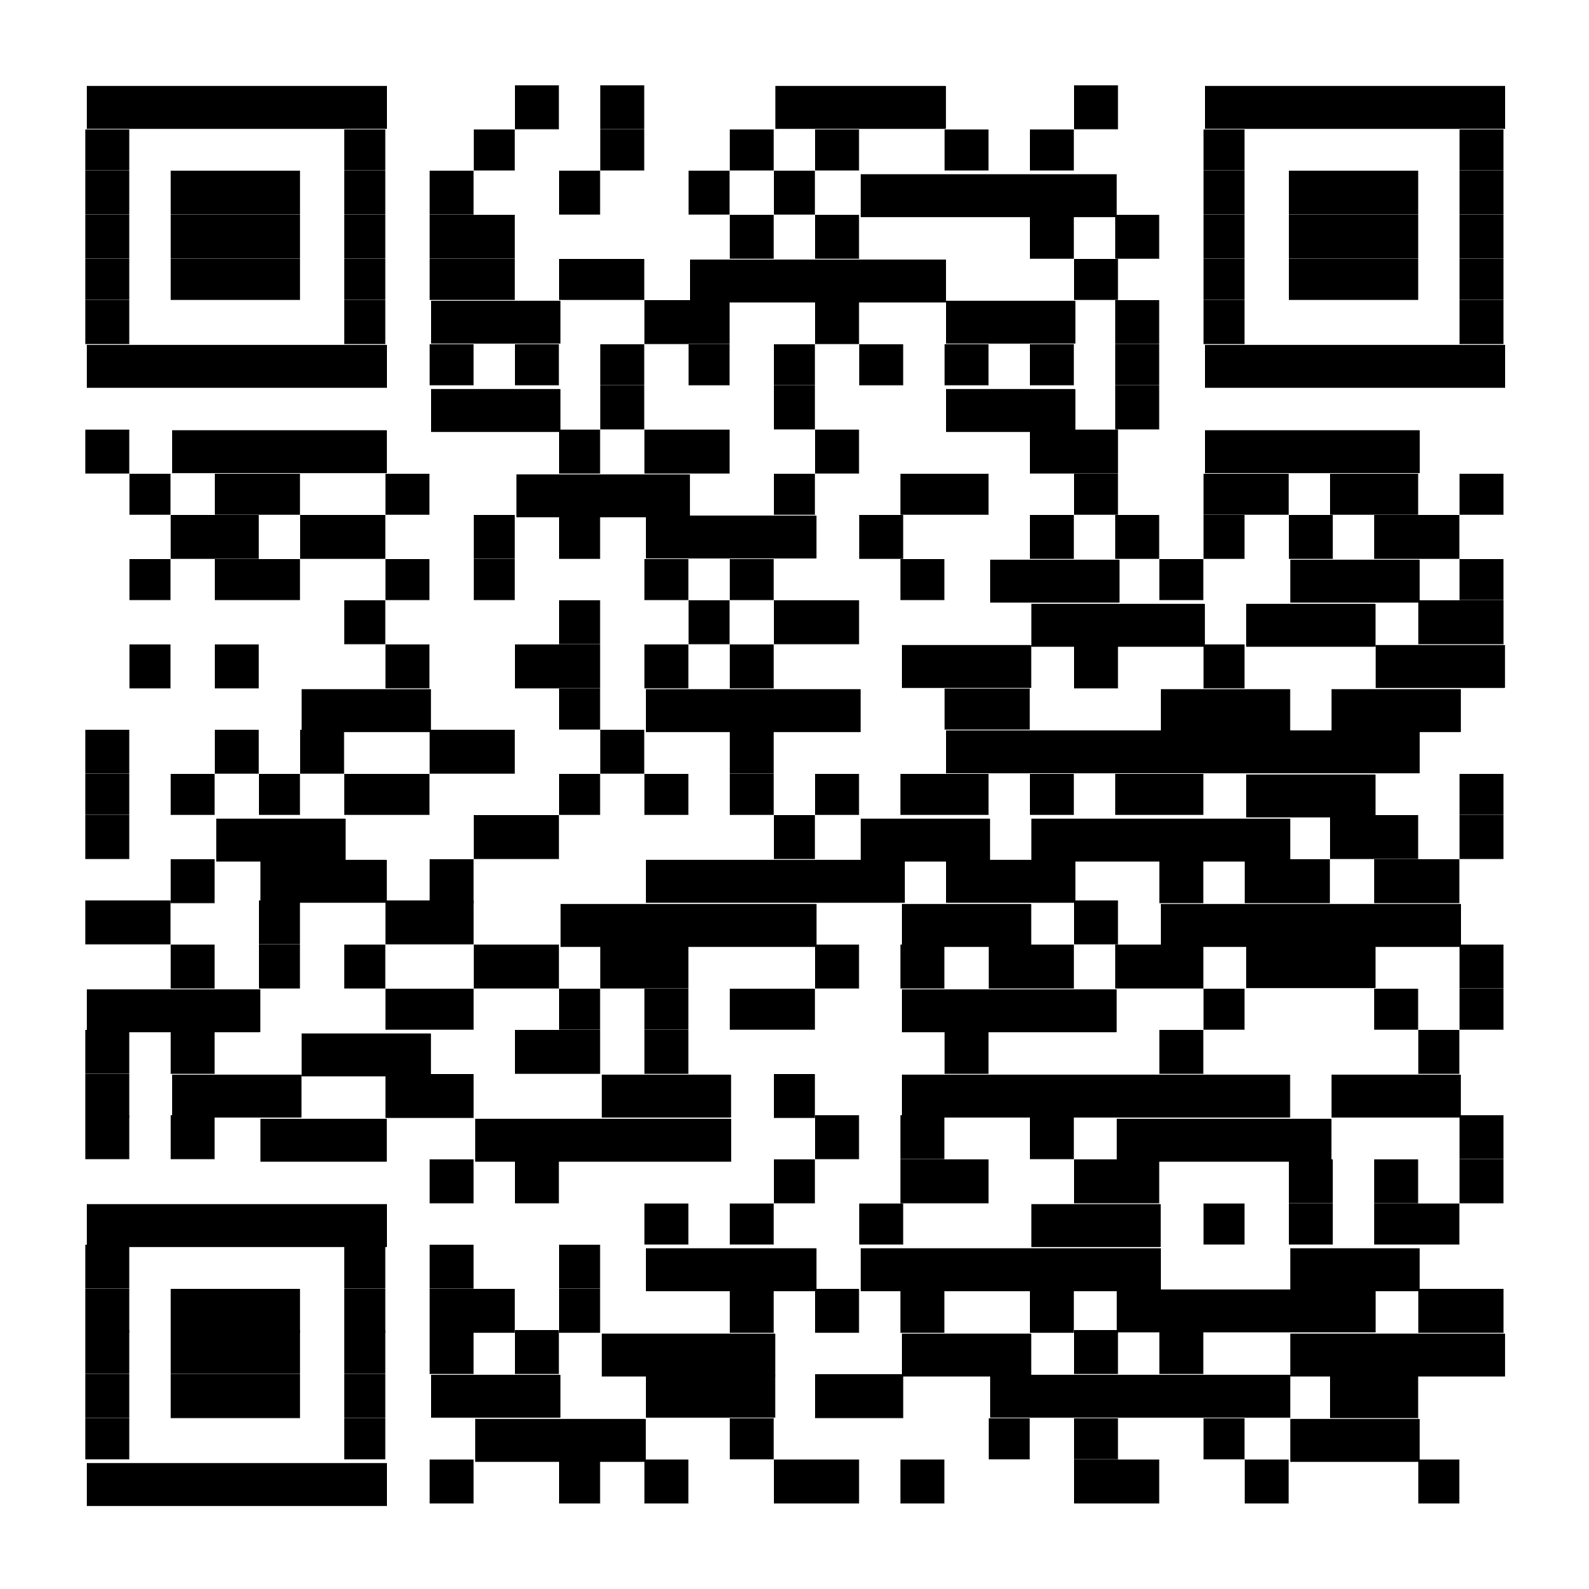
Introductions
Mr. Licht – Principal
Mr. Yeschenko– TCA Principal/Assistant Principal
Mr. Bonacci – Assistant Principal
Mrs. Rowe – 9th Counselor
Mr. Ruffing – 10th – 12th A - L
Mrs. Shields – 10th – 12th M – Z

Slide 3

What West Mifflin has to offer
West Mifflin Area High School offers a variety of unique academic and non- academic opportunities for its students.
The following slides showcase some of these opportunities that students can take advantage of.

Slide 4
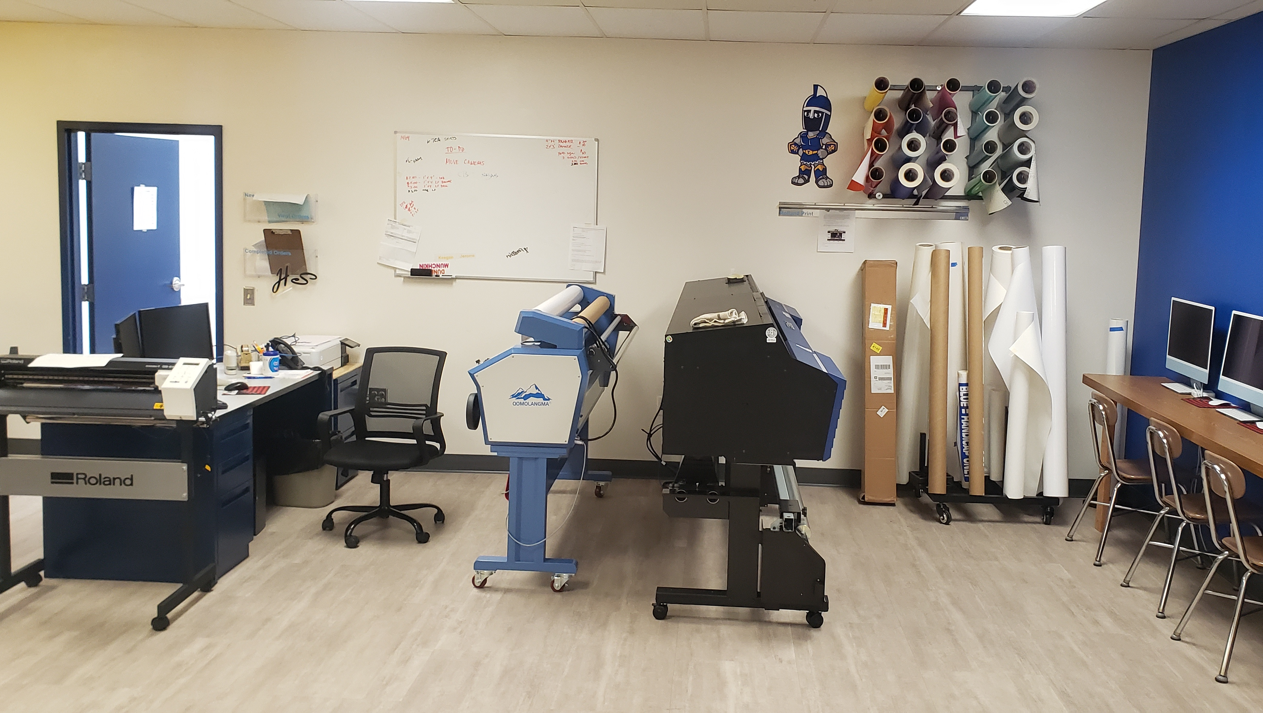
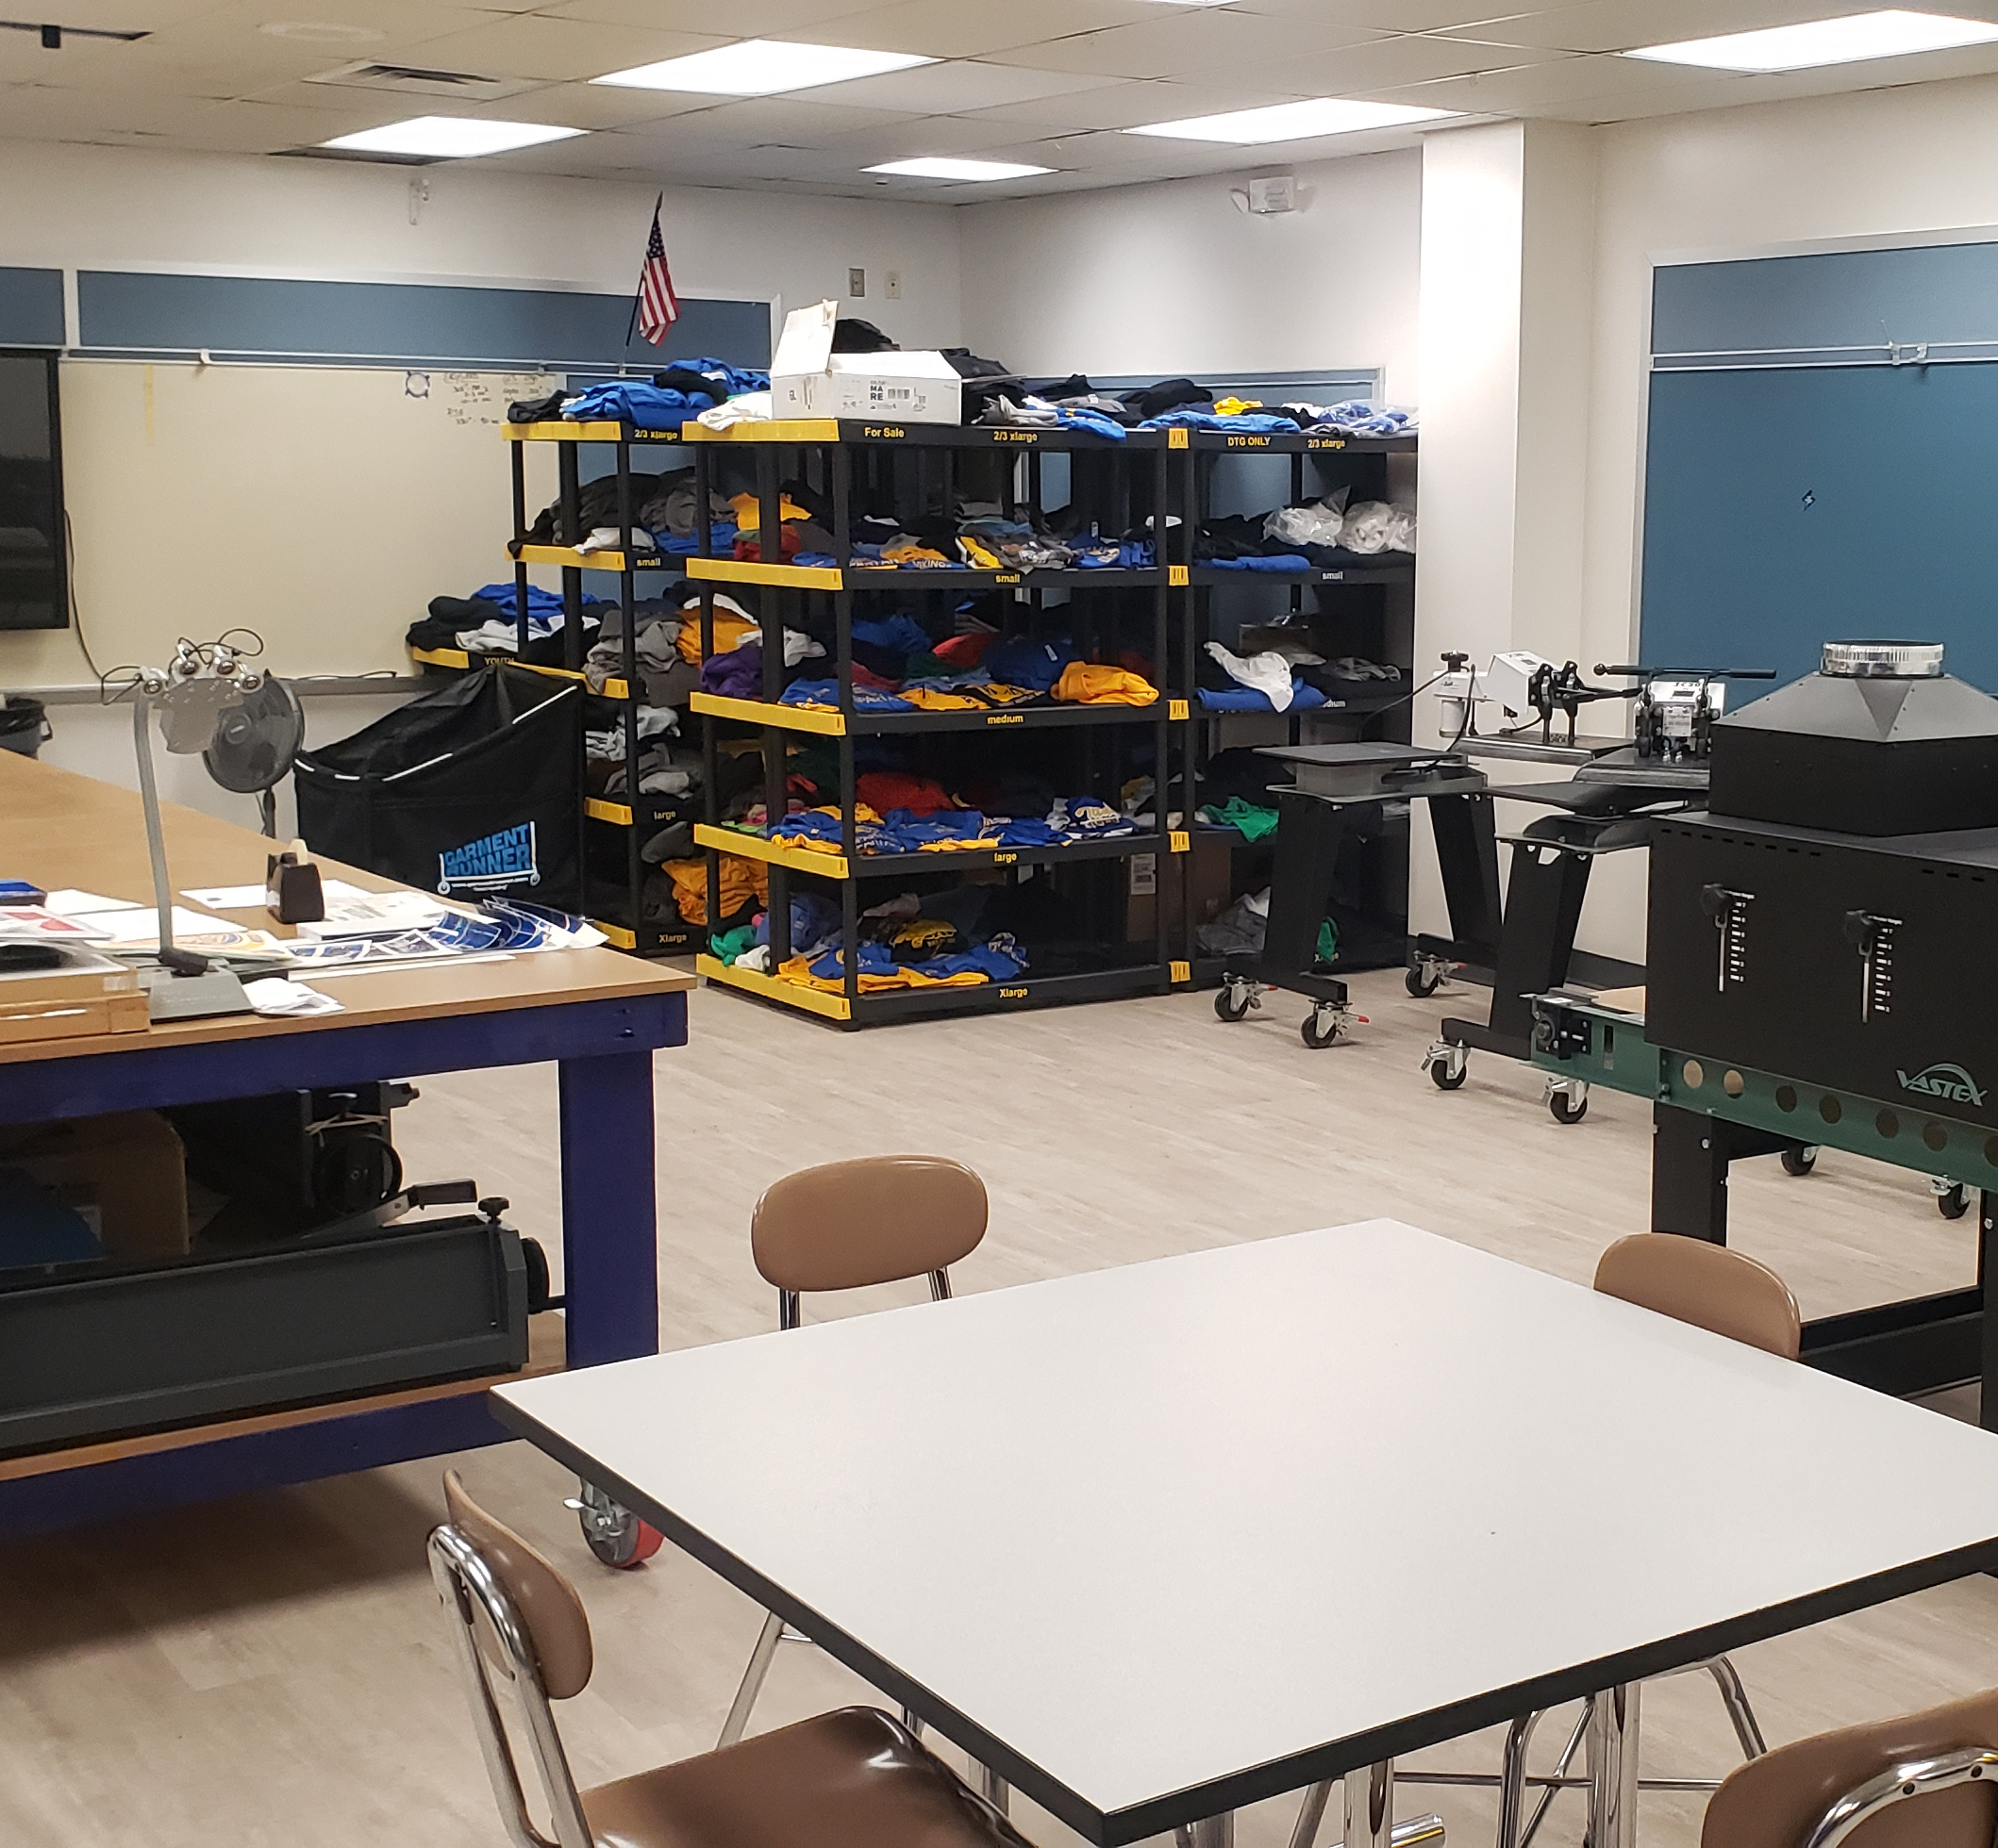
Titan Shoppe

Slide 5
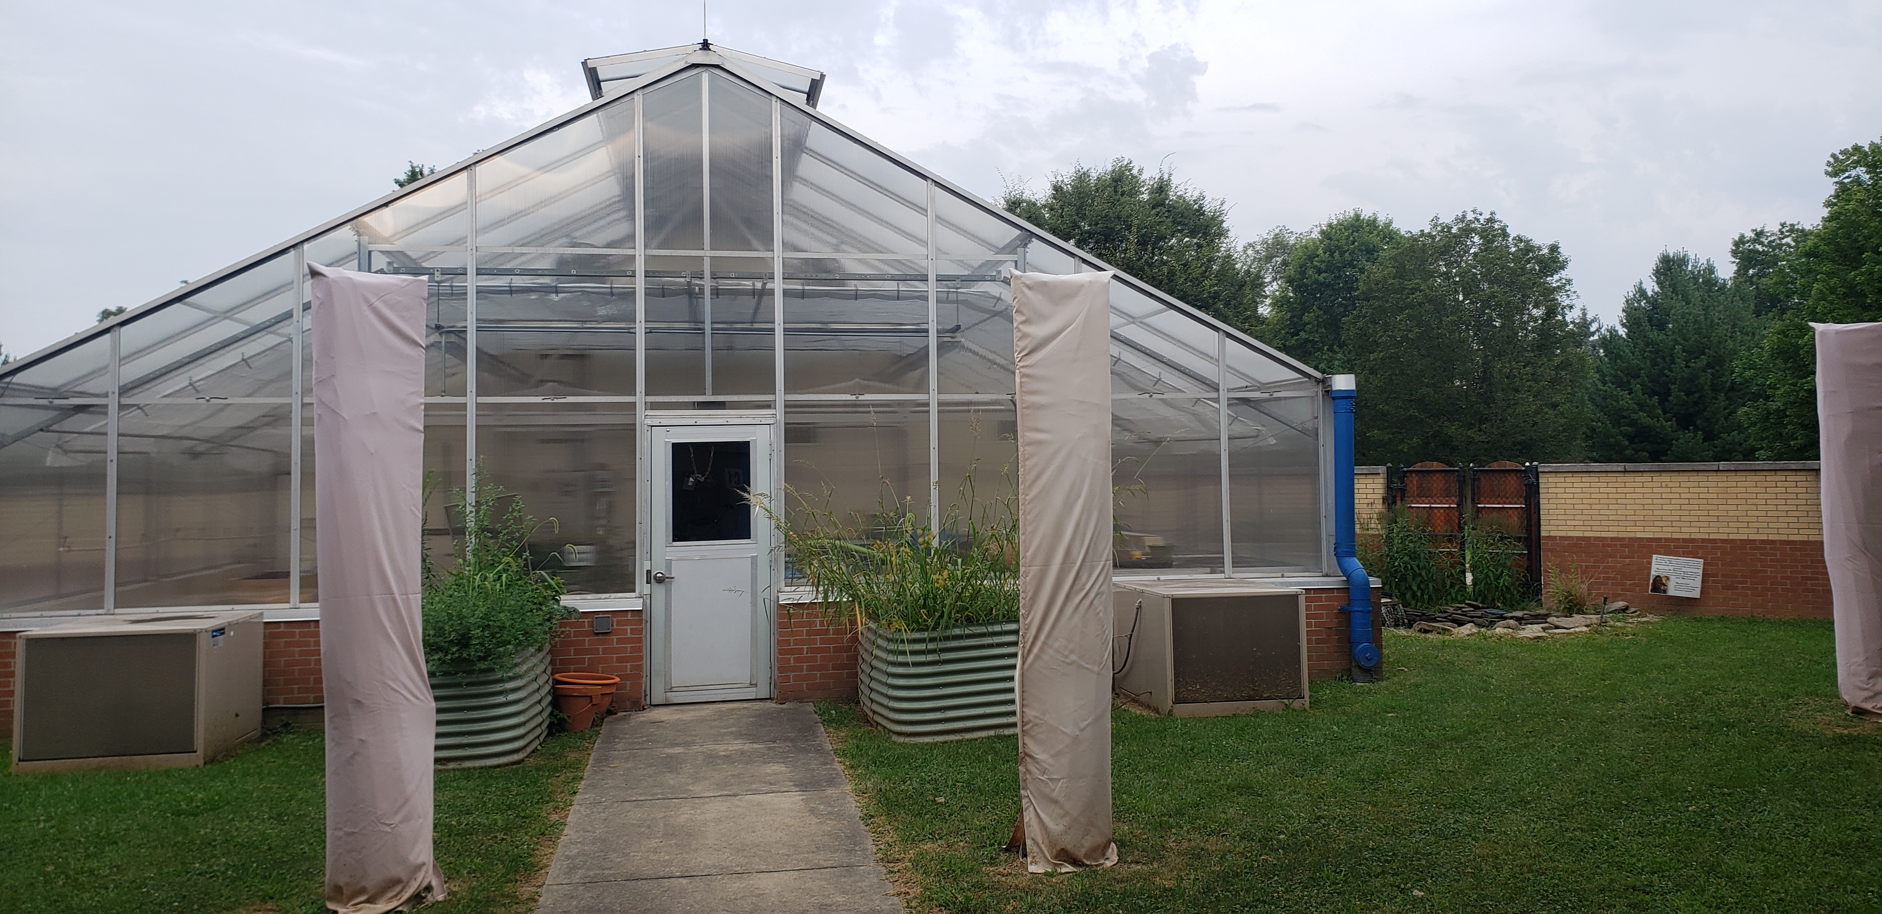
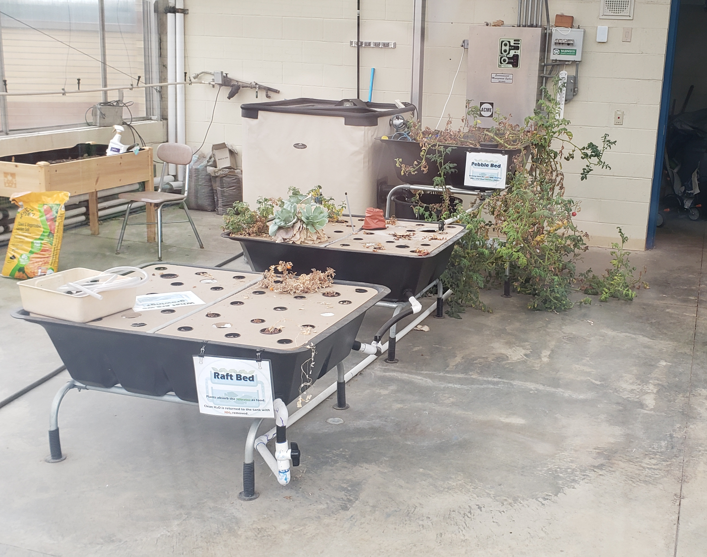
Outdoor STEAM Room

Slide 6
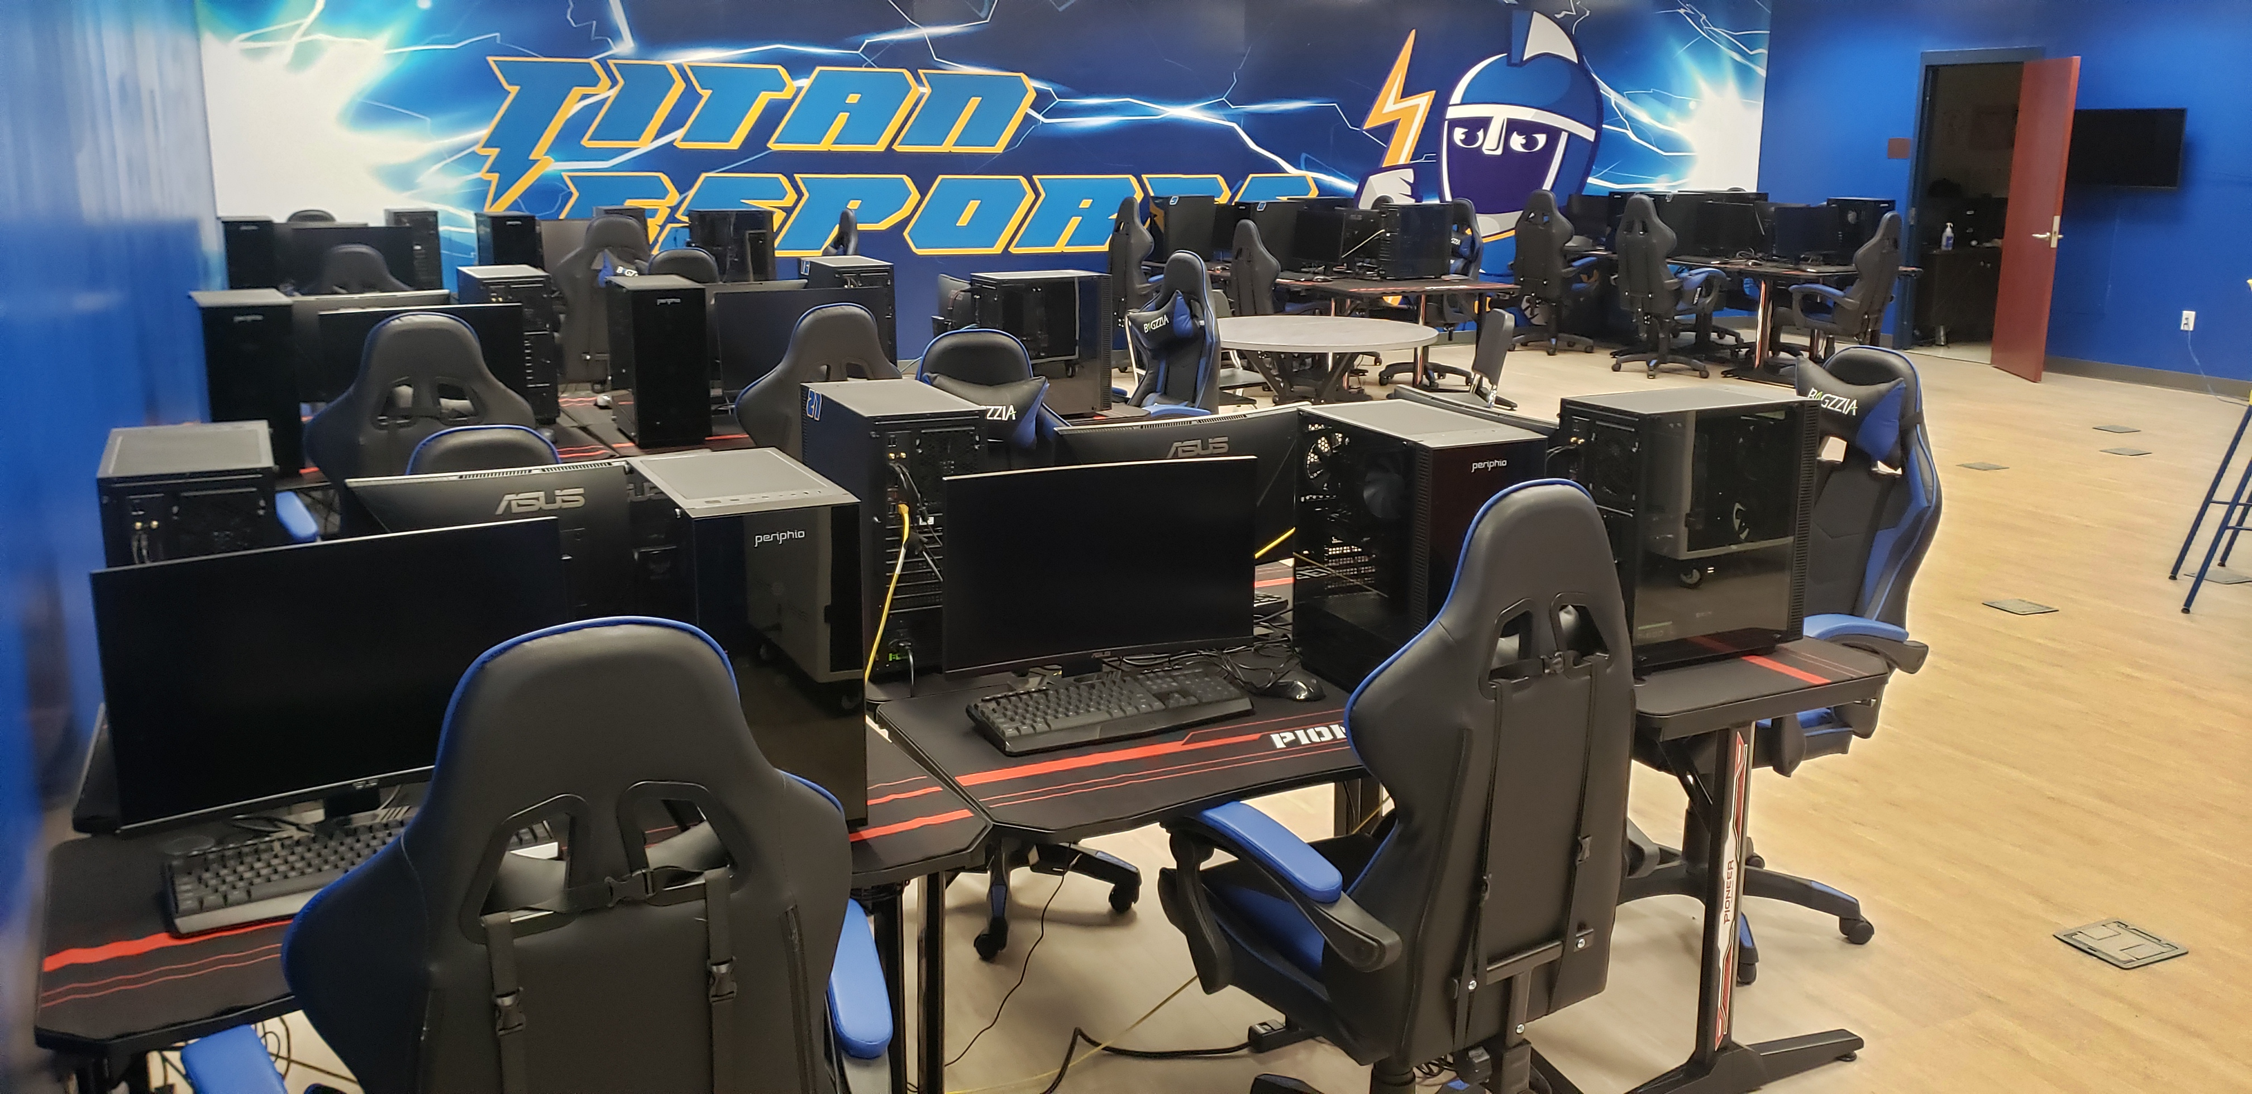
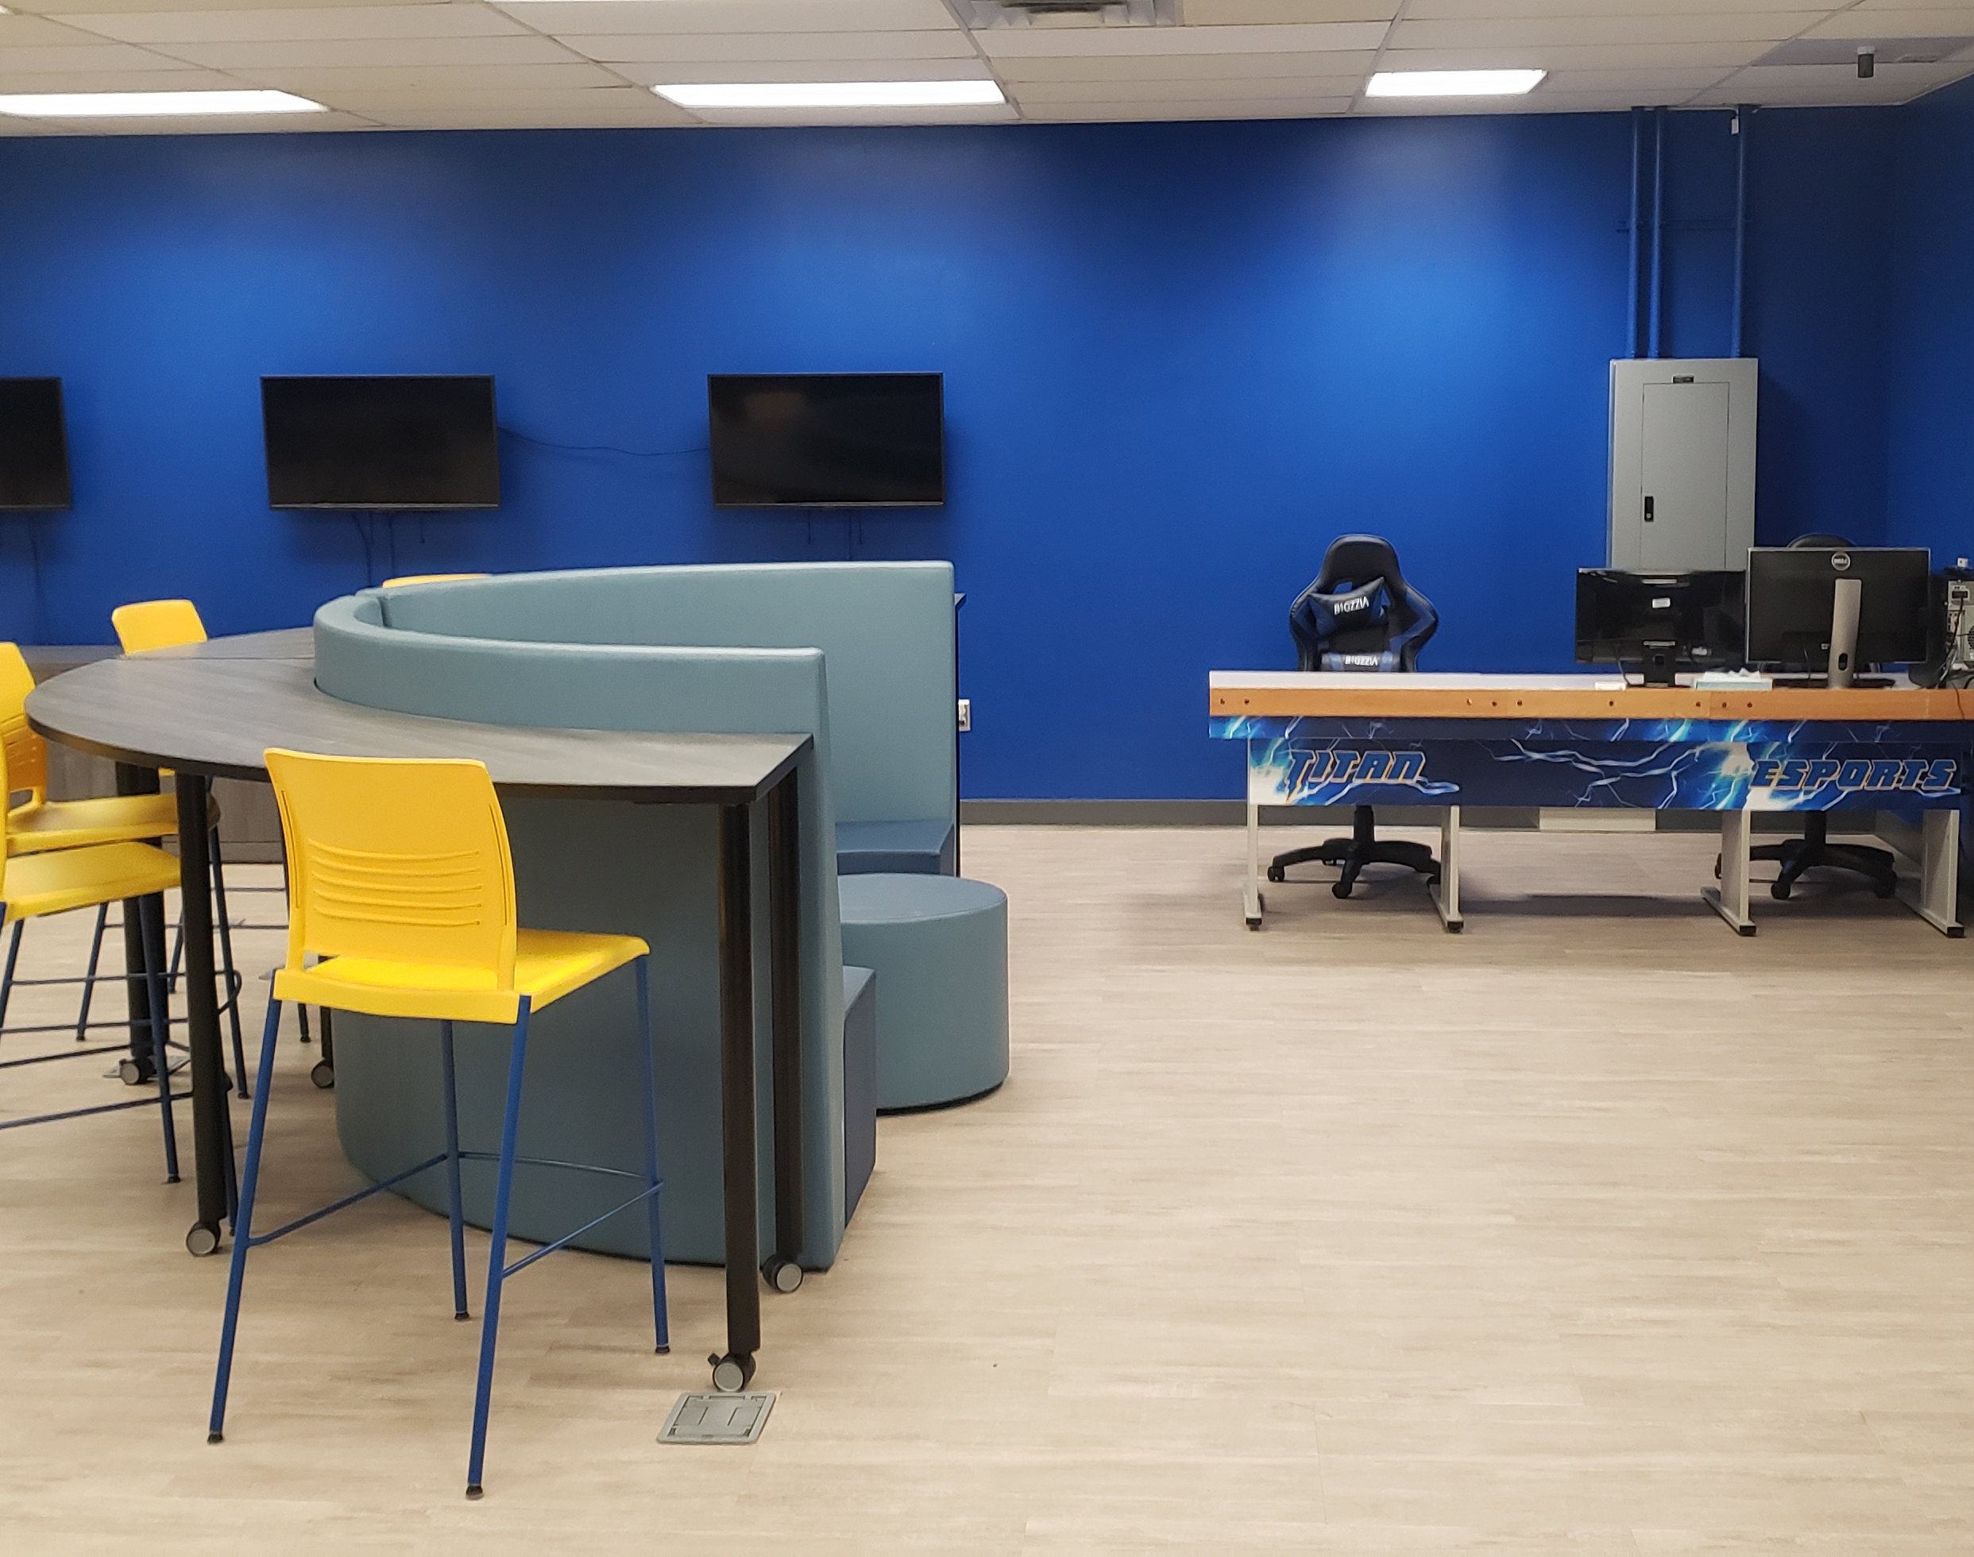
TITAN ESports

Slide 7
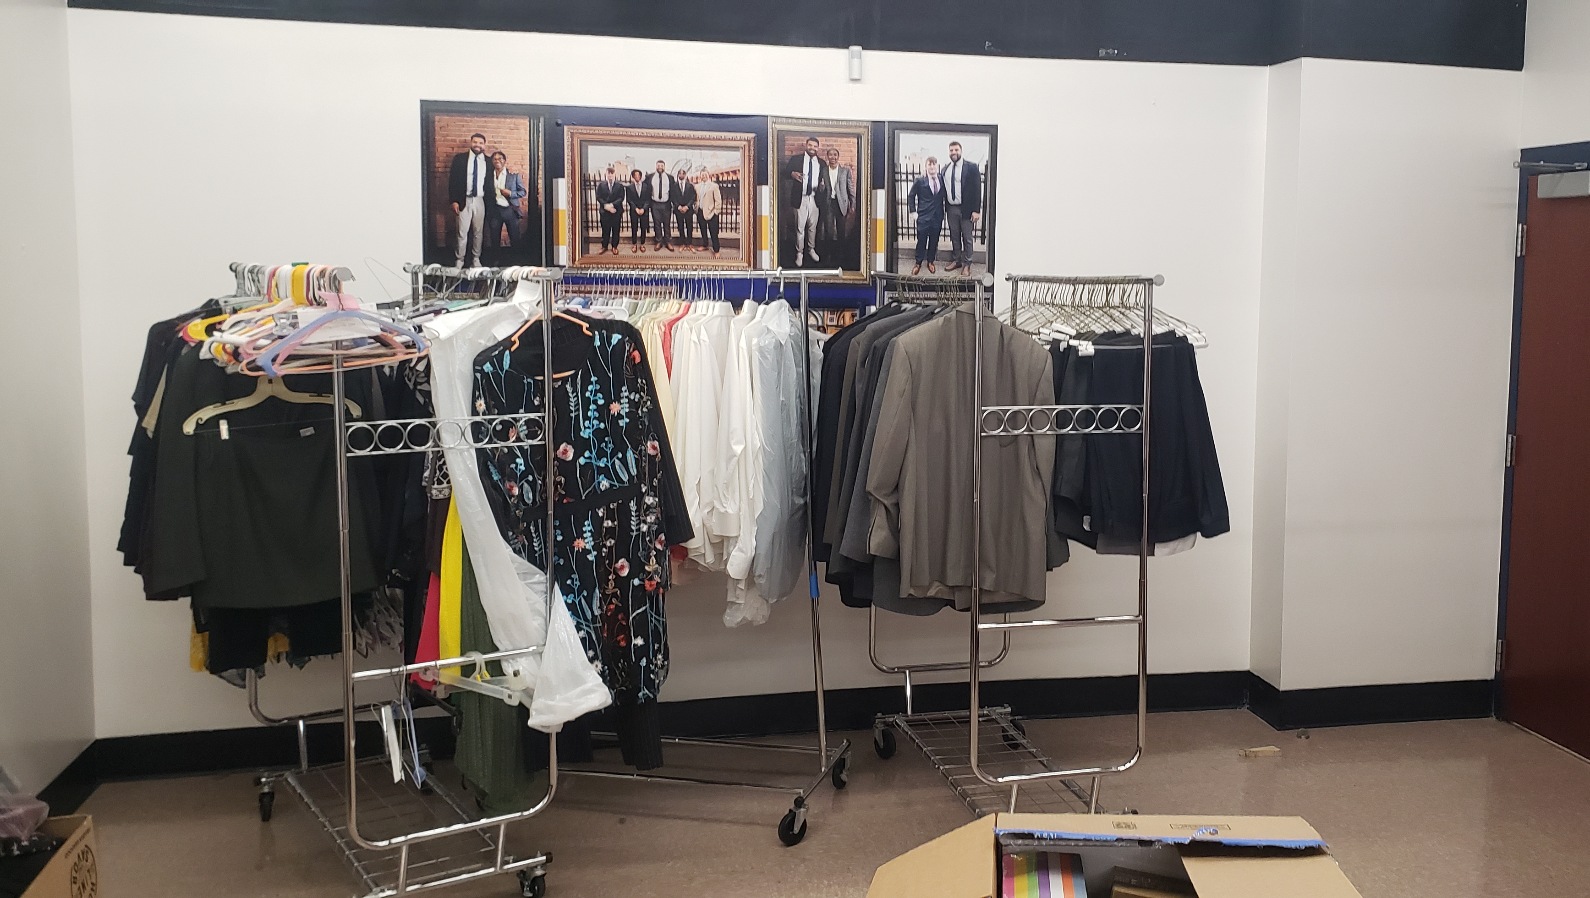
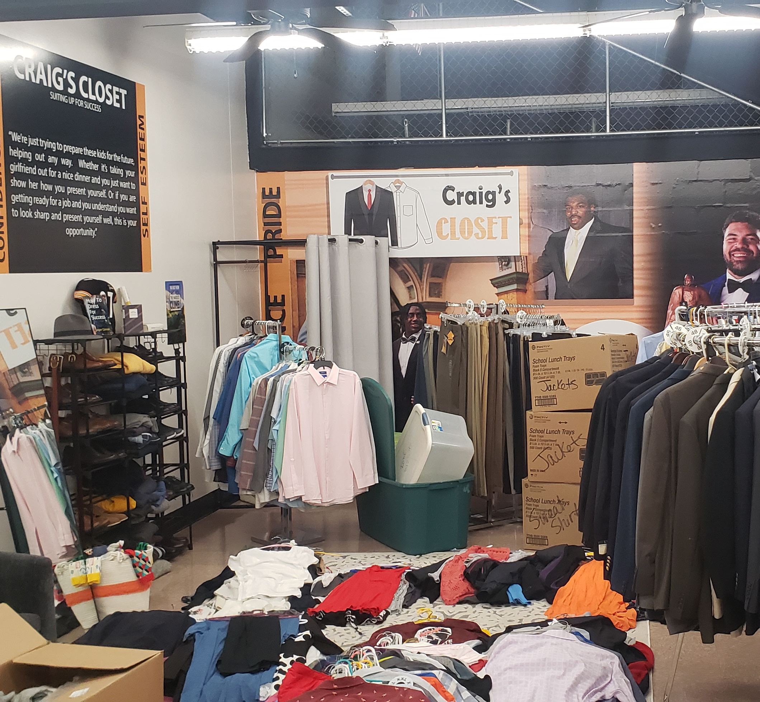
Heyward House

Slide 8
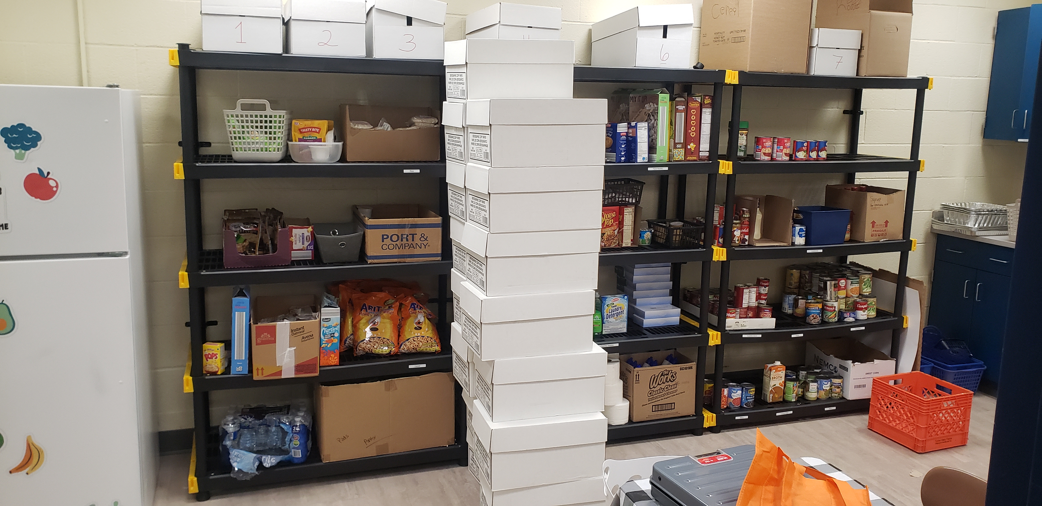
TITAN COMMUNITY CLOSET

Slide 9
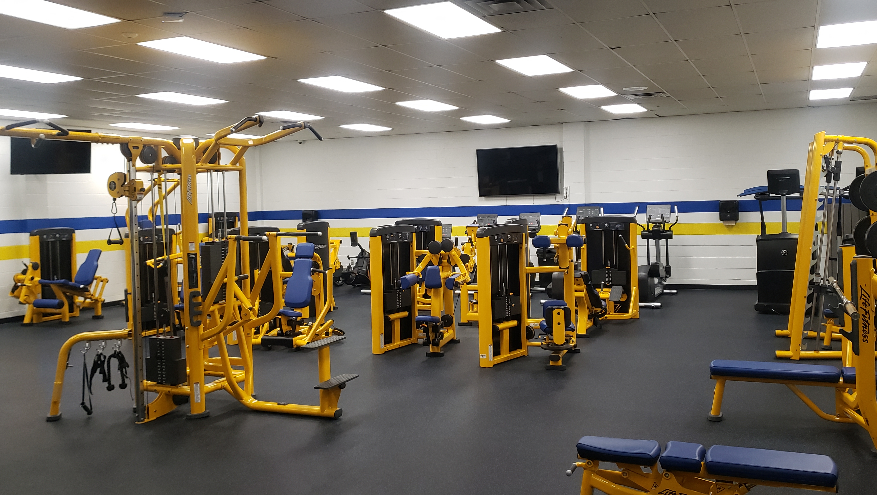
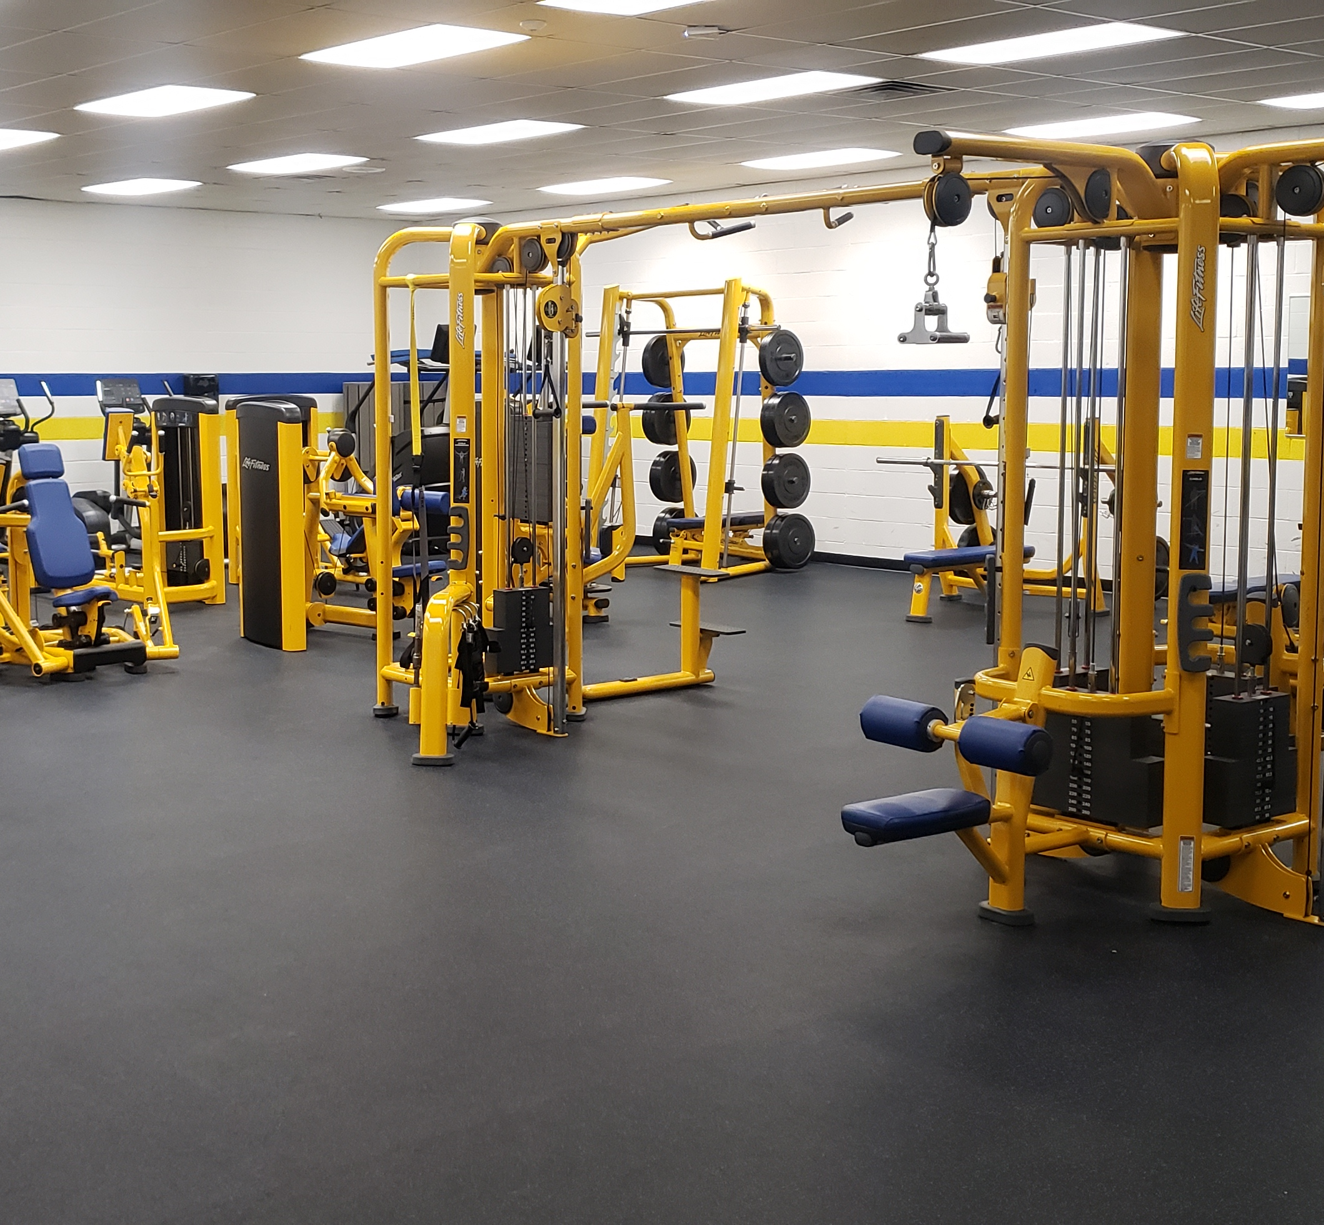
TITAN Sanctuary

Slide 10
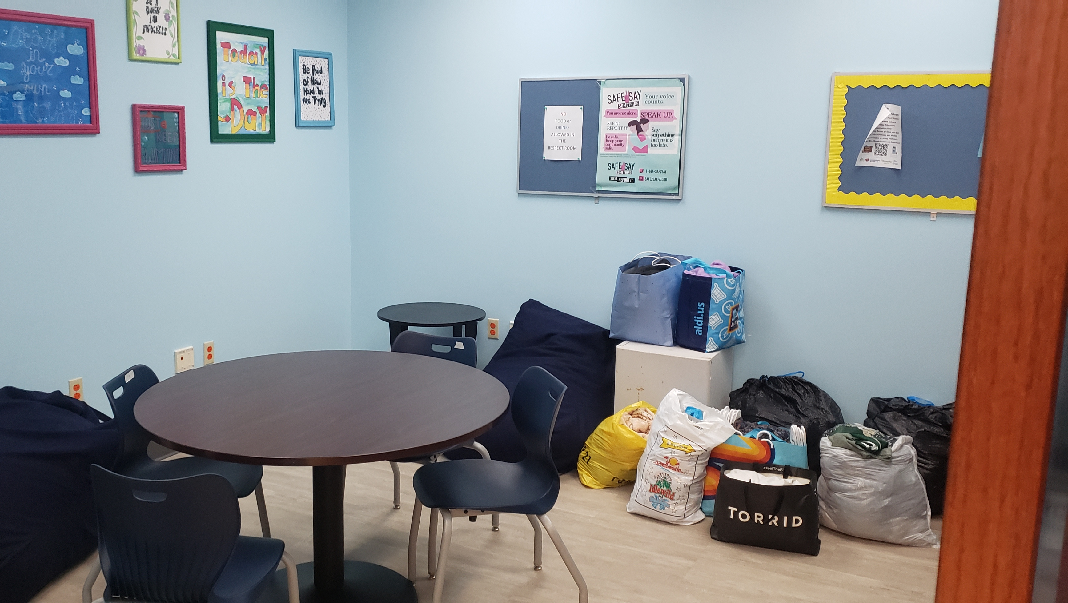
Respect Room

Slide 11

TITAN THYME Catering
Titan Thyme Catering offers a diverse menu featuring a selection of available items, and we are always open to accommodating special requests or new ideas. Our team of students provides flexible catering options to meet your needs and preferences.

Slide 12
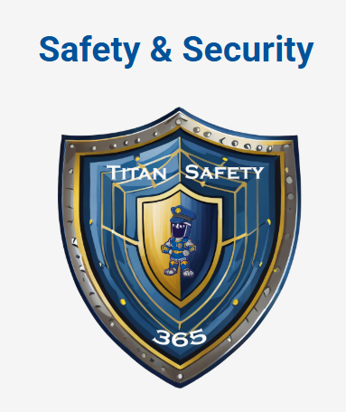
TITAN SAFETY 365
Student and staff safety are top priorities for the West Mifflin Area School District.

Slide 13
TITAN Learning Time (TLT) Goals
Increase student learning and reduce failure rates. If a student is failing a class, teachers add that student to one of their remediation sessions.
Decrease stress for students since students have more time to complete work and get help DURING the school day.
Build positive relationships among students and staff.
Decrease interruptions to the school day

Slide 14
How Does “TLT” Work?
Periods 1-5 and 7-8 would run as normal
6th period would become a 90-minute period.
The 90-minute period would be split into 3 30-minute blocks: A, B, and C.
Before midnight each day, students would sign up for their lunch period (A, B, or C) and two other TLT sessions.

Slide 15
How Does “TLT” Benefit Students
Students who are failing classes can be pulled into remediation sessions.
Students can select the teacher that they are with (less issues).
Students can select a study hall to complete their work.
Students can use the time to prepare for exams (AP, CHS, Keystone, SAT).
Students can pick the same lunch as their friends.
Students can pick some kind of activity for enrichment. (Think of the activities that teachers volunteered to run on our Flex Days.)
Club meetings can happen.
Rehearsals, school photos, and class meetings can happen during this time instead of class time.

Slide 16
Example “TLT” Activities
Weight Room
Pickleball
Yoga
Board Games
Mindfulness
Support Groups
Visiting Colleges
Career Presentations
College Visits
Club Meetings
Rehearsals (chorus, band)
Mentoring
Ceramics
E-Sports
Kahoot, Quizlet Live
Study Hall
Remediation

Slide 17
Title 1
Largest federal aid program for public schools in U.S.
The District Right To Know
  *The right to request information about the qualifications of the
  classroom staff working with your child.
Every Student Succeeds Act (ESSA)
  *Ensures teachers hold an appropriate state certification and
  licensure requirements.
  *Requires us to notify parents if their child is being taught for four
  or more consecutive weeks by a teacher who does not meet
  “appropriate state certification”

