Slide 1
2024-2025 Financial Aid Process
PRESENTER: Brandon Ritchey

Slide 2
The Financial Aid Process begins with the FAFSA Form StudentAid.gov
The Free Application for Federal Student Aid
Watch for websites not affiliated with or endorsed by the U.S. Department of Education (ED) that charge a FEE.
Do not to pay for assistance that is provided for free.

Slide 3
The FAFSA® Form
Application for:
Federal grants, work-study, and student loans
State of Ohio grants
For some schools, institutional scholarships and grants
Information provided:
Demographic
Taxable and untaxed income for 2022
Assets
Students should submit the FAFSA regardless of income!
Income is not the only factor in determining eligibility.

Slide 4
2024-2025 Financial Aid Timelines
For students beginning enrollment Fall 2024 (possibly Summer 2024)
Available online Now.
Submit early/meet college FAFSA Priority Date
*Early application allows time to compare aid offers
*Early application could maximize aid eligibility
Student does not need to be admitted to submit the FAFSA
*College may not review FAFSA/offer aid until admitted
Re-apply/submit the FAFSA every year

Slide 5
Filling out the FAFSA®
What do I need to complete the FAFSA?
Social security number(s)
Driver’s license
Alien Registration number, if not a U.S. citizen
2022 federal tax documents for student and parent(s)
Records of untaxed income
Information on savings, investments, business and farm assets
Federal Student Aid (FSA) ID

Slide 6
Federal Student Aid (FSA) ID
Account username and password
Legal electronic signature
Required to access the FAFSA form
Required of all students and parents
Request at least 3 days before starting FAFSA
You will need:
Social Security Number
Parent that does not have an SSN will have separate verification process
Using information from credit bureaus
This process is NOT available yet
Mobile number and email address
Do not use school email address
Each parent and student must have separate mobile number and email

Slide 7
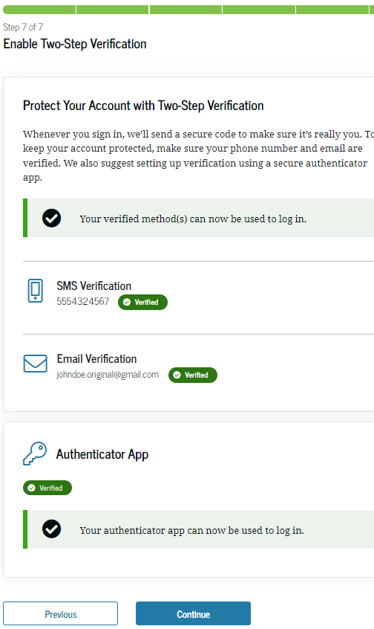
Multi-Factor Authentication (MFA)
Creating FSA ID requires use of MFA
Use MFA one-time code by:
Email
Text
Authenticator app (download from mobile store)
When FSAID is created you are presented with a one-use back-up code
WRITE THIS DOWN (You will not be presented with it again)
Used to access account if you cannot use any other MFA
Once used, MFA is disabled. Re-enable in your account settings
If you cannot log in with MFA or backup code call 1-800-433-3243

Slide 8
Logging in with MFA

Slide 9
Dependency Status
Dependent = Parent(s) apply with the student.
Independent = Student (and spouse) apply without parent(s).
Categories that make a student independent:
Age = 24 as of January 1
Graduate Student
Married
Veteran/Active Duty
Children/Dependents
Orphan/Ward of Court/Foster Care = Age 13 or older
Emancipation/Legal Guardianship
Homeless or at risk of homeless and self-supporting
Most high school students will be dependent.

Slide 10
Parent of Record on the FAFSA®
Biological or Adoptive Parent(s)
If not married BUT living together report BOTH parents
If biological parents are divorced or never married:
Provide information for the parent that provides most financial support in 12 months prior to completing the FAFSA.
If support provided is equal, report for the parent with the greater income and assets.
EVEN if the student does not live with that parent.
If parent is re-married, report information about their spouse (student’s step-parent)

Slide 11
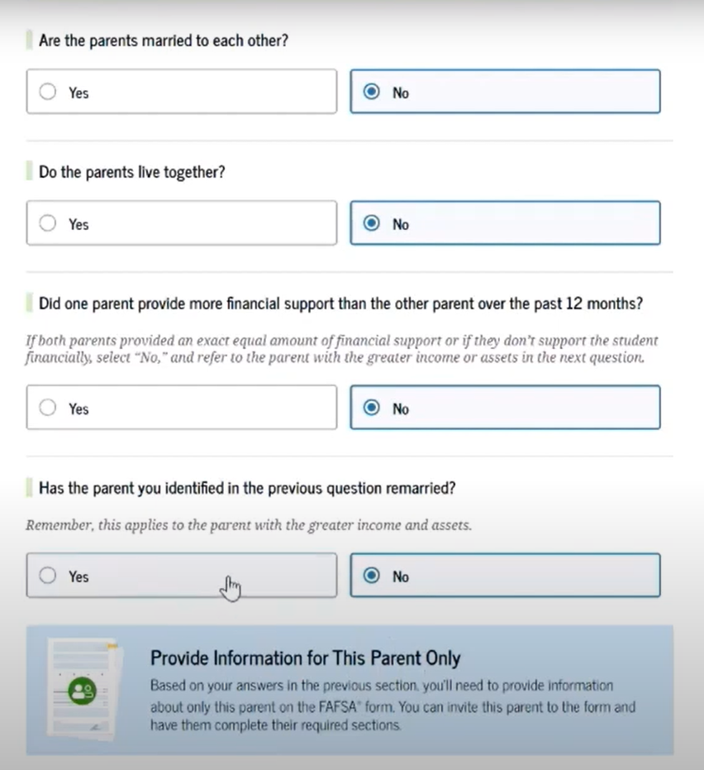
Parent Wizard Questions
Are your parents married to each other?
If yes, provide information about both parents
If no, next question
Do the parents live together?
If yes, provide information about both parents
If no, next question
Did one parent provide more financial support than the other over the past 12 months?
If both parents provided an exact equal amount of financial support or if they don’t support the student financially, select “No,” and refer to the parent with the greater income or assets in the next question.
Yes or No, next question
Has the parent you identified in the previous question remarried?
If yes, provide information for the parent and stepparent
If no, provide information about this parent only

Slide 12
Contributors
Anyone who provides information on the FAFSA
Student (and spouse if married)
Parent/Parents (for dependent students)
Contributors must provide the required information and sign respective section of the FAFSA

Slide 13
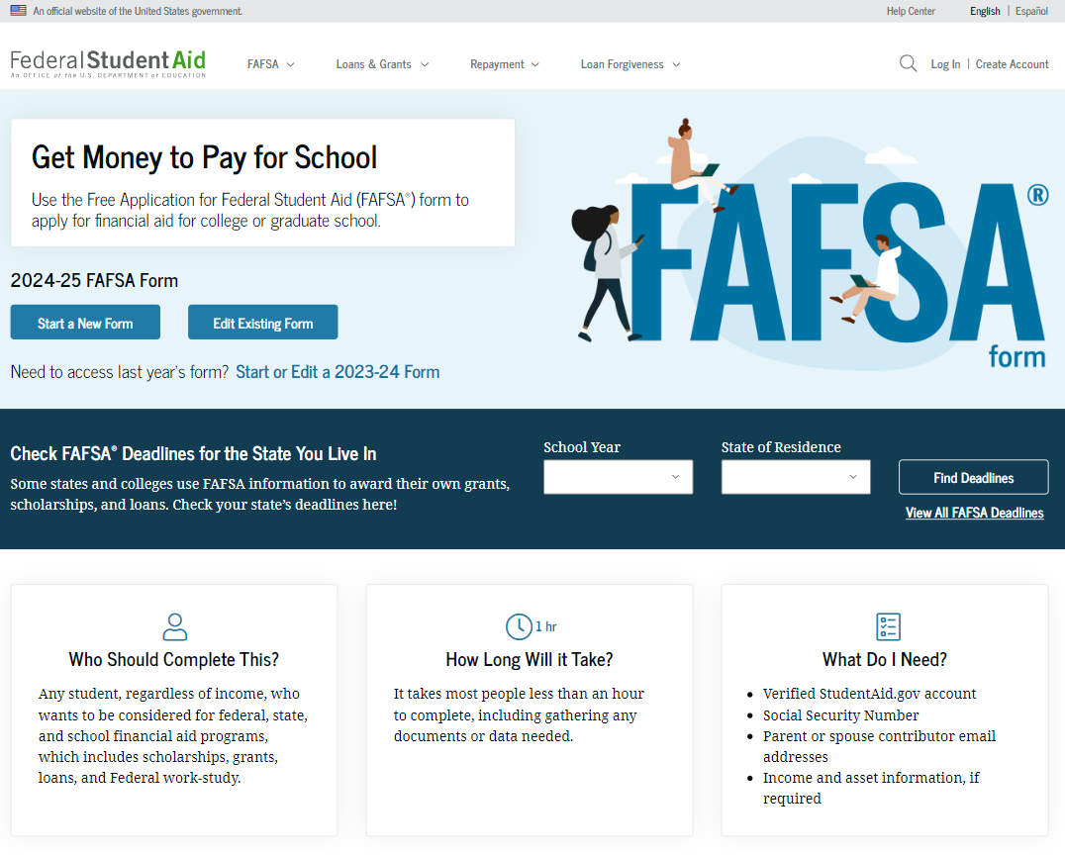
Dependent Student FAFSA® Form Landing Page

Slide 14
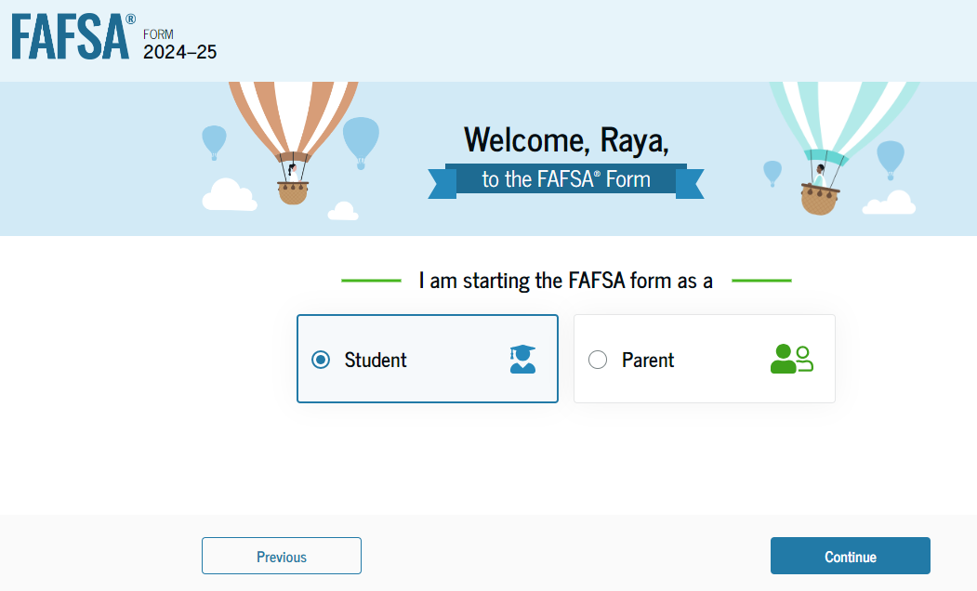
FAFSA® Roles

Slide 15
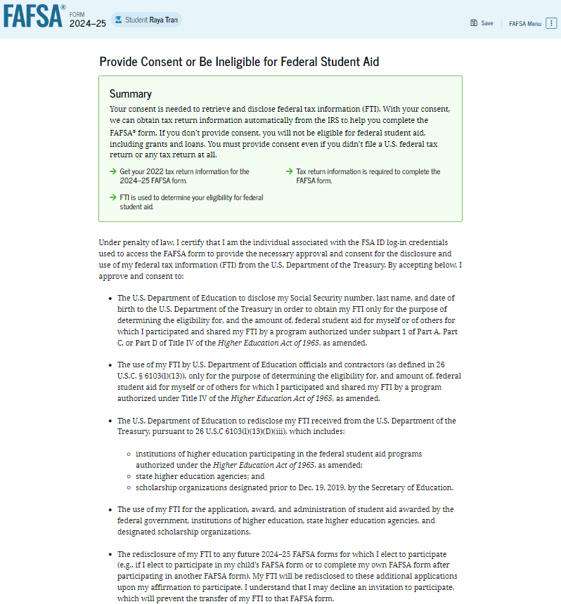
Dependent Student Provides Consent
By providing consent, the student’s federal tax information is transferred directly into the FAFSA® form from the IRS to help complete the Student Financials section.
The student selects "Approve" to provide consent and is taken to the next page.

Slide 16
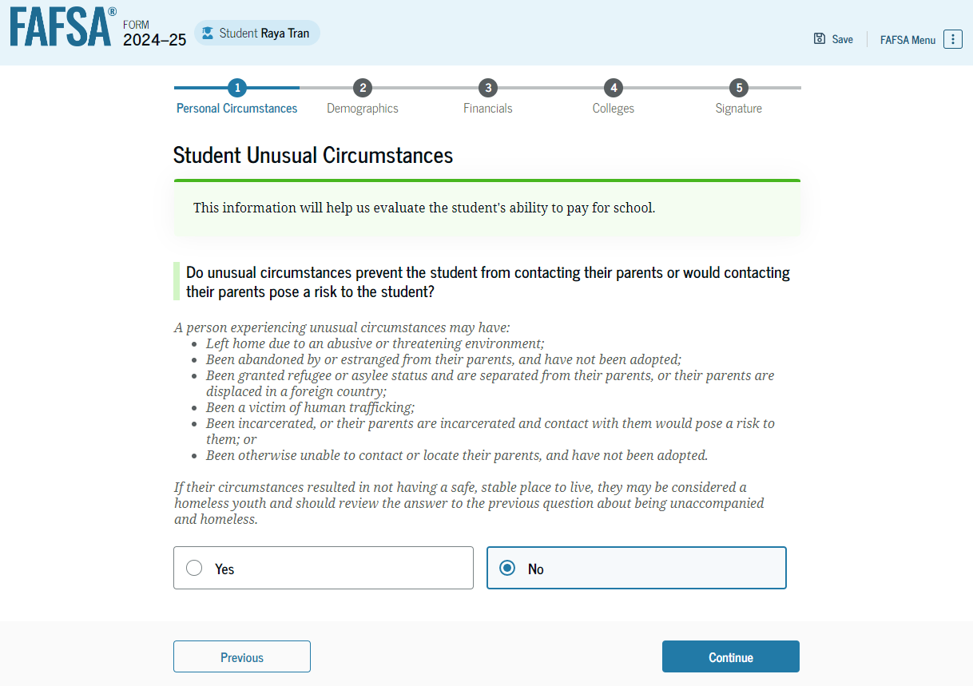
Dependent Student Unusual Circumstances
If a student says “YES” to unusual circumstances, they will submit the FAFSA without parent information.
The college(s) will work with them to finalize status.

Slide 17
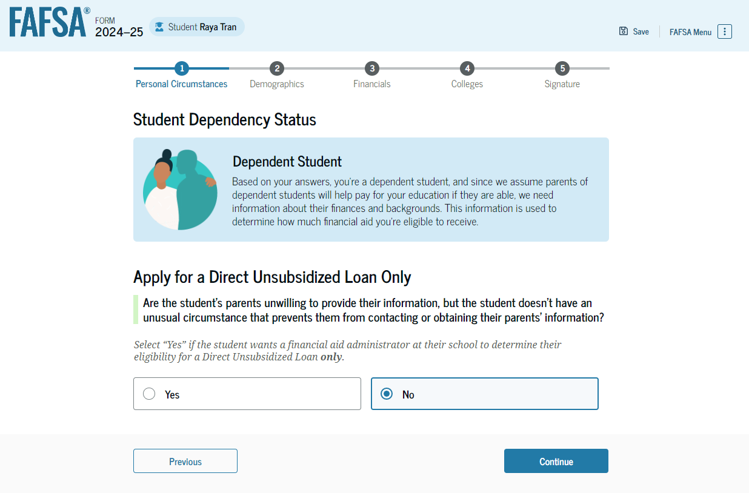
Dependent Student with Unwilling parents

Slide 18
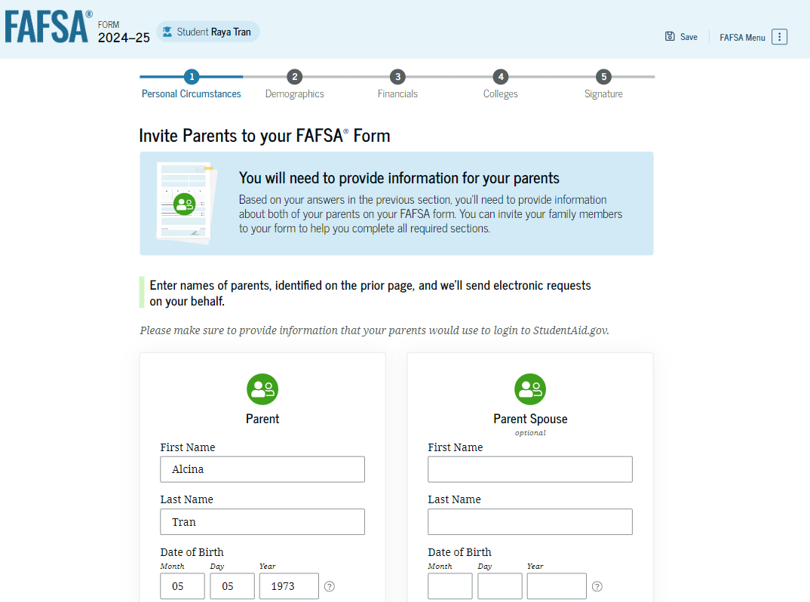
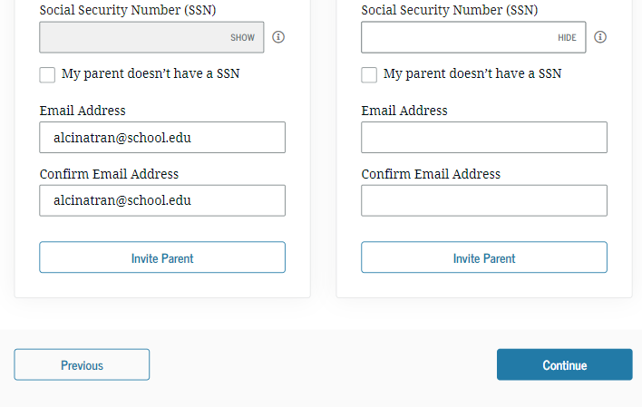
Dependent Student Invites Parents to FAFSA® Form
The student is asked to enter personal information about their parents to send them an invite to their FAFSA®.

Slide 19
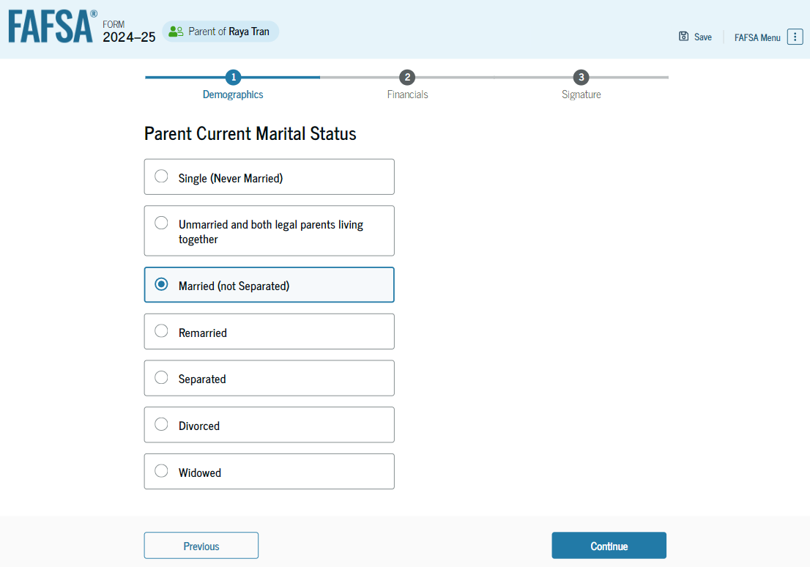
Dependent Student’s Parent Current Marital Status
The parent is asked about their current marital status. They select the "Married (not Separated)" option.

Slide 20
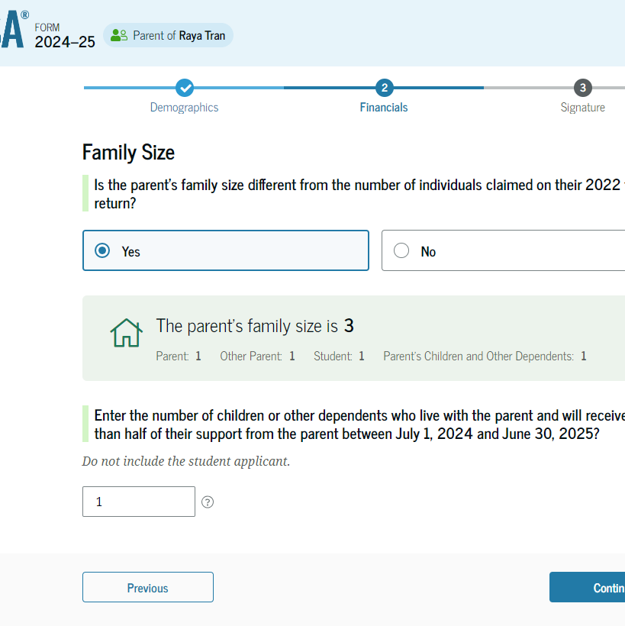
Parent Family Size
This page asks the parent if their family size has changed since filing their 2022 tax return.
If “YES”, parent may update the family size. RECOMMENDED!

Slide 21
Assets Reported
Real estate (not the home you live in)
Rental property
Trust funds
Business and/or investment farm value
Market value of land, building, machinery, equipment, inventory, etc.
Uniform Gifts to Minor Act accounts (UGMA and UTMA)
Money market funds; mutual funds; stocks; stock options; bonds; certificates of deposits
Other securities and Commodities
Installment and land sale contracts
Qualified education benefits and education savings accounts/529 savings plans/Coverdell savings plans/refund value of prepaid tuition plans
Report the Net Worth of Assets:
Value today minus debt
Negative value is reported as Zero

Slide 22
Assets NOT Reported
Primary Residence
Life Insurance Plans
Retirement Plans
PERS/STERS
401K
Pension funds
Annuities
Non-education IRAs
KEOG plans

Slide 23
Student Aid Index
Index figure used by schools to determine eligibility for aid
Calculated results from information provided on the FAFSA
Calculated using a formula established by law
Same figure reported to all schools
Factors that determine the SAI:
Student and parent income (taxed and untaxed) for 2022
Assets
Family Size

Slide 24
Special Circumstances
Conditions exist that cannot be documented on the FAFSA
Send written explanation and documentation to the financial aid office(s)
School will review and request additional information if necessary
School decisions are final and cannot be appealed to the U.S. Department of Education

Slide 25
Special Circumstances
Loss of Child Support
Unusual uncovered medical/dental expenses
Student cannot obtain parental information
Extraordinary dependent care
Parent or spouse death
Loss of employment
Divorce

Slide 26
Financial Aid Office Review
May require additional information
Verification of Income
Family Size
Determines Financial Aid Offer
Sent by email or regular mail
Amount of Aid awarded from each program
How and when aid is disbursed
Terms and conditions of student’s offer
Identity/Statement of educational purpose
Documentation of high school completion

Slide 27
Financial Aid Awards
Federal and State Grants
Pell Grant
Does not need to be repaid.
Eligibility is based on financial need determined by your FAFSA.
Maximum Pell award for 2023-2024 is $7,395/year
Federal Supplemental Grant
Ohio College Opportunity Grant (OCOG)
Does not need to be repaid.
Eligibility is based on financial need determined by your FAFSA, in addition to Ohio residency status.
Must attend a school in Ohio.
Maximum OCOG award for 2023-2024 is $4,700/year at Private Institutions
Federal Loans
Subsidized Loan
Must be repaid.
Based on Financial Need and enrollment status
Does not accrue interest while student is enrolled at least half-time
5.50% fixed interest rate (for 2023-2024, will change 7/1/24)
Unsubsidized Loan
Must be repaid.
All half-time students are eligible
Starts accruing interest from the time the loan is disbursed
5.50% fixed interest rate (for 2023-2024, will change 7/1/24)

Slide 28
Financial Aid Awards
Parent Plus Loan
The government provides a loan option available to parents who are able/willing to assist their child with college costs.
Apply for the Parent Plus Loan at www.studentaid.gov.
Interest rate is 8.05% and origination fee of 4.228% (2023-2024 – will change 7/1/2024)
If the parent is denied for the loan based on their credit, the Financial Aid Office is permitted to increase the amount of the student’s unsubsidized loan by $4,000 for the year. Then it is your decision whether the student applies for the additional loan eligibility or not.

Slide 29
Financial Aid Awards
Outside Scholarships
High School Guidance Counselors
Local Community/Business Scholarships
www.fastweb.com
www.scholarships.com
www.myscholly.com

Slide 30
Questions

