Slide 1
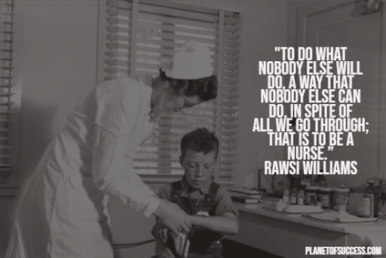

Slide 2
Hello!
I AM Patricia Hornbeck, RN
.
You can find me at:
phornbeck@oncboce.org

Slide 3
Health Occupations
OAOC BOCES
Milford NY
2 Year program
Year 1 Health Science Fundamentals & Home Health Aide Certification
Clinical Observation
Bassett Hospital
Woodside Hall
Year 2 Certified Nursing Assistant
108 Hours Bassett Hospital
Cooperstown Center & Rehabilitation Centers
Phlebotomy Certification - - Senior Year

Slide 4
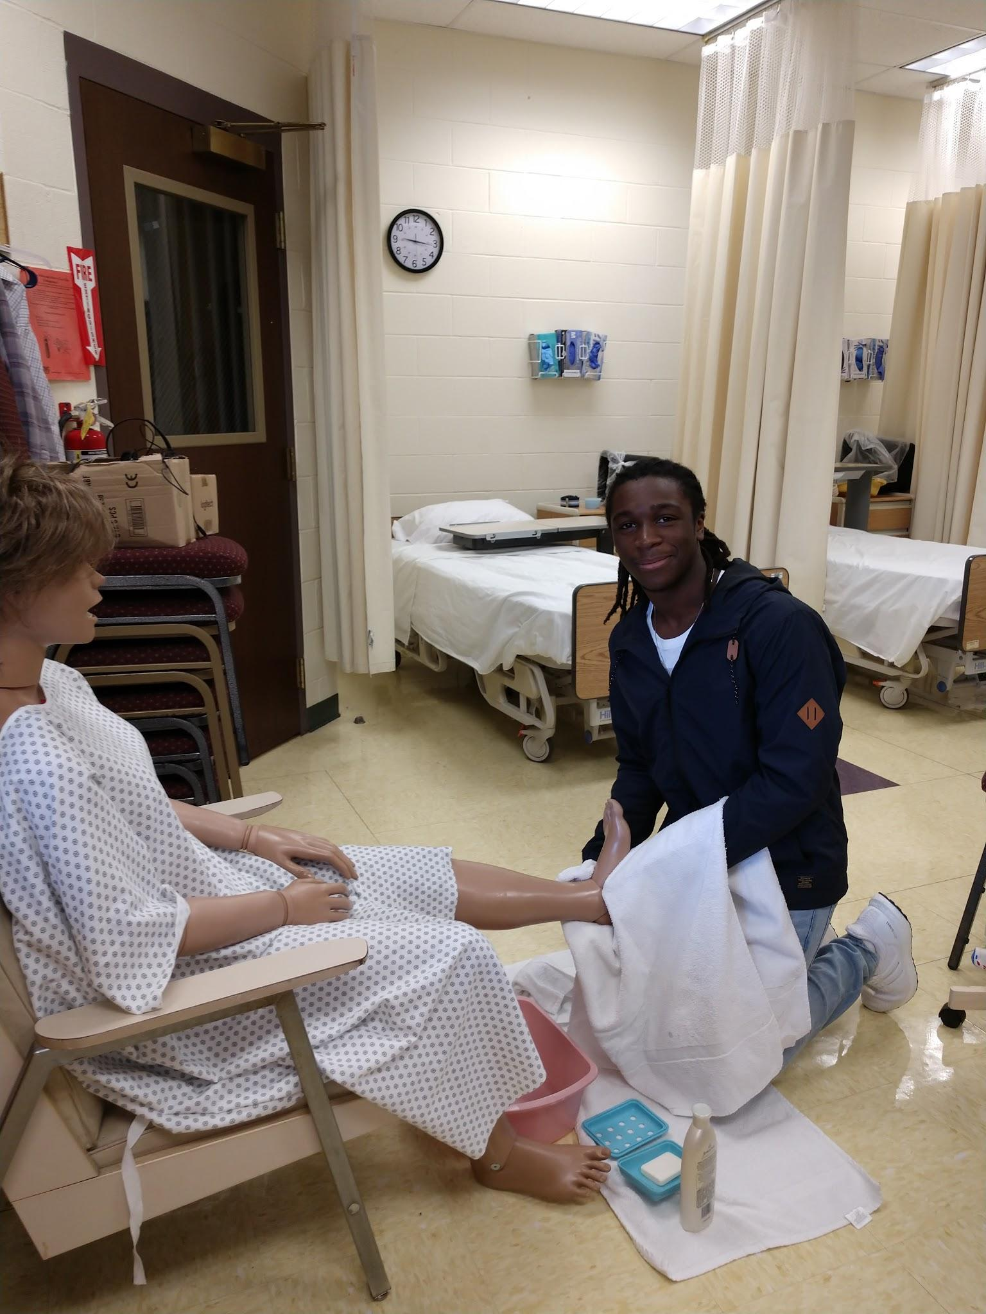
Classroom Day
Read the Chapter together
Complete workbook - no homework
Practice skills
Projects
Class meeting
Clinical on Tuesdays and Thursdays
Kahoot
Bingo

Slide 5
Certifications
Home Health Aide
Heartsaver CPR & First Aid
Certified Nursing Assistant
Basic Life Support SPR
Phlebotomy

Slide 6
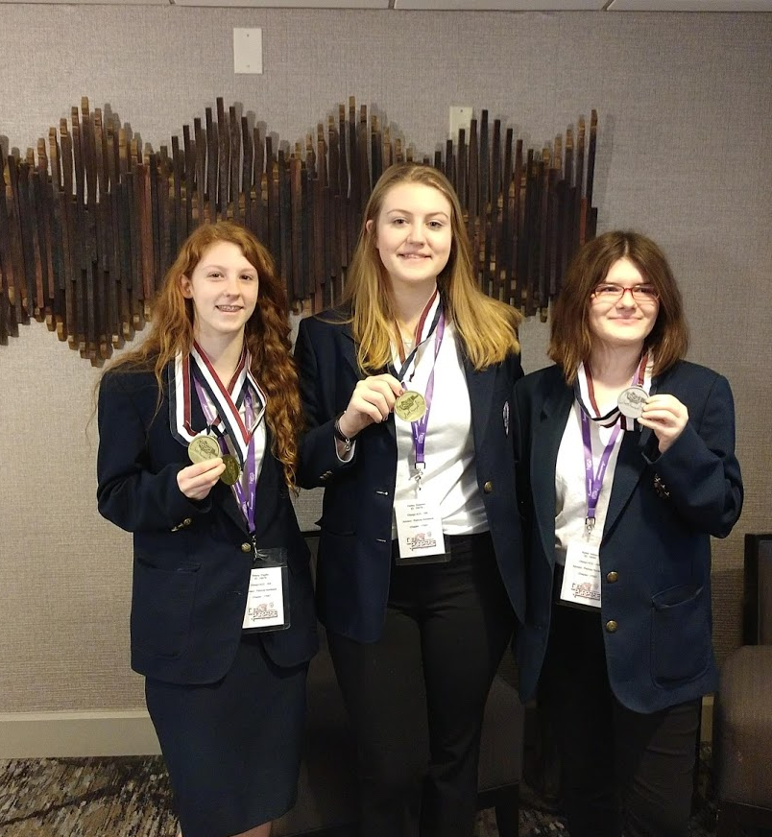
Organizations
Health Occupations
Students of America
Skills
National Technical Honor Society

Slide 7
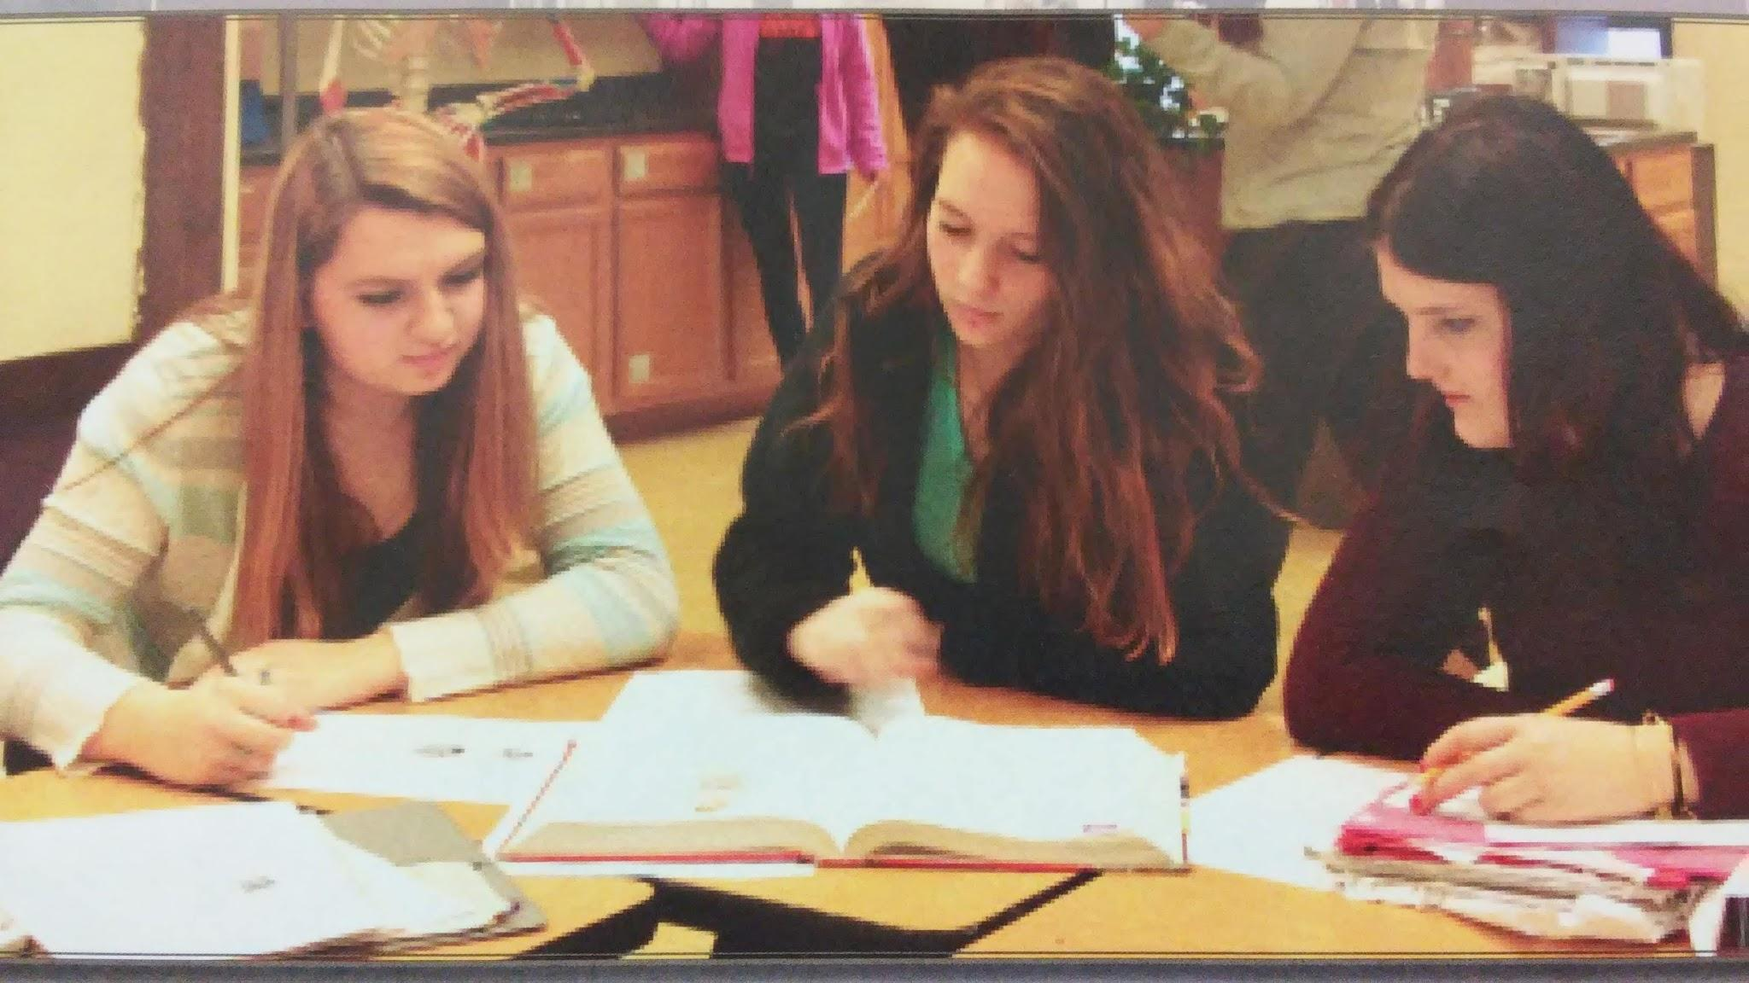
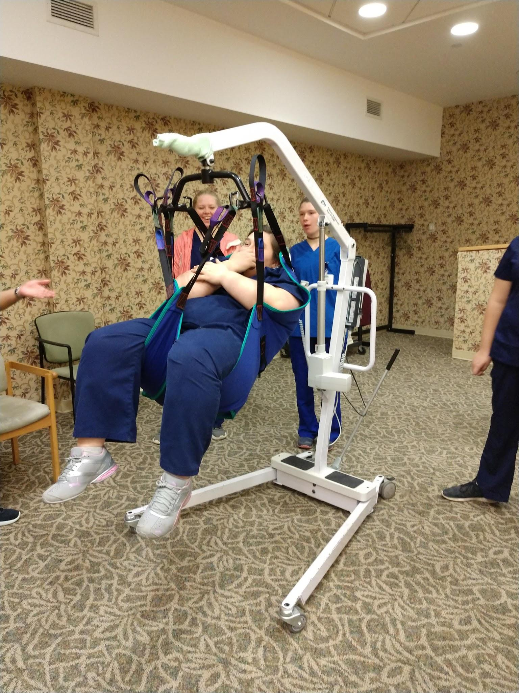
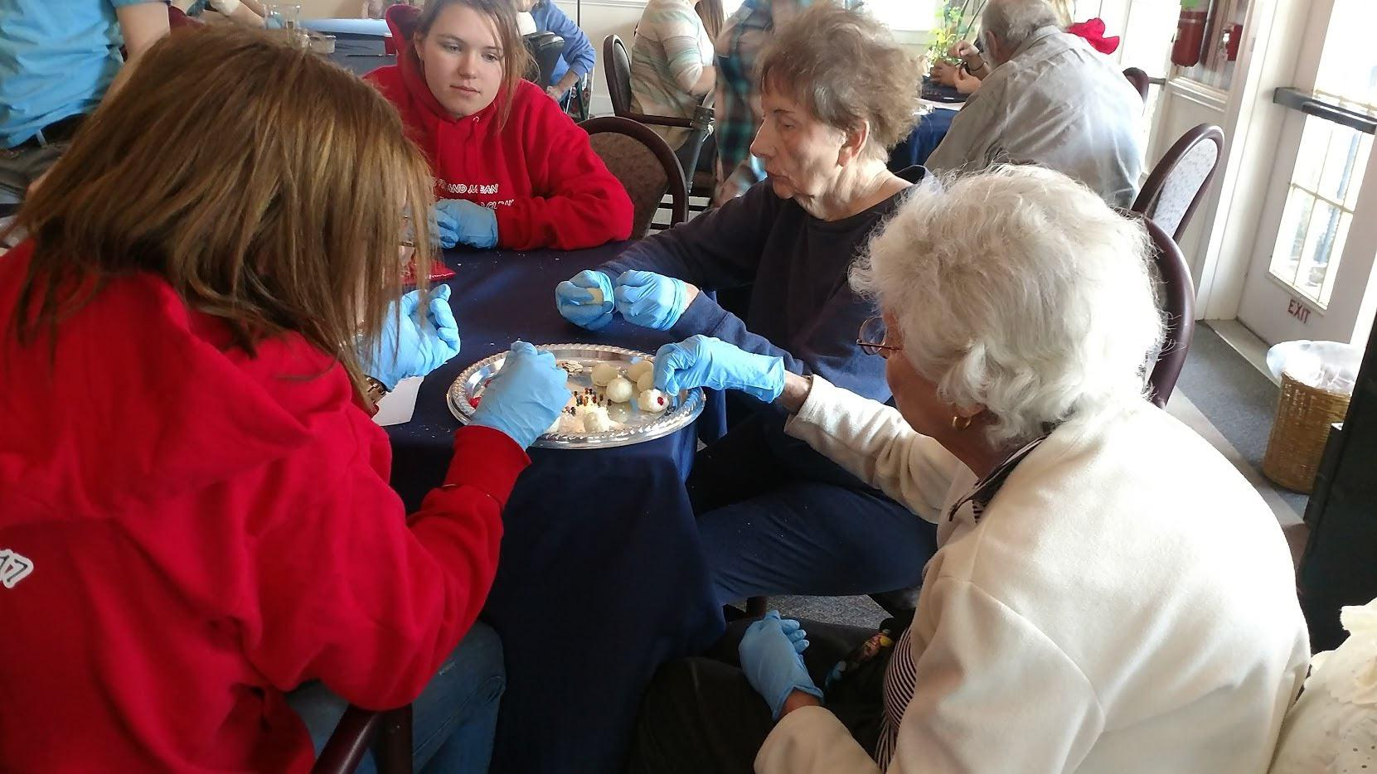
Hands on learning

Slide 8
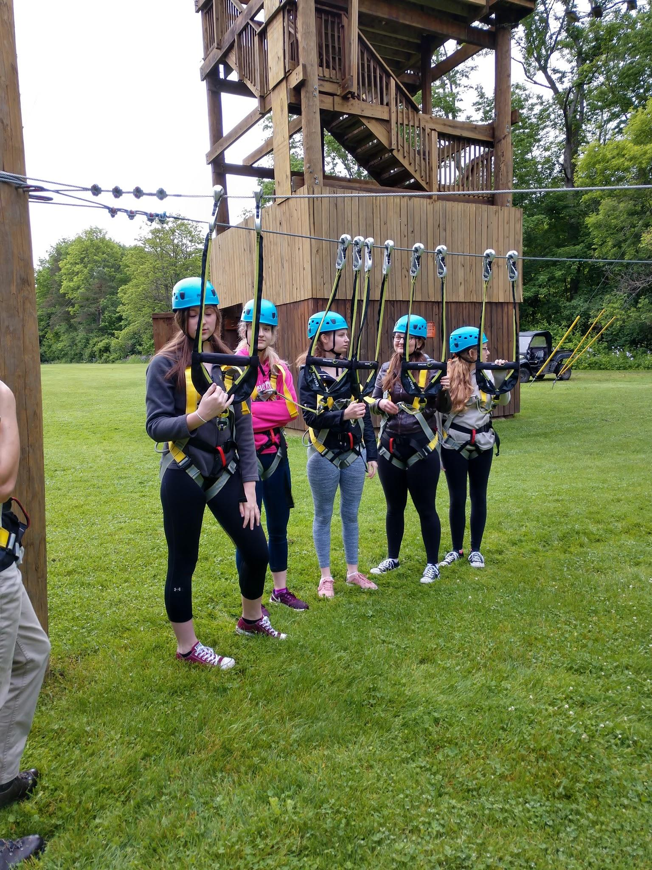
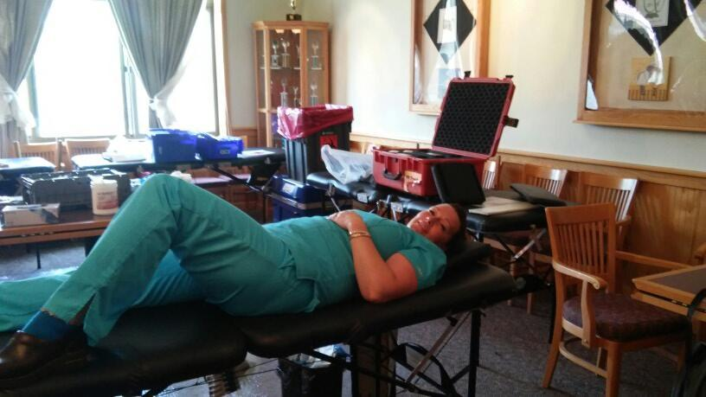
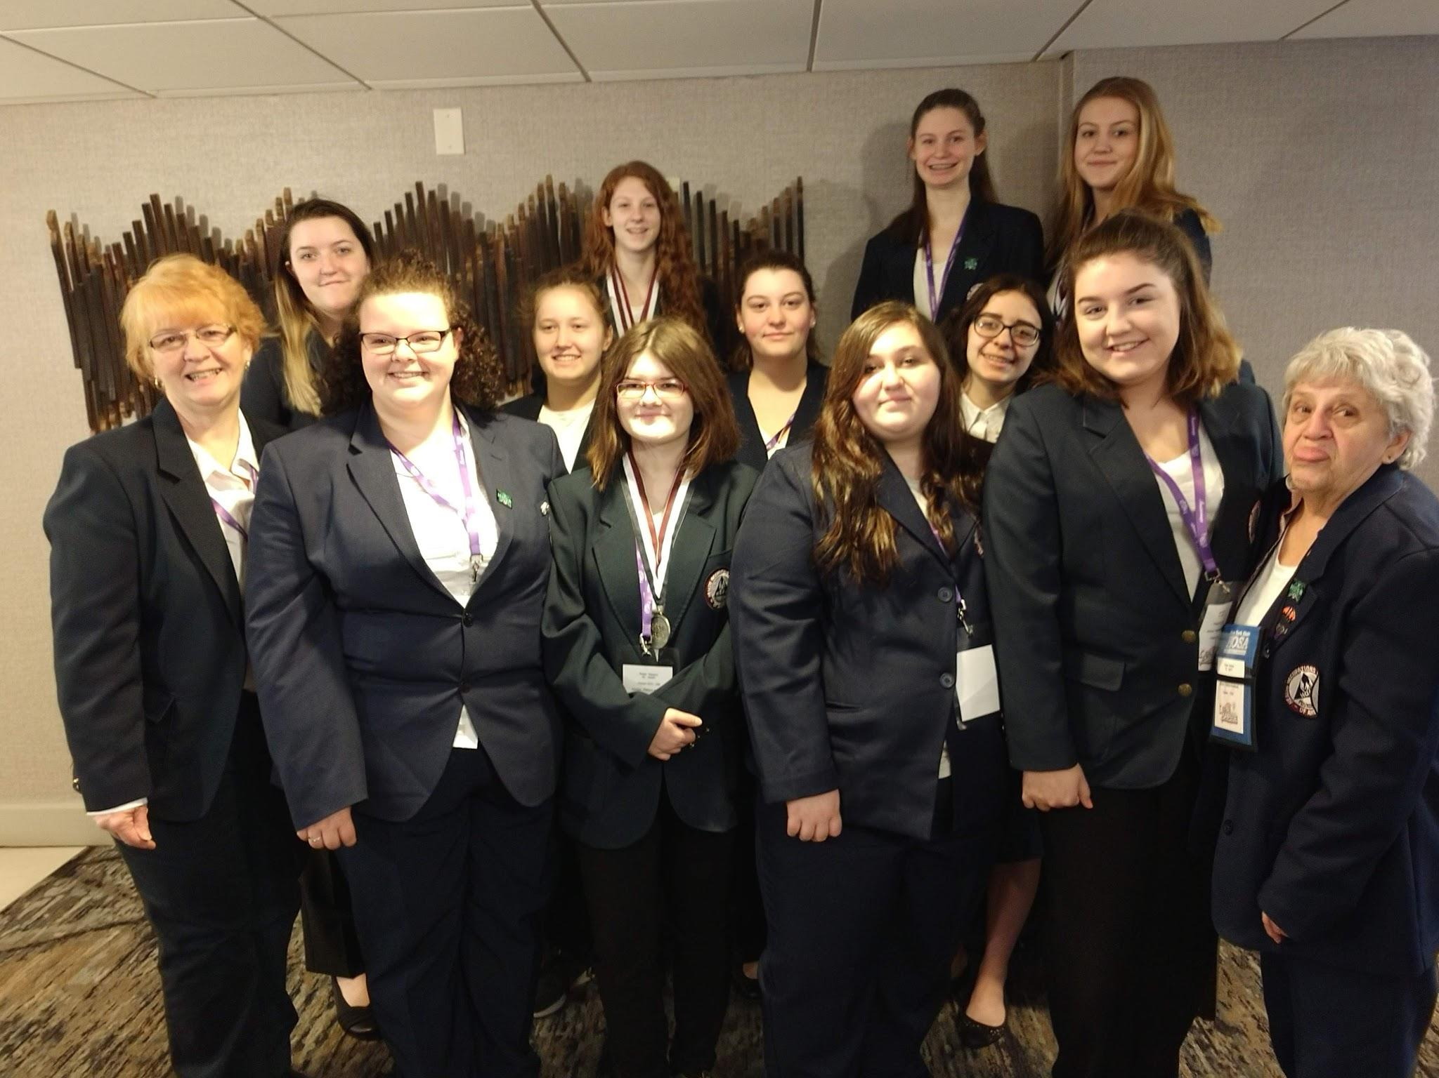
Events
Clarks Gym
Hosa Conference
Blood Drives

Slide 9
Thank you for join us
Please feel free to contact me with any questions. I look forward to seeing you in the next year

