Slide 1
EARLY CARE AND EDUCATION PROVIDER MEETING
October 22, 2024

Slide 2

Agenda
1
2
3
4
Welcome
Science of Reading Resources
Licensing Integration
DCY Program Updates

Slide 3
SCIENCE OF READING GRANTS
Rachael Moore, Project Manager

Slide 4
SCIENCE OF READING Grant - Background
  The Ohio Department of Education and Workforce required the completion of Science of Reading training under Section 265.330(A)(2) of House Bill 33 of the 135th General Assembly. The law awarded $43 million to reimburse school districts and community schools established under Chapter 3314 of Revised Code, and STEM schools established under Chapter 3326 of Revised Code to provide stipends for teachers which completed the training.

Slide 5
SCIENCE OF READING Grant - NEW FUNDING
  The Governor, through the Ohio Department of Children and Youth, is committed to supporting emergent language development and early literacy for wherever children are learning.
    DCY will be launching a parallel grant opportunity for eligible child care centers, family child care homes, and school-age programs.
    Administrators and lead teachers must complete at least 10 hours of Science of Reading Training.
    Approximately $5 million dollars have been made available through the Preschool Development Grant and CCDF Quality.
    Funding is only available until resources are exhausted.
    These trainings may also be used to meet professional development requirements for the revised Step Up To Quality program.

Slide 6
SCIENCE OF READING Grant - Overview and Requirements
Program Requirements | Staff Requirements
Be open and in good standing | Must be listed in the Ohio Professional Registry (OPR) as an Administrator, Lead Teacher, or Family Child Care Owner
Active and serving children | Must complete at least 10 hours of training related to the Science of Reading from an approved lists.
Have an Early Care and Education agreement (previously known as the PFCC Provider Agreement) | Must have the training hours verified in the OPR (that way courses will count towards SUTQ requirement).
Be a Center, Family Child Care Home, or School-Age Program | The administrator must have completed the training in order to receive any funding.

Slide 7
Cox Campus Emergent Literacy Series-INFANT/TODDLER
Level 1: Infant/Toddler Emergent Literacy Aware | Level 2: Infant/Toddler Emergent Literacy Informed | Level 3: Infant/Toddler Emergent Literacy Competent
An Ecosystem Approach to Developing the Foundation for Reading in the Early Years (3.5 hours) ST 10125649 Power of Language: Infants and Toddlers (2 hours) ST 10126795 TALK with ME (3 hours) ST 10126794 | TALK with ME Baby (4 hours) ST 10126791 Rhyme with Me (2.5 hours) ST 10126790 | Read with Me: Part 1 (2.5 hours) ST 10126941 Read with Me: Part 2 (1.5 hours) ST 10126765 Progress Monitoring (3.5 hours) ST 10126763
Notes:
This Slide shows the series for infant and toddler providers. There are three certificate levels available- Emergent Literacy Aware, Emergent Literacy Informed, and Emergent Literacy Complenent. Each one builds upon the previous level, so, for example, you must complete the Level 1 and Level 2 coursework to obtain the Level two certificate.

Slide 8
Cox Campus Emergent Literacy Series-PRESCHOOL
Level 1: Preschool Emergent Literacy Aware | Level 2: Preschool Emergent Literacy Informed | Level 3: Preschool Emergent Literacy Competent
*An Ecosystem Approach to Developing the Foundation for Reading in the Early Years (3.5 hours) ST 10125649 *The Power of Language (2.5 hours) ST 10126793 *Meaningful Conversations (1.5 hours) ST 10126695 *Transforming Story Time (3.5 hours) ST 10126792 | *Building Word Knowledge (2 hours) ST 10126788 Foundations of Learning to Read (5 hours) ST 10126787 *Supporting Dual Language Learners Right from the Start (4 hours) ST 10126786 | Sharing Ideas Through Writing (4.5 hours) ST 10126760 Connecting the Dots for Dual Language Learners Throughout the Preschool Day (2.5 hours) ST 10126755 *Monitoring Children’s Progress in Language & Literacy in the Early Years (3.5 hours) ST 10126763
* Indicates courses in Science of Reading Pathway G (20.5 hours total)
Notes:
This slides shows the same three levels, but this is the series for preschool teachers. You can see that some of the courses are marked with an asterisk to show that they are part of the Department of Education and Workforce Pathway G which meets the Science of Reading Professional Development requirement for preschool teachers in public schools.
(Additional information about how to be sure you receive credit in the OPR for your cox campus courses)
BEFORE completing coursework on Cox Campus:
Create a Cox Campus Account with a profile. Must include your state, Ohio and your OPIN.
See – OCCRRA Support Page
Not all Cox Campus courses are Ohio approved.
Please see OCCRRA's approved training list or Courses Approved on OCCRRA https://coxcampus.org/support/courses-approved-on-occrra/
Upon completing an approved course, credit will be submitted to OCCRRA.

Slide 9

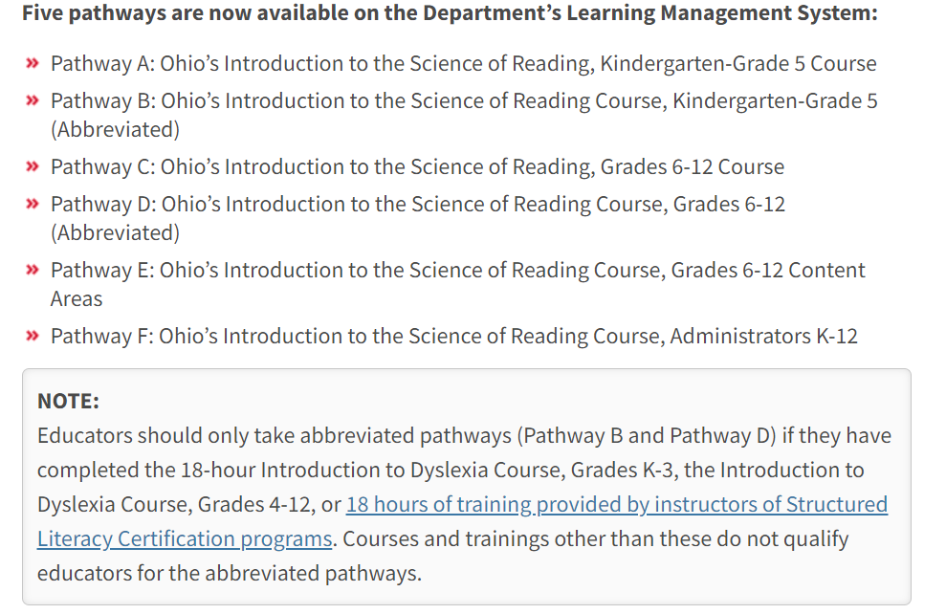
Cox Campus Emergent Literacy Series-School-Age
https://education.ohio.gov/Topics/Learning-in-Ohio/Literacy/The-Science-of-Reading/Professional-Development-in-the-Science-of-Reading
Notes:
This slides shows the same three levels, but this is the series for preschool teachers. You can see that some of the courses are marked with an asterisk to show that they are part of the Department of Education and Workforce Pathway G which meets the Science of Reading Professional Development requirement for preschool teachers in public schools.
(Additional information about how to be sure you receive credit in the OPR for your cox campus courses)
BEFORE completing coursework on Cox Campus:
Create a Cox Campus Account with a profile. Must include your state, Ohio and your OPIN.
See – OCCRRA Support Page
Not all Cox Campus courses are Ohio approved.
Please see OCCRRA's approved training list or Courses Approved on OCCRRA https://coxcampus.org/support/courses-approved-on-occrra/
Upon completing an approved course, credit will be submitted to OCCRRA.

Slide 10
SCIENCE OF READING Grant – GRANT AMOUNTS
Program Type | Payment | Available Awards
Child Care Center | $750 per staff, up to $3,000 | 1,450
School-Age Programs | $750 per staff, up to $3,000 | 25
Family Child Care Homes | $750 for owner/administrator | 1,100

Slide 11
Science of reading grant- application Process
Complete Required Training
Review OPR for appropriate roles and training verification
Submit an application for the grant to DCY
Application Requirements
1. Must have a valid license number and program name and e-mail address matching OCLQS
2. Must have staff names and OPIN that match the OPR
3. Must list completed trainings by individual
Note: This is not a competitive grant with a scoring process. The first applications that meet the criteria will be awarded. If an application is denied, the program may re-apply. Review of the new application will occur in the order it was received regardless of the time/date of the original application.

Slide 12
Science of reading grant - timeline
October
  Announcement of opportunity.
  Guidance letter get published with grant criteria, application process and link.
  Application window opens Tuesday, November 12, 2024.
November
January
  Training must be completed by January 31, 2025 to be considered for the grant.
  Application window closes Friday, February 14, 2025 or until the funding as been exhausted.
February
March
  Final notices are completed.
April
  Payments are issued.

Slide 13
LICENSING INTEGRATION
Laura Graf, Deputy Director
Policy Division

Slide 14
objectives
DO WHAT’S RIGHT FOR KIDS.
1
2
3
Simplify
Avoid Confusion
Ease of Administration
Reduce regulations and red tape for regulated entities
Eliminate programmatic duplication
Embed complimentary program staff with one another to promote efficiency, programmatic improvements, and more seamless service delivery

Slide 15



Approach
Review the current regulatory landscape
Identify existing requirements and review for redundancies and unnecessary restrictions.
Identify how necessary can requirements can be written to improve clarity and compliance.
Propose regulatory changes to:
  Reduce restrictions and red tape
  Simplify language to avoid confusion and improve compliance
  Promote efficiency and programmatic improvements
Engage with shareholders
Review proposed changes with a working group of impacted shareholders.
Take and respond to shareholder feedback.
Draft new regulations
Rescind legacy licensing rules that were transferred to DCY.
Propose new rules based on the recommendations.

Slide 16
Organization | Representative/Attendee(s)
ECAC (Early Childhood Advisory Council) | Todd Barnhouse tbarnhouse@cleverbeeacademy.com
Child Care Advisory Council | Angie Kisor Bridges- akisorbridges@ilcao.org
Ohio Association of Educational Service Centers | Joy Edgell joy.edgell@ovesc.org Sandy Mers sandy.mers@scoesc.org/Sarah Rice Sarah.Rice@scoesc.org
School District Reps | Myla Dodson – mdodson@tps.org Rochelle Wilkerson- rwilkerson8090@columbus.k12.oh.us Karen Lombard- kalombar@daytonpublic.com
Ohio Association of County Boards of Developmental Disabilities | Nancy Stiefel- nstiefel@shelbydd.org Holly Brugh- hbrugh@summitdd.org
Ohio Head Start Directors Association | Amy Joseph - ajoseph@cacfayettecounty.org Wendy Thompson - wthompson@ncstatecollege.edu
Ohio Organizing Collaborative (CEO/Type A) | Dominica Ede- safehavenfcc@yahoo.com Flora White –florawhite1976@icloud.com
Ohio Organizing Collaborative (CEO/Type B) | Rhonda Brown - fycrkb@gmail.com Tawana Dykes – dlaryne@gmail.com
Ohio Association of Child Care Providers | Karen Lampe - klampe@inspirechildren.com Michelle Bieber - michellebieber@gmail.com
Ohio After School Network | Michele Ritchlin - michele@oanohio.org Pam Steurer - steurepa@delawarecityschools.net
Ohio Alliance of YMCAs | Becky Ciminillo - bciminillo@ymcacolumbus.org Heidi Wilson - hwilson@ymcastark.org
Ohio AEYC | Kimberly Tice - ktice@oaeyc.org Dawn Blalock - dawnrblalock@littlemiraclesedc.com
Early Care and Education Stakeholder Roster

Slide 17








plan for Licensing integration
Identify Current Requirements & Regulatory Structure
Hold Requirement Workshops
Draft New Rules & BIAs Based on Workshop Feedback
File Integrated
Licensing Rules
Complete integration
of licensing existing rules
April 15, 2025
SMEs review requirements using review tool
SMEs meet with compliance and systems staff to review findings in tool and develop recommendations
Beginning Jul-2024
Review of each requirement and recommendation with shareholders
Shareholder feedback informs rule organization and drafting
Aug to Jan-2024
Draft rules/BIAs and review with workshop participants
Oct-2024 to Mar-2025

Slide 18
Category-based core rules
Each CATEGORY (ECE, Foster Care, Residential Facilities, SUTQ, and Children Services Licensing Agencies) will each have a set of CORE Rules that apply to ALL types in the category. These core rules represent the minimum requirements an individual/provide must meet to provide care in that category.
Early Care & Education Core Rules
ECE Types:
Foster Home Core Rules
Foster Home Types:
Residential Facilities Core Rules
Residential Facility Types:
School-Age Child Care
Pre-Adoptive Infant Foster Homes
Childrens Residential Center
Preschool
Kinship Foster Homes
Group Homes
Child Care Centers
Family Foster Homes
Children's Crisis Care Facilities
Approved Day Camps
Specialized Foster Homes
Residential Parenting Facility
Type A Homes
Private Nonprofit Therapeutic Wilderness Camp
Type B Homes
Step-Up to Quality Core Rules
Family Prevention Center
In-Home Aides
Children Services Licensing Agencies Core Rules
Scholars Residential Center
Registered Day Camps
Residential Infant Care Center
In addition to core requirements within a given category, effort should be made to standardize requirements across categories, where applicable. Example: Background Checks for ECE & Foster Care Providers and Home Requirements for In-Home Child Care and Foster Homes.

Slide 19
Division and chapter structure
5180:X Licensing and Monitoring
5180:X-1 Requirements for Obtaining and Maintaining an Early Care and Education License or Certificate
5180:X-1-01 Minimum Requirements for Obtaining and Maintaining an Early Care and Education License or Certificate
5180:X-1-02 Additional Requirements for School-Age Child Care Providers
5180:X-1-03 Additional Requirements for Preschools
5180:X-1-04 Additional Requirements for Child Care Centers
5180:X-1-05 Additional Requirements for Registered/Approved Day Camps
5180:X-1-06 Additional Requirements for Type A Homes
5180:X-1-07 Additional Requirements for Type B Homes
5180:X-1-08 Additional Requirements for In-Home Aides

Slide 20
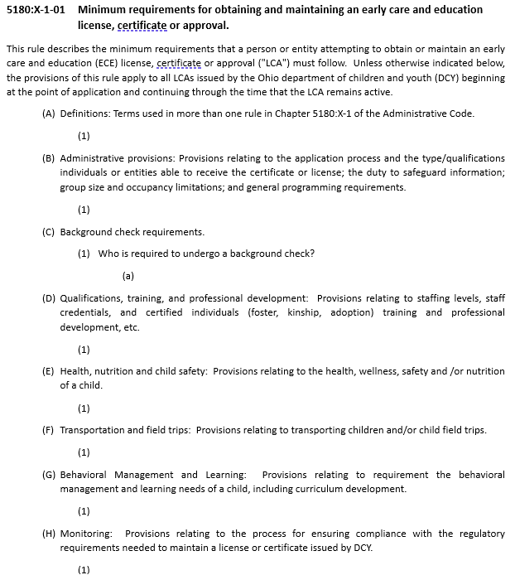
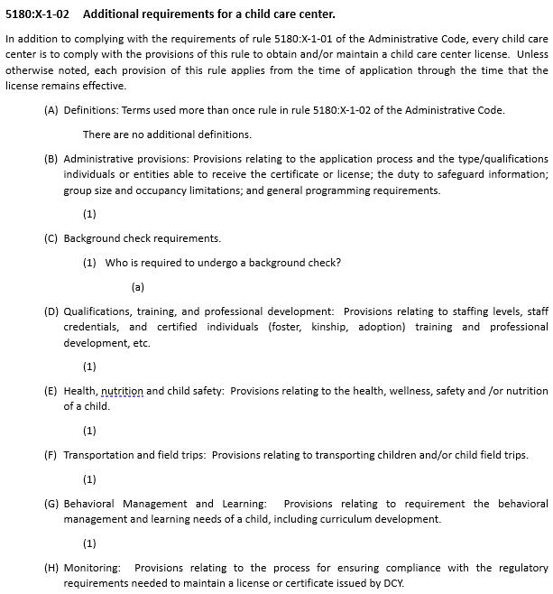
First principle: read the fewest number of rules to get/keep license/Certification/approval
To maintain continuity and a standardized structure, each rule will include a paragraph for each regulatory function. For example, paragraph (C) will always be background checks. Thus, regardless of license type, a reader will always go to (C) to learn their background check requirements. When there are no additional requirements, (as in (D)), the entity is notified that there are no additional requirements (outside the core requirements).

Slide 21
Current order of review
1. Background Checks
2. Definitions
3. Administrative
4. Qualifications, Training and Professional Dev
5. Health, Nutrition and Safety
Definition
Administrative
This requirement relates to background checks required of certain individuals.
This requirement defines a term used in more than one Administrative Code rule.
This is an administrative, procedural or organizational requirement that an individual or entity seeking to obtain or maintain a license or certificate from DCY must follow. This includes, but is not limited to: the application process and the type/qualifications individuals or entities able to receive the certificate or license; the duty to safeguard information; group size and occupancy limitations; and general programming requirements.
This a requirement relates to staffing levels, staff credentials, and certified individuals (foster, kinship, adoption) training and professional development, etc.
This requirement relates to the health, wellness, safety and /or nutrition of a child.
SUTQ
6. Monitoring
7. Behavioral Management and Learning
8. Transportation and Field Trips
9. SUTQ
Monitoring
This requirement relates to the process for ensuring compliance with the regulatory requirements needed to maintain a license or certificate issued by DCY.
This requirement relates to the behavioral management and learning needs of a child, including curriculum development.
This requirement relates to transporting children and/or child field trips.
This requirement relates to the Step-Up to Quality program.

Slide 22
TENTATIVE Early care and education timeline
Activities | 2024 |  |  |  |  |  |  |  |  |  |  |  |  | 2025
 | Oct |  |  |  | Nov |  |  |  | Dec |  |  |  |  | Jan |  |  |  | Feb |  |  |  | Mar |  |  |  |  | Apr |  |  |  | May |  |  |  | June
 | 7 | 14 | 21 | 28 | 4 | 11 | 18 | 25 | 2 | 9 | 16 | 23 | 30 | 6 | 13 | 20 | 27 | 3 | 10 | 17 | 24 | 3 | 10 | 17 | 24 | 31 | 7 | 14 | 21 | 28 | 5 | 12 | 19 | 26 | 2 | 9 | 16 | 23 | 30
Workshop Kickoff
Workshops
Background Check Requirements
Definitions
Administrative Requirements
Qualifications, Training, and Professional Development
Health, Nutrition and Safety
Monitoring
Behavioral Management & Learning
Transportation and Field Trips
Step-Up to Quality
Rule Drafting
Original File On or Before
Rules Become Effective

Slide 23
DCY PROGRAM UPDATES
Alicia Leatherman & Kathy Muehlbauer

Slide 24




Big Goals Overview
4.4 / 1000
REDUCE INFANT MORTALITY RATE
Top 10 in the country, saving an additional 330 babies per year
IMPROVE KINDERGARTEN READINESS
More than 26,000 more children demonstrating Readiness on the KRA
60%
REDUCE RATE OF CHILDREN ENTERING FOSTER SYSTEM
Top 10 in the country, supports families to keep more than 3,300 children in their homes
2 / 1000
Notes:
Goal 1: Reduce Infant Mortality Rate
The Vision
Aim: To be in the top 10 states for infant vitality
Target: Achieve an infant mortality rate of 4.4 deaths per 1,000 live births
Impact: Save an additional 330 babies per year
Goal 2: Improve Kindergarten Readiness
The Vision
Aim: Increase the percentage of children demonstrating readiness on the Kindergarten Readiness Assessment (KRA)
Target: 60% of children demonstrating readiness, up from 36.6%
Impact: More than 26,000 additional children prepared for academic success
Goal 3: Reduce Rate of Children Entering Foster System
The Vision
Aim: To be in the top 10 states for keeping children with their families
Target: Reduce the rate of children entering foster care to 2.0 per 1,000
Impact: Keep more than 3,300 additional children in their homes

Slide 25

IMPROVE KINDERGARTEN READINESS
Aim: Increase the percentage of children demonstrating readiness on the Kindergarten Readiness Assessment (KRA)
Target: 60% of children demonstrating readiness
Impact: More than 26,000 additional children prepared for academic success
Key Data & Recent Wins
The Sparkler app launched September 16, 2024!
567 total ASQ’s completed in September 2024. This is a 44% increase since July/August with 316 (combined) completed screenings.
321 children under three were screened in September 2024. For July and August, a total of 243 screenings were completed. Indicates a 24% increase in utilization
246 children between 3-5 were screened in September and a total of 153 preschoolers were screened in July and August. This means 399 MORE children who would not have been screened if it weren’t for the expansion.
Since July 2024, 132 Children connected to 0-3 programs, and 33 children connected to Preschool Special Education.
44% increase since July/Aug
24% increase in utilization for children 0-3
399 MORE children served
Source: Bright Beginnings Monthly ASQ Report for September 2024
Notes:
The launch of Sparkler this September has dramatically increased our ability to identify and support children who need early intervention services.
In just one month since launch, we've completed 567 developmental screenings - a 44% increase compared to the previous two months combined.
We're reaching more of our youngest learners than ever before, with 321 children under three screened in September alone - representing a 24% increase in utilization for this critical age group.
The expansion to serve preschool-aged children has been tremendously successful, with 246 children ages 3-5 screened in September. This represents nearly 400 children who wouldn't have been screened without this initiative.
Most importantly, these screenings are leading to real support for families - since July, we've connected 132 children to early intervention programs and 33 children to preschool special education services.
Next Steps
First Quarterly Data reports of FY2025 are coming.
Continue to grow provider partnerships with early care and education providers.

Slide 26




SUTQ BY THE NUMBERS
27 Completed Applications Received
20 Ratings Awarded
    Centers (4 Bronze, 2 Silver, 9 Gold)
    Preschools (3 Gold)
    Type Bs (1 Silver, 1 Gold)
6 Ratings Pending Approval
    3 Bronze
    3 Gold
Notes:
The Department of Education and Workforce has many resources available related to the Science of Reading. Here are a few links that provide specific information for early care and education teachers and administrators about emergent literacy. The first is the main Emergent Literacy webpage, which houses early childhood-focused resources including the next two items
First link: https://education.ohio.gov/Topics/Learning-in-Ohio/Literacy/Implementing-Ohio%E2%80%99s-Plan-to-Raise-Literacy-Ach-1/Emergent-Literacy
(second bullet) A Guide for Early Care and Education Leaders, which is available on the link labeled “School Leader’s Implementation Guide, Emergent Readers” This guide is designed support birth through kindergarten-entry early care and early childhood education leaders, programs and school-based teams in their collaborative efforts to analyze language and literacy processes and provide high-quality, evidence-based language and literacy practices.
https://education.ohio.gov/getattachment/Topics/Learning-in-Ohio/Literacy/Implementing-Ohio%E2%80%99s-Plan-to-Raise-Literacy-Ach-1/Emergent-Literacy/B-K-Entry-Implementation-Guide.pdf.aspx?lang=en-US
(Third bullet) The Coc Campus Emergent Literacy Professional Development Series for early care and education teachers, which we have mentioned on this call before. These trainings are Ohio Approved, Free, On-Demand, and have two paths: one for infant and toddler teachers and one for preschool teachers. I will provide more detail including the ST numbers for trainings on the next slides. To begin, enter one of the ST numbers into the Ohio Professional Registry at occrra.org and select the training for more instructions about accessing the courses and obtaining credit through the registry.
Cox Campus link:
https://education.ohio.gov/getattachment/Topics/Learning-in-Ohio/Literacy/Implementing-Ohio%E2%80%99s-Plan-to-Raise-Literacy-Ach-1/Emergent-Literacy/Language-and-Literacy-Professional-Development.pdf.aspx?lang=en-US

Slide 27


Curriculum RFP
There will be a free curriculum available for ALL licensed programs in Ohio that will meet the Step Up To Quality curriculum requirement – This curriculum is:
  Aligned with the Early Learning and Development Standards
  Aligned to the Science of Reading
There will be two RFPs for the following activities:
  Center-based and Family Child Care Curriculum
  Lesson Plan/Implementation Strategies
RFP Released
Curriculum Announced and Available
Curriculum Training and Implementation
July 2024
Fall 2024
(after the start of school year)
Winter 2024-Spring 2025

Slide 28
SAMPLE FORMS- SUTQ
Just a reminder that forms are not required.
However, samples are available on the website for the following items:
    Sample Developmental Screening Referral Process for Step Up To Quality (SUTQ) Silver and Gold Levels (word, pdf)
    Sample Curriculum Selection Process For Step Up To Quality (SUTQ) (word, pdf)
    Sample Continuous Improvement Plan (CIP) For Step Up To Quality (SUTQ) (word, pdf)
    Sample Activity Plan For Step Up To Quality (SUTQ) (word, pdf)
    Sample Classroom / Group Self- Assessment Action Plan For Step Up To Quality (SUTQ) (word, pdf)
    Sample Individual Child Activity Plan For Step Up To Quality (SUTQ) (word, pdf)
Coming soon: Family Needs Survey Tool!
    Child Development and Education
    Child and Family Health
    Financial and Household Support

Slide 29




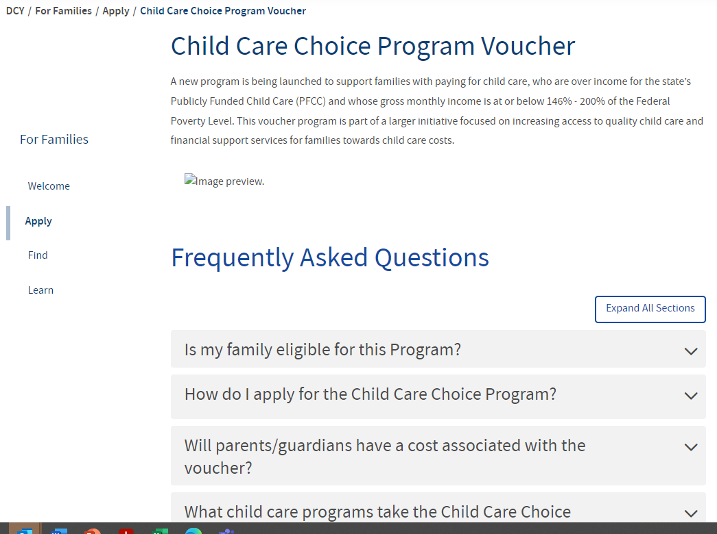
Child care choice voucher program Update
The Child Care Choice Voucher Program launched April 29th to provide child care to families 146- 200% FPL. who are working or attending school.
Key Data
Program Updates
As of September 27, 2024
  Total families: 2,840
  Children by age:
    Infant 724
    Toddler 819
    Preschool 1,285
    School-Age 1,393
    Total 4,221
  Enrollment Payments:
    Received: 4,161
    Complete: 3,843
Recent Wins
Next Steps
Additional FAQ were added to the DCY website.
Determine steps for returning enrollment payments to DCY for children that were never enrolled at the program.
Process enrollment payments.
Continue to monitor children enrolled in the program.

Slide 30
Early Childhood Education grant Update
The Early Childhood Education (ECE) Grant is an important investment in Ohio’s youngest learners. The purpose of the ECE Grant is to maximize a child’s early educational experiences. These experiences help to prepare children for success in kindergarten by providing high-quality early learning services to Ohio’s preschool age children. The state funded ECE Grant is awarded to early care and education programs who are required to provide developmentally appropriate learning environments that address the outcomes and goals essential for healthy development and academic growth.
Program Updates
Recent Wins
Next Steps
Enrollment Survey: DCY is required to collect enrollment information to determine the utilization of slots beginning this month. Grantees who are 75%-100% full will be allowed to receive additional slots or be interested in converting half-day slots to full-day.
Trainings/Targeted Technical Assistance.
To better meet the needs of grantees, DCY will be offering trainings and targeted technical assistance to address the unique situation of each grantee.
Ohio Benefits (OB) has authorized 3,602 ECE applications for enrollment.
On October 1, Families began to apply for eligibility through the Ohio Benefit System.
Grantees have expressed a lot of interest in the full day options for families.
Key Data
ECE Grant- 563 early care and education programs (grantees) are participating in the ECE grant.
1,170 slots have been returned.

Slide 31
2024 Changes for Early care and education income eligibility
Effective 10/1/2024 new eligibility income amounts for families receiving publicly funded child care (PFCC) and Child Care Choice Program (CCCP).
Child Care Manual Procedure Letter No. 182
Child Care Center Manual Procedure Letter No. XX
Family Child Care Manual Procedure Letter No. XX

Slide 32
Examples: PFCC Intake application
Before 10/1/2024 | On or After 10/1/2024
Family: Parent and two children in need of care Employment: Joann Fabrics Pay Rate: $17.50/hr @ 40hr/wk Income: $700 wk Family Monthly Income: $3,010 Max Monthly Income Limit for Initial PFCC Eligibility for a Family of 3: $3,004 Result: Over income for PFCC* *Provider will receive payment for days the children attended from application date to application denial + 5 days | Family: Parent and two children in need of care Employment: Joann Fabrics Pay Rate: $17.50/hr @ 40hr/wk Income: $700 wk Family Monthly Income: $3,010 Max Monthly Income Limit for Initial PFCC Eligibility for a Family of 3: $3,120 Result: Eligible for PFCC Weekly Copay: $60.92

Slide 33
Examples: CCCP Intake application
Before 10/1/2024 | On or After 10/1/2024
Family: Parent and two children in need of care Employment: Kettering Health Nursing Pay Rate: $25/hr @ 40hr/wk Income: $1000 wk Family Monthly Income: $4,300 Max Monthly Income Limit for Initial CCCP Eligibility for a Family of 3: $4,144 Result: Over income for CCCP* *Provider will receive payment for days the children attended from application date to application denial + 5 days | Family: Parent and two children in need of care Employment: Kettering Health Nursing Pay Rate: $25/hr @ 40hr/wk Income: $1000 wk Family Monthly Income: $4,300 Max Monthly Income Limit for Initial CCCP Eligibility for a Family of 3: $4,304 Result: Eligible for CCCP Weekly Copay: Determined by program

Slide 34
Changes to the Provider agreement
New title "Provider Agreement for Early Care and Education Services".
Updated to include Early Childhood Education grant language.
Programs with a current provider agreement on file will not be required to sign a new agreement.
Any early care and education program signing an agreement on or after 9/30/2024 will sign the updated agreement.

Slide 35
Changes to the dCY 01115 Early Care and Education Services Release of Information
The consent language in the release of information was revised to reflect additional early care and education programs.
Families with a current release of information for a specific provider on file will not be required to submit a new release for the same provider.
Child Care Manual Procedure Letter No. 183

Slide 36
THANK YOU!
Next Call: November 26, 2024
2:00pm-3:00pm

