Slide 1
EARLY CARE AND EDUCATION PROVIDER MEETING
September 24, 2024

Slide 2
AGENDA
1
2
3
4
5
Welcome
ASQ Expansion/Sparkler App
Infant and Early Childhood Mental Health
Step Up To Quality Updates
Child Care Funding Updates

Slide 3
BIG GOALS OVERVIEW
4.4 / 1000
REDUCE INFANT MORTALITY RATE Top 10 in the country, saving an additional 330 babies per year
60%
IMPROVE KINDERGARTEN READINESS More than 26,000 more children demonstrating Readiness on the KRA
REDUCE RATE OF CHILDREN ENTERING FOSTER SYSTEM Top 10 in the country, supports families to keep more than 3,300 children in their homes
2 / 1000
Notes:
Talking Points:
4.4/1,000 down from 7.1 - TOP 10
For Ohio to be a top 10 state for infant vitality it would need to achieve an infant mortality rate of 4.4 deaths per 1,000 live births or a 37% reduction from its current mortality rate
60% up from 36.6% - bring all counties to the 99th percentile
112,000 children took the KRA in 23/24 school year – 60% would increase the number of children demonstrating by more than 26,000
2.0 per 1,000 for children services – TOP 10
Current 3.3 per 1000 in children entering foster care

Slide 4
ASQ EXPANSION/SPARKLER APP
Bright Beginnings

Slide 5
OHIO’S ASQ ONLINE EXPANSION (BEGAN JULY 1, 2024)
ASQ-3 and ASQ:SE-2 screening available for Ohio children birth through age 5
Ongoing monitoring of growth and developmental progress
ASQ-3 and ASQ:SE-2 screening available in English, Spanish, Chinese, French and Arabic
Notes:
Ohio expanded it’s ASQ services on July 1.This expansion…
Increased the age availability from B-3 to B to age 5 for all Ohio children and providers serving children B through age 5
Provides ongoing monitoring of growth and developmental progress. Helpful reminders occur through push notifications on the Sparkler family app. Parents receive a reminder message when it is time to complete their child’s next age-interval screening. Providers can view screenings that are due directly from their dashboard. This monitoring piece can improve child outcomes by tracking each child’s developmental growth over time.
The final expansion component was to increase access to the screening by offering them is a variety of languages. The ASQ-3 and ASQ:SE-2 screenings are now available in English, Spanish, Chinese, French and Arabic

Slide 6
WHAT ARE ASQ-3 AND ASQ:SE-2?
Parent- or caregiver-completed screening tools that encourage parent/caregiver involvement
Series of questionnaires for children ages 1 month to 5½ years (ASQ-3) and 6 years (ASQ:SE-2)
Tools to accurately identify children at risk for developmental or social-emotional delay
Tools to educate adults about child development and guide developmental promotion
Screening tools (including the ASQs) are not appropriate for use with children on an IFSP or IEP
Notes:
The ASQ is a formal research-based instrument that asks questions about a child’s development, including language, motor, cognitive, social, and emotional development.
The questionnaires can be used with children as young as 1 month. They are currently available using Ohio’s ASQ Online for birth through age 5.

Slide 7
PURPOSE OF DEVELOPMENTAL SCREENING
Provide a quick check of child’s development to make sure they are developing on-schedule
Identify strengths and learn whether there are any concerns
Uncover new milestones to celebrate
May identify children who would benefit from practice/support in specific areas
Identify children at risk for developmental delays (DD) who should be referred for further evaluation
Answer the question: Does the child need an in-depth assessment?
Notes:
Ohio offers all families and providers of young children birth through age five the Ages and Stages Questionnaires through the Sparkler platform. These developmental screening tools can be used to:
I do want to point out, that the ASQ should not be used with children who are receiving early intervention or preschool special education. Those children have already been identified and would not benefit from developmental screening. They have already received an in-depth assessment. This is an important exemption for providers who are participating in Ohio’s SUTQ to keep in mind.

Slide 8
SHOULD EVERY CHILD IN MY PROGRAM BE SCREENED?
No! Screening a child is not necessary if:
A child was recently screened by another agency/professional
A child is receiving Early Intervention/Early Childhood Special Education services
A parent does not choose to participate in screening
Notes:
Ask parents/caregivers for permission to view the completed screening results
Ask parents/caregivers for permission to view the child’s IFSP/IEP. Knowing a child’s goals is essential to assisting and enhancing a child’s developmental progress
It is important to develop a supportive, trusting relationship with parents/caregivers. Doing so requires respecting their decisions. In time, it may be appropriate to ask parents/caregivers again to allow their child to be screened.

Slide 9
Notes:
Sparkler is a platform that will make using expanded ASQ Online services even easier for both families and providers. This tool is live as of Monday, September 16th!

Slide 10
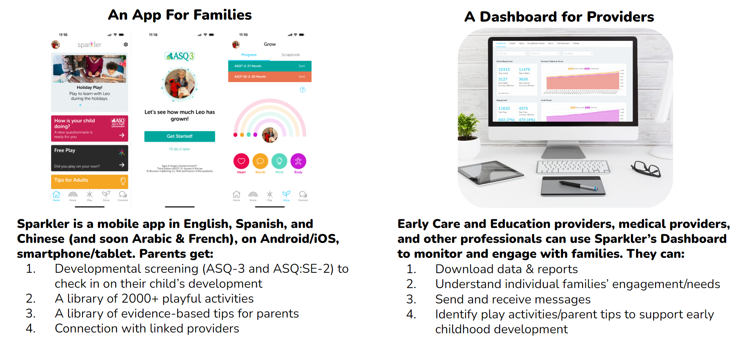
THE SPARKLER EXPERIENCE
Notes:
For families, the Sparkler: Play for Parenting app makes it easy to complete the free ASQ with their child using a mobile device. The app also offers activities to encourage a child's developmental growth.
For providers, signing up to become a program partner provides access to a Sparkler dashboard. With parental consent, the dashboard allows for viewing ASQs completed by families or completing ASQs of children in your care.

Slide 11
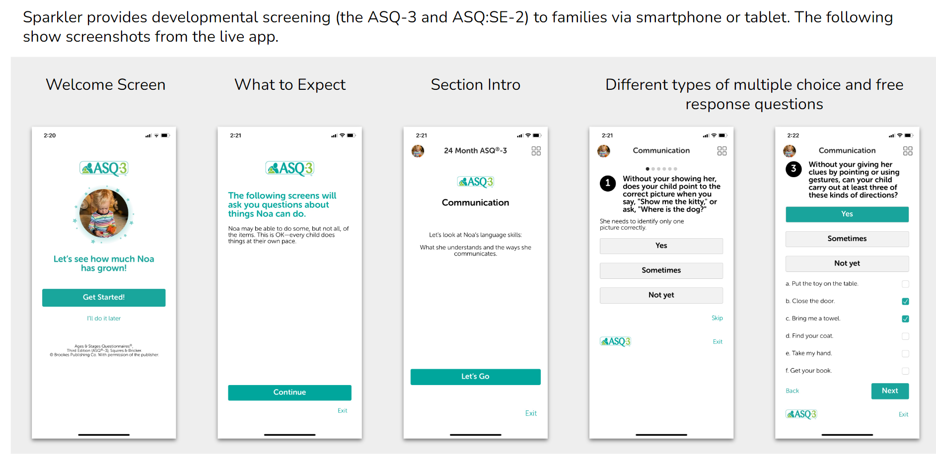
SPARKLER’S DEVELOPMENTAL SCREENING FUNCTIONALITY

Slide 12
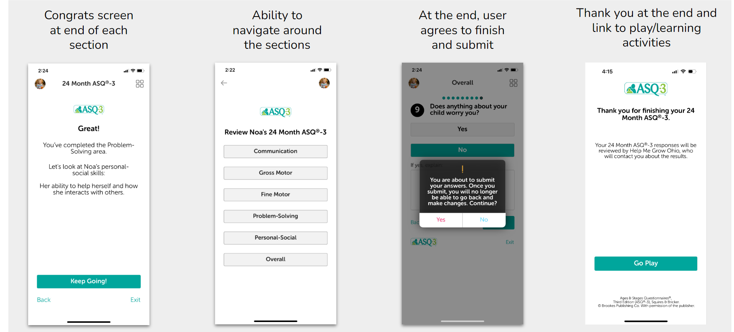
MOBILE ASQ-3, CONTINUED

Slide 13
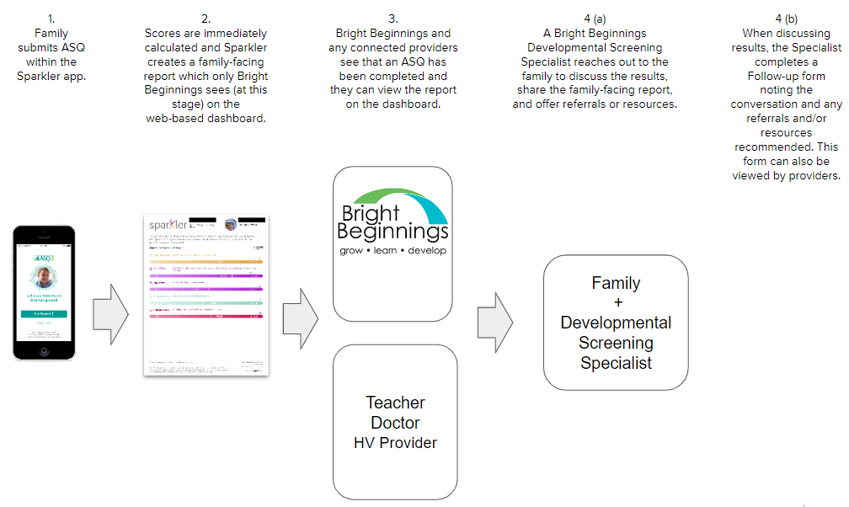
WHAT HAPPENS WHEN A FAMILY TAKES AN ASQ?
Notes:
Let’s look at what happens after a parent completes a screening. Once they answer all questions and press “Submit,” the ASQ is automatically scored. A family-facing report is generated and the screening results are sent to the Sparkler dashboard that BB and any providers connected with the family has access to. The parent will receive a coaching message through Sparkler that the results have been received and to respond with a day/time that would be convenient for them to receive a phone call to discuss the results. Then a BB Developmental Screening Specialist will reach out to share the family-facing report and discuss results of the screening. If necessary, they will help connect the family with additional supports such as EI or HV or local resources through our CRD. During the call, a Follow-up Summary form is completed. All providers are able to view this form and any notes within the form. Families then continue playing and learning within the app. They will receive tickler reminders when the next age-interval ASQ is ready to be completed.

Slide 14
BENEFITS FOR PROVIDERS USING OHIO’S ASQ ONLINE SERVICE
Cost effective and free to use for Ohio’s providers and caregivers
Immediate access to screening results and customizable reports that can increase partnerships with parents/caregivers.
Meets the developmental screening requirement of Ohio’s revised Learning & Development quality rating standard (ECE)
Increases communication with parents
Improved child outcomes with ongoing monitoring
Notes:
There are many benefits to using Ohio’s ASQ platform and we hope that your program decides to become a Sparkler Partner Program!

Slide 15
SPARKLER SUPPORT FOR PROVIDERS
How to videos, FAQs and other helpful resources at www.helpmegrow/ASQproviders
1:1 Sparkler Set-up and Implementation sessions https://calendly.com/jbabcock-brightbeginningskids/getting-started-ohio-s-asq-online-sparkler-dashboard
ASQ Open Office Hours every Wednesday at 1:30pm https://us02web.zoom.us/meeting/register/tJ0rdOyhqjMsGNVrR9vqmnrix4_6cOKAj8dv
Email questions to asq@helpmegrow.org
Notes:
We have a variety of supports available for providers to ensure utilizing Sparkler and the ASQ is easy for both families and providers.
Once Sparkler is launched next week, you will find a wealth of information and helpful resources on our Help Me Grow website. We have created an ASQ page just for providers. You can access the page using the URL or QR code shown on your screen now.
After completing the Program Partner form and setting up your account, you can schedule a 1:1 session for your program to assist you in getting started with the Sparkler dashboard and viewing ASQs. If you need training on the ASQ tools, please contact your local Childcare Resource and Referral agency or your State Support team.
If you have general questions about Ohio's ASQ Online service and/or the Sparkler dashboard, you can join me every Wednesday at 1:30pm for open office hours. Drop in to ask a question, hear implementation ideas from others professionals or share your ASQ success story.
Finally, you can email us at asq@helpmegrow.org

Slide 16
INFANT AND EARLY CHILDHOOD MENTAL HEALTH CONSULTATION

Slide 17
INFANT AND EARLY CHILDHOOD MENTAL HEALTH CONSULTATION
What is IECMHC?
IECMHC is a prevention-based approach that pairs a mental health consultant with adults who work with infants and young children in the different settings where they learn and grow.
IECMHC is NOT
Mental health consultation is not about “fixing kids.”
It is not therapy.
Mental health consultation equips teachers/caregivers to facilitate children’s healthy social and emotional development.
Adapted from Georgetown COE for Infant & Early Childhood Mental Health Consultation
Notes:
Infant and Early Childhood Mental Health Consultation is a prevention based approach that pairs a mental health consultant with adults who work with infants and young children in the different settings where they learn and grow. Mental health consultation isn’t about fixing kids. It isn’t therapy. The goal of mental health consultation is to provide supports before a child is labeled or diagnosed. A coalition of the nation's leading experts in pediatric health has issued an urgent warning declaring the mental health crisis among children so dire that it has become a national emergency.

Slide 18
IECMH CONSULTANTS
IECMH Consultants are highly trained licensed professionals with knowledge in:
Child development
The effects of stress and trauma on families
The important of attachment for young children
The impact of adult mental health on developing children
The ability to work in diverse early childhood programs or other settings
Accessing local mental health treatment when deemed appropriate
Mental health practices and psychological concepts related to adult functioning
Notes:
Infant and early childhood mental health consultants are highly trained professionals with a vast array of knowledge. They are trained in child development, the impact of trauma and stress on families, the impact of adult/parental mental health on developing children. They also have advanced training in working with diverse early childhood programs and settings and take into consideration cultural and community factors affecting young children. Mental health consultants also collaborate with various other community agencies to help children and families receive mental health treatment when indicated. They are also specialized in mental health practices for children, families and psychological concepts related to adults and adult functioning, among many other specialized topics.

Slide 19
SERVICES PROVIDED BY IECMH CONSULTANTS
Services Provided
Consultation to a whole program, classroom, or child/family
Resources for staff wellness/family wellness
S/E screenings and assessments
Classroom tools to increase social emotional outcomes for young children
Referrals to mental health treatment for children/adults
Meetings with educators and families regarding social emotional needs of children
Intervention planning and implementation
Individual or group adult resilience surveys/plans
Crisis management resources/planning
Trauma Information
Professional development opportunities
Notes:
There are three types of consultative services provided by IECMH consultants. Consultation can be provided to an entire program—this may be needed for a number of reasons, including but not limited to community trauma, high staff turnover rates, or administrative turnover. If consultation is requested for many classrooms in the same program, this might also be indicative of a need for programmatic consultation. Classroom consultation benefits all children in the classroom as noted by multiple studies. When multiple children in a classroom are having difficulties, or the early educators are facing challenges, classroom consultation is warranted. Consultation in this model provides support and services to the adults working in a classroom with the consultation being focused on helping the entire group of children and the adults in their lives. Child/family focused consultation is for a child who may be having difficulty for any number of reasons; trauma, health related issues, extreme poverty, caregivers with substance use disorder, etc. This focused consultation aims to bring the educators, administration, and family together to gain strategies and attain resources to best help the child excel. In addition to the different types of programmatic consultation just discussed, IECMH consultants can also provide resources for both early education staff and families regarding wellness, conduct S?E screenings and assessments, provide classroom tools focused on positive social emotional outcomes, referrals to mental health treatment, when appropriate. Consultants also take part in meetings with families and early educators, provide intervention planning and implementation, and provide adult resilience surveys and planning. In the event of a trauma impacted the staff, children, or community an early care and education site is located, consultants can also assist in crisis management, resources, and response. Consultants can also provide or link you to a trainer and trainings on social emotional development that are Ohio approved, free of charge, and facilitated by a mental health specialist.

Slide 20
WHY IT MATTERS FOR CHILDREN
Between 10-16% of young children experience mental health conditions including PTSD and anxiety.
For babies in poverty, that number increases to 22%.
Each dollar invested in infant and early childhood mental health programming returns $3.64 back in prevented treatments later in life.
1
2
3
Think Babies. (2022). Infant and early childhood mental health. Centers for Disease Control and Prevention (2022, June 3). Data and statistics on children’s mental health.
Notes:
Over the past few years, and particularly since the Covid 19 Pandemic, young children are facing increased mental health conditions including PTSD and anxiety. For babies and young children living in poverty, that number is even higher at 22%. Children who have mental health conditions or poor social emotional skills that are not attended to become adults with unattended mental health disorders. Studies show that for every dollar invested in early childhood mental health programming, there is a return on investment of $3.64 in prevented treatments later in life.

Slide 21
WHY IT MATTERS FOR ADULTS
When caretakers of children are struggling, children are negatively impacted.
25% of early educators report signs of clinical depression
It takes a healthy village to raise a healthy child.
-Nefertiti Poyner
18% to 35% of parents report clinical signs of depression
Notes:
We also know that mental health affects adults in a significant manner. Up to 25% of early educators report signs of clinical depression (some studies after covid indicated up to 63%). Maternal and paternal rates of depression span between 18% and 35%. When the adults that shape the lives of young children are unwell, it is more likely that children will also be unwell. Adults are more punitive when they are overwhelmed and less able to connect with children when they need it most, this can negatively impact a child’s ability to typically and appropriately function later in life. The good news, however, is that science shows that children who do well despite serious hardships in their life have had at least one stable and committed relationship with a supportive adult. These relationships buffer children from developmental disruption and help them develop “resilience”—the skills needed to respond to adversity and thrive. When we ensure that adults are healthy, we are also taking the biggest and best steps to ensure that children are healthy. Healthy children are more likely to grow up to be healthy adults.

Slide 22
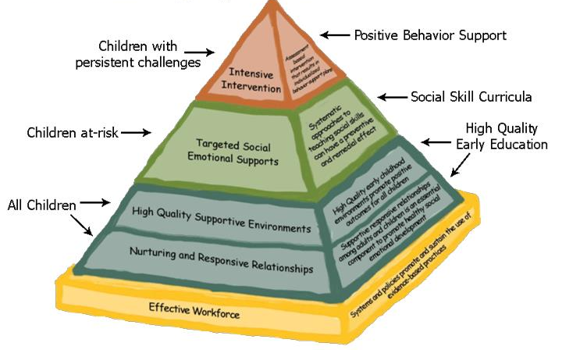
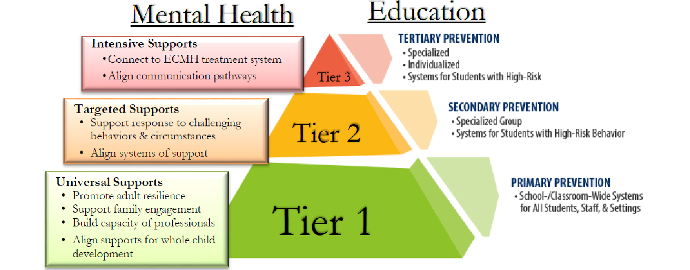
WHERE CAN YOU FIND IECMH CONSULTANTS
Behavioral Health Organizations
State Support Team Regions
Child Care Resource & Referral Service Delivery Areas
Serving on Early Intervention Teams
The Ohio Preschool Expulsion Prevention Partnership
Notes:
Over the past few years, and particularly since the Covid 19 Pandemic, young children are facing increased mental health conditions including PTSD and anxiety. For babies and young children living in poverty, that number is even higher at 22%. Children who have mental health conditions or poor social emotional skills that are not attended to become adults with unattended mental health disorders. Studies show that for every dollar invested in early childhood mental health programming, there is a return on investment of $3.64 in prevented treatments later in life.
In Behavioral Health Organizations around Ohio
In each State Support Team Region (1 FTE per SST)
In each Child Care Resource & Referral Service Delivery Area (1/2 FTE per SDA)
Serving on Early Intervention Teams and assisting in EI Evaluation & Assessment
By calling the Ohio Preschool Expulsion Prevention Partnership—see next slide

Slide 23
OHIO PRESCHOOL EXPULSION PREVENTION PARTNERSHIP (OPEPP)
What is OPEPP?
The Ohio Preschool Expulsion Prevention Partnership is a free, statewide program that aims to reduce the rate of expulsions in preschool age children. This is a rapid response model to assist Ohio’s Early Education Programs (private, public, home based) in retaining our youngest children in care.
OPEPP aims to provide support for the following challenges:
Lack of policies & processes for suspension & expulsion in early education settings
Negative trajectory associated with denied educational and social opportunities
Academic failure associated with expulsion in early education
Pre-school to prison pipeline
1-844-678-2227
Notes:
Partnership-The Ohio Preschool Expulsion Prevention Partnership is a free, statewide program that aims to reduce the rate of expulsions in preschool age children. This is a rapid response model to assist Ohio’s Early Education Programs (private, public, home based) in retaining our youngest children in care.
This FREE resource is available for:
Any licensed preschool or family child care provider licensed by Ohio Department of Job and Family Services (ODJFS) or Ohio Department of Education (ODE)
Head Start programs
Private preschools
Caregivers can also access program—just let the early care and education site know that you would like to have a consultation for your child.
The Ohio Preschool Expulsion Prevention Partnership will:
Come to a program site to provide support within 48 hours of request
Provide tools and resources for providers on ways to manage challenging behaviors through observation, modeling specific strategies and information on specific topics
Link you to helpful, free Ohio Approved Trainings
Early care & education providers are stressed & in need of supports/resources
Child is suspended or expelled, parents are asked to pick up early or told child is not a good “fit”
Child is denied educational & social emotional opportunities=negative trajectory
Negative trajectory continues
Child is more likely to experience later academic failure, become disengaged, or dropout
As an adult, there is a greater likelihood of incarceration

Slide 24
IECMH TRAINING INSTITUTE
IECMH Master Trainers are specialized professionals who are trained in national, evidence-based models:
Every county in the state is covered in the Master Trainer Service Areas
Trainings are FREE, onsite or virtual and can be found on the Ohio Professional Registry—quarterly calendar can be found under Infant Mental Health and Early Childhood Mental Health on the “credentials” tab
In addition to early learning professionals, Master Trainers provide specialized training to the IECMH licensed workforce.
Fulton
Lucas
Lake
Ashtabula
Williams
Ottawa
Geauga
Defiance
Henry
Wood
Sandusky
Erie
Cuyahoga
Trumbull
Lorain
Portage
Paulding
Seneca
Huron
Medina
Summit
Putnam
Hancock
Mahoning
Van Wert
Wyandot
Crawford
Ashland
Wayne
Stark
Columbiana
Allen
Richland
Hardin
Carroll
Mercer
Auglaize
Marion
Morrow
Holmes
Logan
Knox
Tuscarawas
Jefferson
Shelby
Union
Delaware
Coshocton
Harrison
Darke
Champaign
Licking
Miami
Muskingum
Guernsey
Belmont
Clark
Madison
Franklin
Preble
Montgomery
Greene
Fairfield
Noble
Monroe
Fayette
Pickaway
Perry
Morgan
Butler
Warren
Clinton
Hocking
Washington
Ross
Vinton
Athens
Hamilton
Highland
Clermont
Pike
Jackson
Meigs
Brown
Adams
Scioto
Gallia
Lawrence
Physical location of an IECMH Master Trainer
Notes:
Ohio’s ECMH Training Institute is designed to share best practices with the field and provide professional development opportunities to early childhood mental health (ECMH) professionals seeking the Ohio ECMH Credential. The purpose and goal of the training institute is to prepare ECMH professionals to deliver quality service to early learning centers and families; and to ensure providers have competency in the six domains of ECMH: Social and Emotional Growth and Development, Family and Community Relations, Assessment, Interventions, Professional Development, Cultural and Linguistic Competency. The Ohio Department of Mental Health and Addiction Services (OhioMHAS) serves as the sponsoring body for the Infant Early Childhood Mental Health (IECMH) Credentials. OhioMHAS is a partner agency in Governor DeWine’s Children’s Initiative. The Ohio Child Care Resource and Referral Association (OCCRRA) manages the IECMH provider’s profile, processes applications for all Ohio’s early childhood credentials through the Ohio Professional Registry and hosts Ohio Approved (OA) Training data.
The Master Trainer Role
Ohio Department of Mental Health and Addiction Services Bureau of Children, Youth and Families provides funding for up to seven master trainers to provide statewide training and technical assistance to infant and early childhood mental health counselors and consultants. The goal is to get the “right care, to the right children, at the right time” early enough to make the difference in their education and future success by deploying Ohio’s experts in infant and early childhood mental health to reduce and eliminate preschool to kindergarten expulsions. The position is designed to increase capacity of Infant and Early Childhood Mental Health Professionals statewide to provide rapid response to early learning settings when parents, teachers or program directors have a need for help to stabilize a student’s emotional or behavioral classroom adjustment.

Slide 25
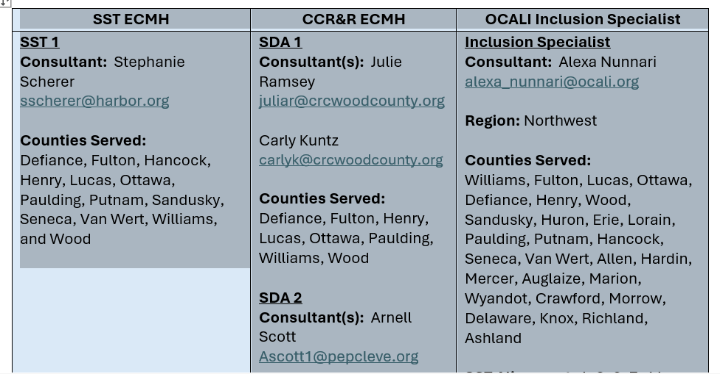
HOW TO ACCESS AN IECMH CONSULTANT IN YOUR REGION
You can find an IECMH consultant in your region by reaching out to:
Your local CCCR&R
Your local State Support Team
Or by contacting the Ohio Preschool Expulsion Prevention Partnership
A regional alignment document with contact information will be provided with the slide deck from this meeting.
Notes:
Infant and early childhood mental health consultants can be found in local behavioral health organizations in your region as well as in your local Child Care Resource and Referral Agency, your local state support team, or by contacting the Ohio Preschool Expulsion Prevention Partnership which I will discuss in more detail on the next slide.

Slide 26
THANK YOU!
For more information, contact Misty Cole
Misty.Cole@childrenandyouth.ohio.gov

Slide 27
STEP UP TO QUALITY UPDATES
Sophie Hubbell

Slide 28
SUTQ BY THE NUMBERS
11 Completed Applications Received
7 Ratings Awarded
3 Bronze
4 Gold
4 Ratings Pending Approval
1 Bronze
3 Gold
Notes:
The Department of Education and Workforce has many resources available related to the Science of Reading. Here are a few links that provide specific information for early care and education teachers and administrators about emergent literacy. The first is the main Emergent Literacy webpage, which houses early childhood-focused resources including the next two items
First link: https://education.ohio.gov/Topics/Learning-in-Ohio/Literacy/Implementing-Ohio%E2%80%99s-Plan-to-Raise-Literacy-Ach-1/Emergent-Literacy
(second bullet) A Guide for Early Care and Education Leaders, which is available on the link labeled “School Leader’s Implementation Guide, Emergent Readers” This guide is designed support birth through kindergarten-entry early care and early childhood education leaders, programs and school-based teams in their collaborative efforts to analyze language and literacy processes and provide high-quality, evidence-based language and literacy practices.
https://education.ohio.gov/getattachment/Topics/Learning-in-Ohio/Literacy/Implementing-Ohio%E2%80%99s-Plan-to-Raise-Literacy-Ach-1/Emergent-Literacy/B-K-Entry-Implementation-Guide.pdf.aspx?lang=en-US
(Third bullet) The Coc Campus Emergent Literacy Professional Development Series for early care and education teachers, which we have mentioned on this call before. These trainings are Ohio Approved, Free, On-Demand, and have two paths: one for infant and toddler teachers and one for preschool teachers. I will provide more detail including the ST numbers for trainings on the next slides. To begin, enter one of the ST numbers into the Ohio Professional Registry at occrra.org and select the training for more instructions about accessing the courses and obtaining credit through the registry.
Cox Campus link:
https://education.ohio.gov/getattachment/Topics/Learning-in-Ohio/Literacy/Implementing-Ohio%E2%80%99s-Plan-to-Raise-Literacy-Ach-1/Emergent-Literacy/Language-and-Literacy-Professional-Development.pdf.aspx?lang=en-US

Slide 29
CURRICULUM RFP
There will be a free curriculum available for ALL licensed programs in Ohio that will meet the Step Up To Quality curriculum requirement – This curriculum is:
Aligned with the Early Learning and Development Standards
Aligned to the Science of Reading
There will be two RFPs for the following activities:
Center-based and Family Child Care Curriculum
Lesson Plan/Implementation Strategies
RFP Released
Curriculum Announced and Available
Curriculum Training and Implementation
July 2024
Fall 2024 (after the start of school year)
Winter 2024-Spring 2025

Slide 30
SCIENCE OF READING RESOURCES
Department of Education and Workforce
Implementing Ohio’s Plan to Raise Literacy Achievement: A Guide for Early Care and Education Leaders
Emergent Literacy: Supporting Learners Birth through Kindergarten Entry webpage
Cox Campus Emergent Literacy Professional Development Series
Ohio Approved
Free
Age specific: Infant/Toddler or Preschool
Enter an ST number into the occrra.org training search for detailed instructions about accessing the courses and obtaining Ohio Approved credit
Notes:
The Department of Education and Workforce has many resources available related to the Science of Reading. Here are a few links that provide specific information for early care and education teachers and administrators about emergent literacy. The first is the main Emergent Literacy webpage, which houses early childhood-focused resources including the next two items
First link: https://education.ohio.gov/Topics/Learning-in-Ohio/Literacy/Implementing-Ohio%E2%80%99s-Plan-to-Raise-Literacy-Ach-1/Emergent-Literacy
(second bullet) A Guide for Early Care and Education Leaders, which is available on the link labeled “School Leader’s Implementation Guide, Emergent Readers” This guide is designed support birth through kindergarten-entry early care and early childhood education leaders, programs and school-based teams in their collaborative efforts to analyze language and literacy processes and provide high-quality, evidence-based language and literacy practices.
https://education.ohio.gov/getattachment/Topics/Learning-in-Ohio/Literacy/Implementing-Ohio%E2%80%99s-Plan-to-Raise-Literacy-Ach-1/Emergent-Literacy/B-K-Entry-Implementation-Guide.pdf.aspx?lang=en-US
(Third bullet) The Coc Campus Emergent Literacy Professional Development Series for early care and education teachers, which we have mentioned on this call before. These trainings are Ohio Approved, Free, On-Demand, and have two paths: one for infant and toddler teachers and one for preschool teachers. I will provide more detail including the ST numbers for trainings on the next slides. To begin, enter one of the ST numbers into the Ohio Professional Registry at occrra.org and select the training for more instructions about accessing the courses and obtaining credit through the registry.
Cox Campus link:
https://education.ohio.gov/getattachment/Topics/Learning-in-Ohio/Literacy/Implementing-Ohio%E2%80%99s-Plan-to-Raise-Literacy-Ach-1/Emergent-Literacy/Language-and-Literacy-Professional-Development.pdf.aspx?lang=en-US

Slide 31
COX CAMPUS EMERGENT LITERACY SERIES-INFANT/TODDLER
Level 1: Infant/Toddler Emergent Literacy Aware | Level 2: Infant/Toddler Emergent Literacy Informed | Level 3: Infant/Toddler Emergent Literacy Competent
An Ecosystem Approach to Developing the Foundation for Reading in the Early Years (3.5 hours) ST 10125649 Power of Language: Infants and Toddlers (2 hours) ST 10126795 TALK with ME (3 hours) ST 10126794 | TALK with ME Baby (4 hours) ST 10126791 Rhyme with Me (2.5 hours) ST 10126790 | Read with Me: Part 1 (2.5 hours) ST 10126941 Read with Me: Part 2 (1.5 hours) ST 10126765 Progress Monitoring (3.5 hours) ST 10126763
Notes:
This Slide shows the series for infant and toddler providers. There are three certificate levels available- Emergent Literacy Aware, Emergent Literacy Informed, and Emergent Literacy Complenent. Each one builds upon the previous level, so, for example, you must complete the Level 1 and Level 2 coursework to obtain the Level two certificate.

Slide 32
COX CAMPUS EMERGENT LITERACY SERIES-PRESCHOOL
Level 1: Preschool Emergent Literacy Aware | Level 2: Preschool Emergent Literacy Informed | Level 3: Preschool Emergent Literacy Competent
*An Ecosystem Approach to Developing the Foundation for Reading in the Early Years (3.5 hours) ST 10125649 *The Power of Language (2.5 hours) ST 10126793 *Meaningful Conversations (1.5 hours) ST 10126695 *Transforming Story Time (3.5 hours) ST 10126792 | *Building Word Knowledge (2 hours) ST 10126788 Foundations of Learning to Read (5 hours) ST 10126787 *Supporting Dual Language Learners Right from the Start (4 hours) ST 10126786 | Sharing Ideas Through Writing (4.5 hours) ST 10126760 Connecting the Dots for Dual Language Learners Throughout the Preschool Day (2.5 hours) ST 10126755 *Monitoring Children’s Progress in Language & Literacy in the Early Years (3.5 hours) ST 10126763
* Indicates courses in Science of Reading Pathway G (20.5 hours total)
Notes:
This slides shows the same three levels, but this is the series for preschool teachers. You can see that some of the courses are marked with an asterisk to show that they are part of the Department of Education and Workforce Pathway G which meets the Science of Reading Professional Development requirement for preschool teachers in public schools.
(Additional information about how to be sure you receive credit in the OPR for your cox campus courses)
BEFORE completing coursework on Cox Campus:
Create a Cox Campus Account with a profile. Must include your state, Ohio and your OPIN. See – OCCRRA Support Page
Not all Cox Campus courses are Ohio approved.
Please see OCCRRA's approved training list or Courses Approved on OCCRRA https://coxcampus.org/support/courses-approved-on-occrra/ Upon completing an approved course, credit will be submitted to OCCRRA.

Slide 33
EARLY CARE AND EDUCATION - UPCOMING OPPORTUNITIES
Step Up To Quality: Regional Meetings
DCY, in partnership with the Child Care Resource and Referral Agencies and the State Support Teams, will provide opportunities to learn more about the changes to Step Up To Quality, including the transition from a 5-star to a 3-level rating system, the new program standards, implementation requirements, the verification process and transition timeline.
Sessions are now open in the Ohio Professional Registry.
Early Childhood Education Grant: Office Hours
The ECE Grant team will host an open office virtual meeting series for the 2024-2025 school year. Office hours will be based on specific topics to support the timeline of the ECE Grant Requirements.
Sessions are held every Thursday from 1-2 pm.
Preschool Special Education: Office Hours
The preschool special education team will host an open office virtual meeting series for the 2024-2025 school year. Educators and school personnel will have the opportunity to ask the team questions related to providing preschool special education services and supports to children with disabilities ages three through five.
Sessions are held on the fourth Wednesday of every month from 3-4 p.m.

Slide 34
CHILD CARE FUNDING UPDATES
Alicia Leatherman

Slide 35
CHILD CARE FUNDING UPDATES
 | Child Care Choice – as of 9/20/24 – 4,044 children; 2,714 families Infants: 690 Toddlers: 787 Preschoolers: 1,231 School-Age: 1,336
 | One-Time Payments - $4.7M 1,249 programs
 | Infant Toddler Infrastructure Grants - $29.3M 254 Centers 17 Type A 71 Type B Total: 342 (Estimated Capacity Expansion: 4,923)

Slide 36
THANK YOU!
Next Call: October 22, 2024 2:00pm-3:00pm

